Slide 1
Mental Health Integration
Week 1 Part 1- Introduction

Slide 2
Photo by Frank Cone from Pexels

Slide 4
Outline of the course
Biblical Base for Mental Health
Biological Base for Mental Health
Case Studies on Mental Health and the Bible
How to Get Well
The Opportunity of Growth
How to Support Someone Else
What the Church Can Do

Slide 5
Expectations for this class
Engage all of yourself
Take this work seriously
Do the homework
Laugh early and often

Slide 6
Basis of this Class
Theological Basis
Physical Basis
Integration

Slide 7
Assumptions in this Class
People all matter
These are not small problems
God cares for the whole person

Slide 8
Photo by Ryutaro Tsukata from Pexels

Slide 9
Photo by Harshi Rateria from Pexels

Slide 10
Mental Health Integration
Week 1 Part 2- Origins

Slide 12
Genesis 1:26-28 NIV
²⁶ Then God said, “Let us make mankind in our image, in our likeness, so that they may rule over the fish in the sea and the birds in the sky, over the livestock and all the wild animals, and over all the creatures that move along the ground.”
²⁷ So God created mankind in his own image, in the image of God he created them; male and female he created them.
²⁸ God blessed them and said to them, “Be fruitful and increase in number; fill the earth and subdue it. Rule over the fish in the sea and the birds in the sky and over every living creature that moves on the ground.”

Slide 14
Image: Selem
“Whoever sheds human blood, by humans shall their blood be shed; for in the image of God has God made mankind.
Genesis 9:6 NIV
When Adam had lived 130 years, he had a son in his own likeness, in his own image; and he named him Seth.
Genesis 5:3 NIV
drive out all the inhabitants of the land before you. Destroy all their carved images and their cast idols, and demolish all their high places.
Numbers 33:52 NIV

Slide 15
Likeness: D’mut
Also out of the midst thereof came the likeness of four living creatures. And this was their appearance; they had the likeness of a man..
Ezekiel 1:5 NIV
Then King Ahaz went to Damascus to meet Tiglath-Pileser king of Assyria. He saw an altar in Damascus and sent to Uriah the priest a sketch of the altar, with detailed plans for its construction.
2 Kings 16:10 NIV
And, behold, one like the similitude of the sons of men touched my lips: then I opened my mouth, and spake, and said unto him that stood before me, O my lord, by the vision my sorrows are turned upon me, and I have retained no strength.
Daniel 10:16 NIV

Slide 16
Karen
Photo by RODNAE Productions from Pexels

Slide 17
Genesis 2:15 NIV
¹⁵ The Lord God took the man and put him in the Garden of Eden to work it and take care of it.

Slide 18
Genesis 1:31 NIV
³¹ God saw all that he had made, and it was very good. And there was evening, and there was morning—the sixth day.

Slide 19
Photo by Ryutaro Tsukata from Pexels

Slide 20
Photo by Harshi Rateria from Pexels

Slide 21
Mental Health Integration
Week 1 Part 3- The Fall

Slide 22
¹⁵ The Lord God took the man and put him in the Garden of Eden to work it and take care of it. ¹⁶ And the Lord God commanded the man, “You are free to eat from any tree in the garden; ¹⁷ but you must not eat from the tree of the knowledge of good and evil, for when you eat from it you will certainly die.”
Genesis 2:15-17 NIV
Photo by Harshi Rateria from Pexels

Slide 23
Now the serpent was more crafty than any of the wild animals the Lord God had made. He said to the woman, “Did God really say, ‘You must not eat from any tree in the garden’?”
² The woman said to the serpent, “We may eat fruit from the trees in the garden, ³ but God did say, ‘You must not eat fruit from the tree that is in the middle of the garden, and you must not touch it, or you will die.’”
⁴ “You will not certainly die,” the serpent said to the woman. ⁵ “For God knows that when you eat from it your eyes will be opened, and you will be like God, knowing good and evil.”
Genesis 3:1-5 NIV

Slide 24
⁶ When the woman saw that the fruit of the tree was good for food and pleasing to the eye, and also desirable for gaining wisdom, she took some and ate it. She also gave some to her husband, who was with her, and he ate it. ⁷ Then the eyes of both of them were opened, and they realized they were naked; so they sewed fig leaves together and made coverings for themselves.
Genesis 3:6-7 NIV

Slide 25
⁸ Then the man and his wife heard the sound of the Lord God as he was walking in the garden in the cool of the day, and they hid from the Lord God among the trees of the garden. ⁹ But the Lord God called to the man, “Where are you?”
¹⁰ He answered, “I heard you in the garden, and I was afraid because I was naked; so I hid.”
Genesis 3:8-10 NIV

Slide 26
Photo by Rafael Barros from Pexels

Slide 27
¹¹ And he said, “Who told you that you were naked? Have you eaten from the tree that I commanded you not to eat from?”
¹² The man said, “The woman you put here with me—she gave me some fruit from the tree, and I ate it.”
¹³ Then the Lord God said to the woman, “What is this you have done?”
The woman said, “The serpent deceived me, and I ate.”
Genesis 3:11-13 NIV

Slide 28
Photo by Nida from Pexels

Slide 29
¹⁴ So the Lord God said to the serpent, “Because you have done this,
“Cursed are you above all livestock and all wild animals! You will crawl on your belly and you will eat dust all the days of your life. ¹⁵ And I will put enmity between you and the woman, and between your offspring and hers; he will crush your head, and you will strike his heel.”
Genesis 3:14-15 NIV

Slide 30
¹⁶ To the woman he said,
“I will make your pains in childbearing very severe; with painful labor you will give birth to children. Your desire will be for your husband, and he will rule over you.”
Genesis 3:16 NIV

Slide 31
Photo by RODNAE Productions from Pexels

Slide 32
¹⁷ To Adam he said, “Because you listened to your wife and ate fruit from the tree about which I commanded you, ‘You must not eat from it,’
“Cursed is the ground because of you; through painful toil you will eat food from it all the days of your life. ¹⁸ It will produce thorns and thistles for you, and you will eat the plants of the field. ¹⁹ By the sweat of your brow you will eat your food until you return to the ground, since from it you were taken; for dust you are and to dust you will return.”
Genesis 3:17-19 NIV

Slide 33
²⁰ Adam named his wife Eve, because she would become the mother of all the living.
²¹ The Lord God made garments of skin for Adam and his wife and clothed them. ²² And the Lord God said, “The man has now become like one of us, knowing good and evil. He must not be allowed to reach out his hand and take also from the tree of life and eat, and live forever.” ²³ So the Lord God banished him from the Garden of Eden to work the ground from which he had been taken. ²⁴ After he drove the man out, he placed on the east side of the Garden of Eden cherubim and a flaming sword flashing back and forth to guard the way to the tree of life.
Genesis 3:20-24 NIV

Slide 34
Photo by Nida from Pexels

Slide 35
Photo by Ryutaro Tsukata from Pexels

Slide 36
Photo by Nida from Pexels

Slide 37
Relationship is shattered with
Self
God
Others
Creation
Photo by Jill Burrow from Pexels

Slide 38
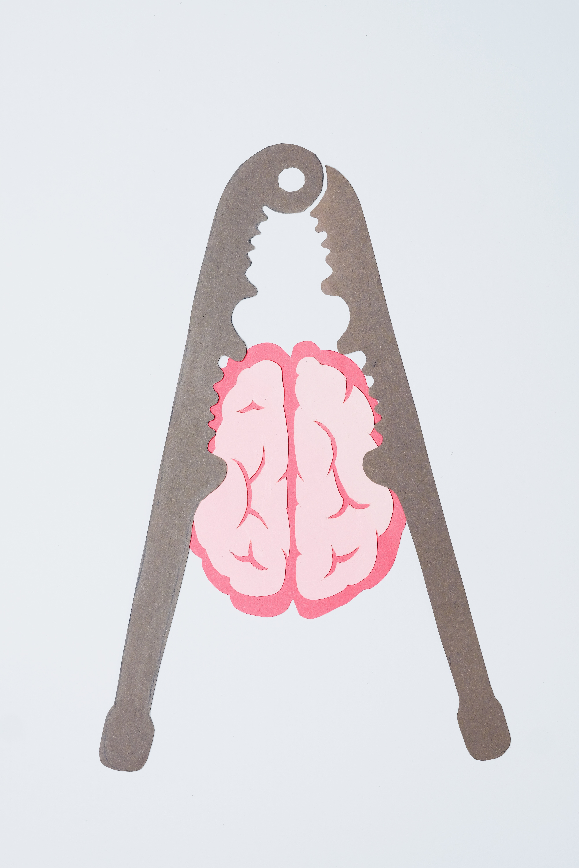
Photo by Nadezhda Moryak from Pexels

