Slide 1
Ancient India
About 500 B.C.-1000 A.D.
Shift in cultural dominance from the Indus to the Ganges (west to east).

Slide 2
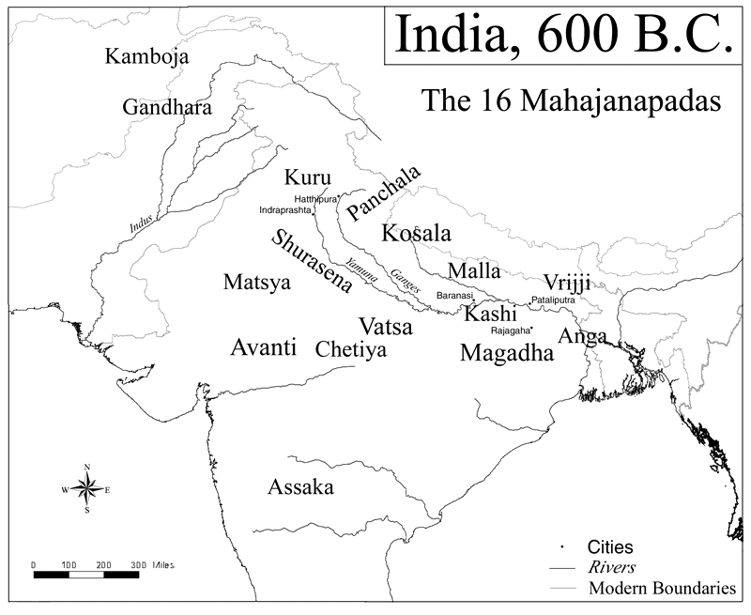
https://upload.wikimedia.org/wikipedia/commons/f/ff/Ancient_india.png

Slide 3
Indus region—Persian control 550-330 B.C., followed by Alexander the Great in 337, later splinters into numerous local kingdoms. Alexander marched as far as the Ganges River. But troops threatened to mutiny and returned to Babylon via overland routes through coastline and desert.

Slide 4
Magadha culture
Ganges River, home of Buddha. Becomes a dominant group and northeast India---

Slide 5
https://upload.wikimedia.org/wikipedia/commons/f/ff/Ancient_india.png

Slide 6
The Maurya Empire
Maurya dominate group in from Magadha region following Alexander's near invasion, around 322 B.C., lasted until 185 B.C.
Much of India unified under Maurya rule…Leader—Chandragupta Maurya
Key Maurya leader—Ashoka the Great, 272-232 B.C.

Slide 7
Ashoka
READING ASSIGNMENT: Article entitled Ashoka by Cristian Violatti found at http://www.ancient.eu/Ashoka/

Slide 8
Ashoka, consolidates Maurya Empire in India. Conquers with great brutality, and ruled just as harshly.
Around 260 B.C., after especially violent war, Ashoka rejects violence and embraces a non-violent policy toward humans and animals. Published in the Edict of Ashoka.

Slide 9
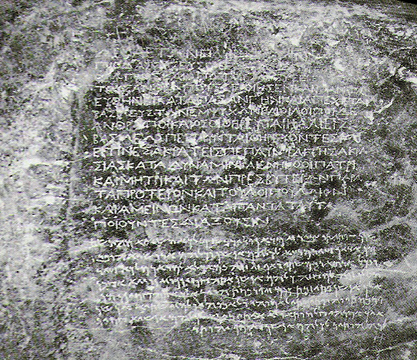
http://www.ancient.eu/uploads/images/display-259.jpg?v=1431031697

Slide 10
Ashoka and Buddhism
Ashoka establishes Buddhism as religion of empire and sends missionaries to South East Asia, China, Persia, Egypt, Africa…..
Spread of Buddhism as world religion.
Remains tolerant of other religions

Slide 11
India: 200 B.C.-320 A.D.
Various states gained control: some centralization in a few groups.
Hinduism flourished, often preferred by local rulers.
India expanded political and trade over much of Southeast Asia, with vast shipping routes. Continued trade with West.

Slide 12
Gupta Empire
Reading Assignment: Article entitled Gupta Empire by Dola R.C. found at http://www.ancient.eu/Gupta_Empire/

Slide 13
Gupta Empire
Hinduism flourished in particular, other religions too…Buddhism and Jainism
Ganges River area---320-650 A.D.
Golden Age of Indian culture: art, trade, architecture flourished.
United most of northern India.

Slide 14
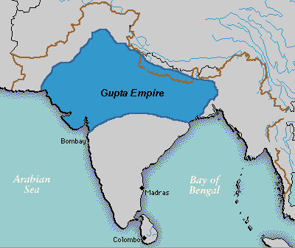
https://upload.wikimedia.org/wikipedia/commons/4/47/Guptaempire.gif

Slide 15
Huns in India
After 650 A.D. central Asian warrior groups (Huns) gained control of northwest India and through warfare disrupted the other kingdoms in India. Destabilized central authority.

Slide 16
Muslim Conquest
712 A.D. Muslim, Umayyad Empire, gains control of Indus Valley, and has constant struggles with rest of India.
Islam official religion of conquered territories; less tolerant of other faiths…yet…sometimes a synthesis of faiths…

Slide 17
Muslim Control
Over next hundreds of years, Muslims gained considerable control in India, especially in north mountains regions and on the western coast. Around 1200 A.D., India comes under control of Muslims from Turkey, establish the Delhi Sultanate, lasted under about 1400 A.D.
Often associated with international trade.
For the most part did not integrate into Indian cultures.

Slide 19
China 500 B.C. 1000 A.D.
READING ASSIGNMENT: Article entitled Ancient China by Joshua Mark found at https://www.ancient.eu/china/

Slide 20
Qin Dynasty 221-206 B.C.
Review: Imperial China under emperor Shi Huangti, great wall begun, from border with Korea in east to desert in west—about 3000 miles; imperial roads and the Grand Canal linking two rivers to make trade possible.
Legalism as religion of land

Slide 21
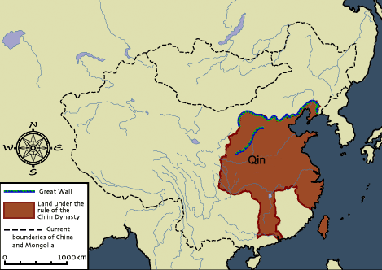
http://www.chinahighlights.com/image/map/ancient/qin-dynasty-map1.gif

Slide 22
Han Dynasty 202 B.C.-220 A.D.
Following Qin, rebellion among generals, with Liu-Bang, from province of Hanzhong as victor—hence Han Dynasty.
Under Liu-Bang great stabilization and cultural progress—writing (invention/use of paper), medicine, trade.
Confucianism religion of land, but tolerant of other faiths.

Slide 23
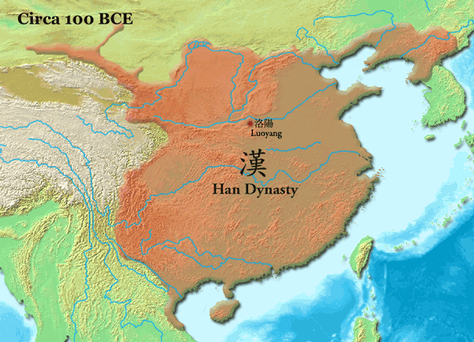
https://upload.wikimedia.org/wikipedia/commons/3/38/Han_Dynasty_100_BCE_%28Chinese%29.png

Slide 24
Han Wu the Great
138 B.C. Sends, Zhan Qian an ambassador West to open trade talks with Rome.
Opens in 130 B.C. “Silk Road”---overland caravan routes and trade centers that link Asia and Europe for next 1000 years.

Slide 25
China: 220-589 A.D.
Han Dynasty—as most others, internal rebellions, often over rights of farmers…consistent theme in Chinese history.
Fractured into various states, until united in 589 under Sui Dynasty

Slide 26
Sui Dynasty 589-618
United China ambitious military and public works—including Grand Canal linking The Yellow and Yangzi rivers. Over extension of resources, military and building. Rebellion among generals…another consistent pattern for China and other empires.
Followed by Tang Dynasty

Slide 27
Tang Dynasty 618-907 A.D.
Expanded borders westward; especially trade with Byzantium and Muslim central Asia along the Silk Road. China becomes most prosperous empire in world.
All about SILK!
Replaced by the Sung Dynasty in 907, following splintering until 960 with the rise of the Sung Dynasty.

Slide 28
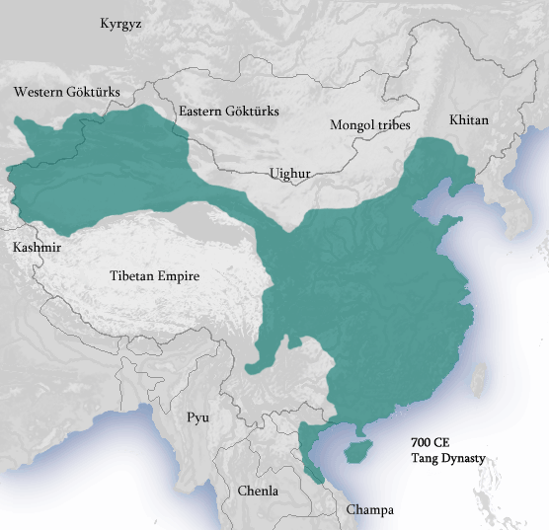
https://upload.wikimedia.org/wikipedia/commons/1/1c/Tang_Dynasty_circa_700_CE.png

