Slide 1
Leadership Session 1
A Look Back

Slide 2
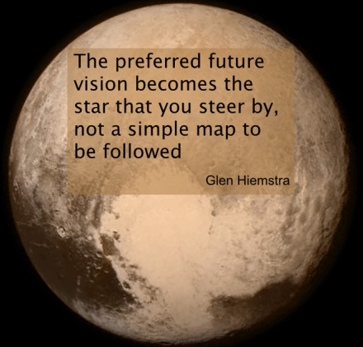
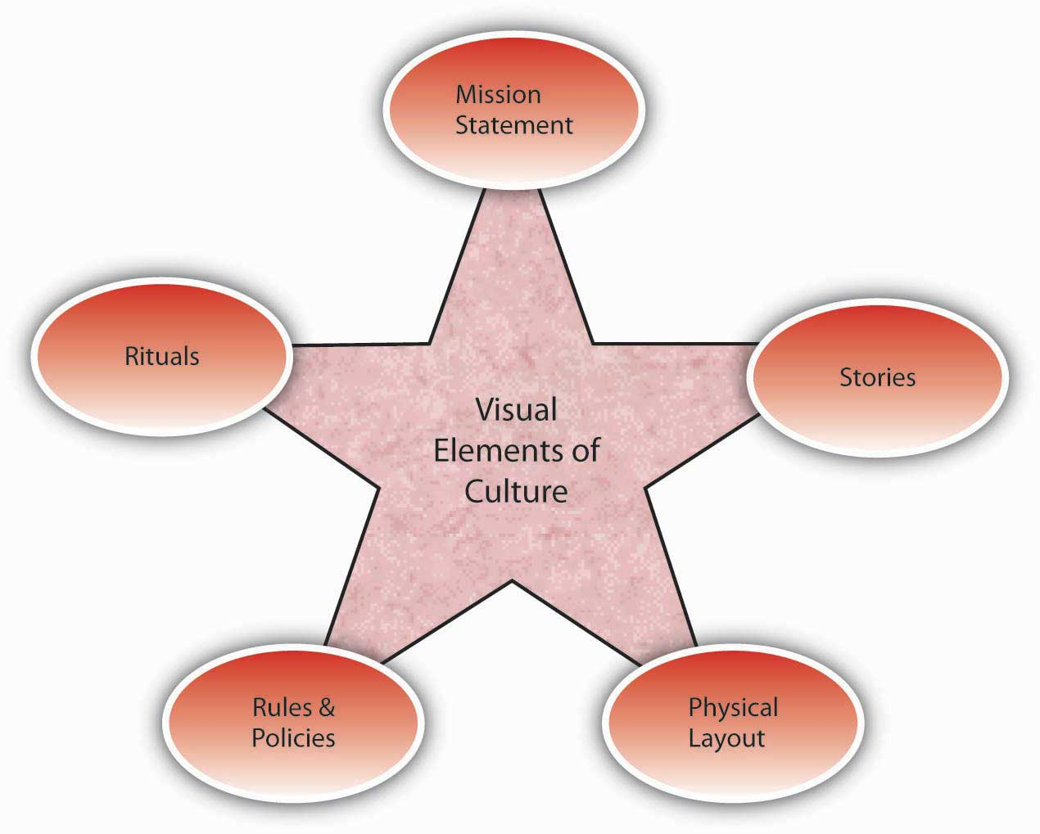
Vision
Culture
Prayer and Planning
Leader

Slide 3
A leader, with all his plusses and minuses, strengths and weaknesses, interacts with a group of people to define the culture (the way things are done here) in order to develop a vision for a preferable future, and then provides the impetus for doing the actions necessary to bring about that future with plans and prayer.

Slide 4
Vision
Culture
Prayer and Planning
Leader

Slide 5
What goes into making you as a leader?
Baggage
Birth Order
Life-Experience
Personality

Slide 6
Personal Mission Statement
Bible Study
Personal Values
People You Admire
Personal Strengths and Gifts

Slide 7
Leadership Styles
Laissez Faire
Democratic/Participative
Benevolent-Autocratic
Autocratic -Bureaucratic

Slide 8
Leadership Levels -- John Maxwell
Personhood
People
Development
Production
Permission
Position

Slide 9
The Dark Side
Overcoming the Dark Side

