Slide 1
Learning To Lead
Session 16)
Generational Culture
Continued

Slide 2
Leadership 9
Generational Culture
Continued

Slide 3
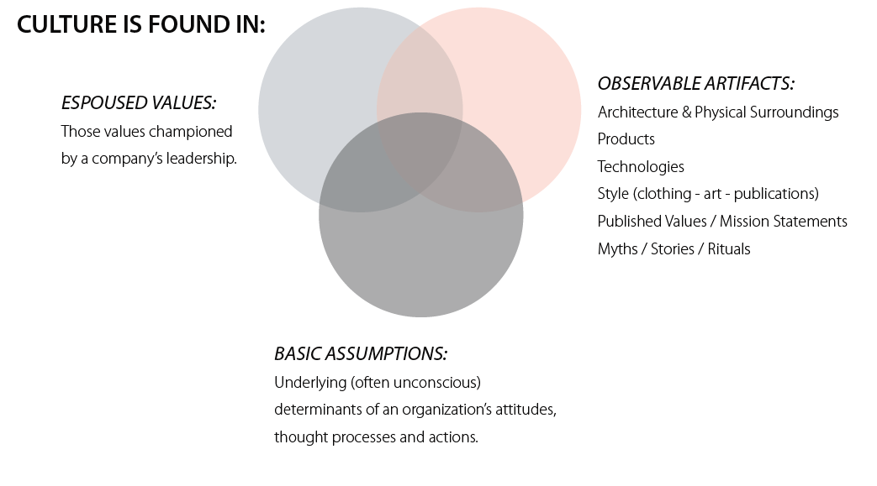

Slide 4
Millennial Culture in US
Sense of entitlement
Lack of delayed gratification
Individualism and isolation
Postponed generation
Fast-paced and unfocused
Undecided and indecisive
Blurred sex roles
Comfortable with contradiction

Slide 5
What kinds of ministries reach millennials?
Builder Generation 51%
Boomer Generation 38%
Busters 28%
Millennials 17%?

Slide 6
What kinds of ministries reach millennials?
Why Leaving?
- Shallow worship
- Nobody Listens
- Helping poor not a priority
- Distrust of use of resources
- Longing to be mentored
- A need to be valued
- No place for outsiders

Slide 7
What kinds of ministries reach millennials?
What kind of church?
- Kingdom minded (not power)
- Tangible –makes a difference now
- Communal – relationships a priority
- Justice
- Authentic

Slide 8
What about your culture?
- Who are you trying to reach?
- What is their culture like?
- What strategies might work?
One example

