Slide 1
By
Financial Freedom & Success Institute
Presents
Alex Barrón

Slide 2
Financial Freedom & Success Institute
Founded in 2012 by Alex Barrón
Slogan: “¡Dare to Prosper!”
Web: www.daretoprosper.com
Facebook: https://www.facebook.com/daretoprosper1/
Twitter: @daretoprosper
Telephone: (915) 637-5040
Email: seminars@financial-freedom.org
Office: 13 Diamond Crest, El Paso TX 79902

Slide 3
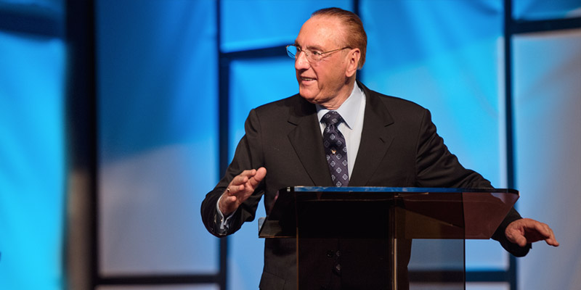
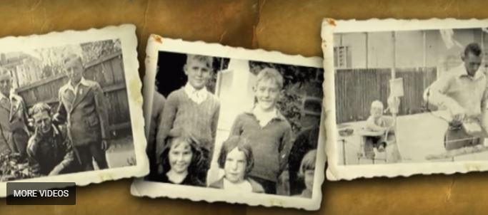
How it All Began?
Success Seminar by Peter J. Daniels - 1994
From illiterate poor bricklayer to multi millionaire businessman
How did he do it???
www.peterjdaniels.com

Slide 4
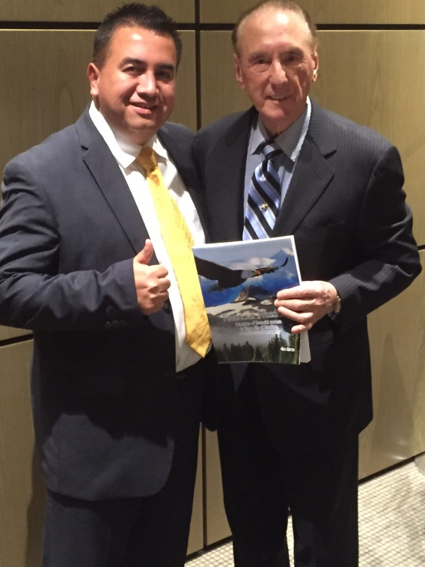
After 20 Years of Study

Slide 5
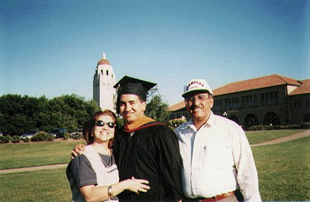
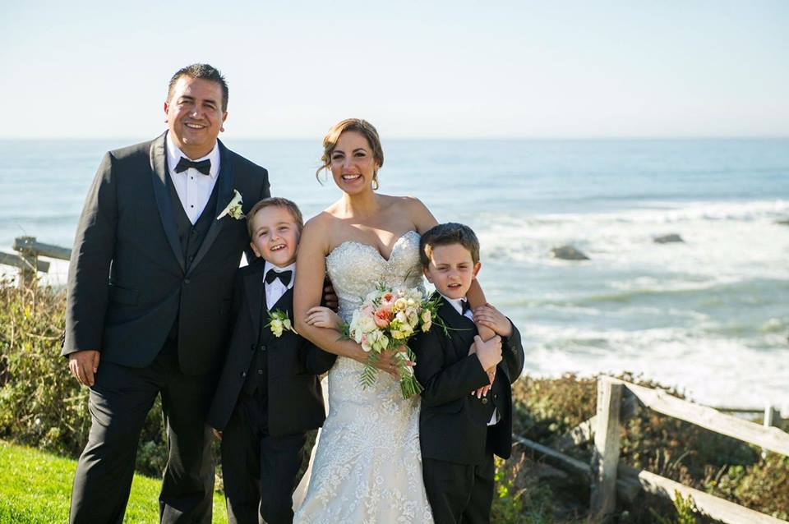
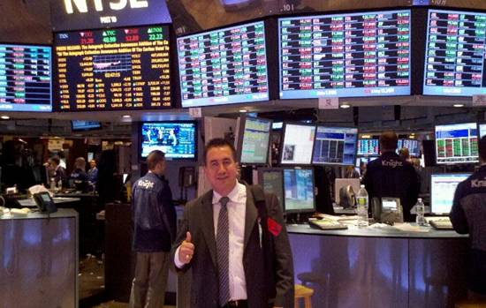
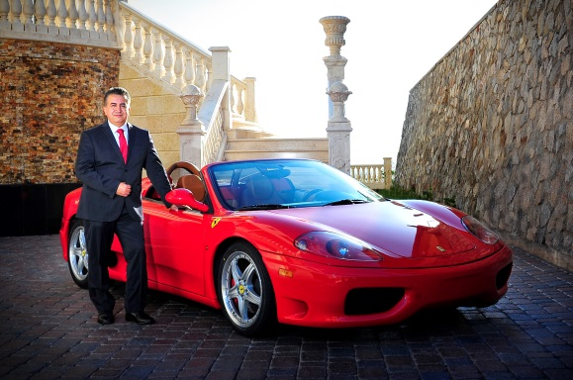
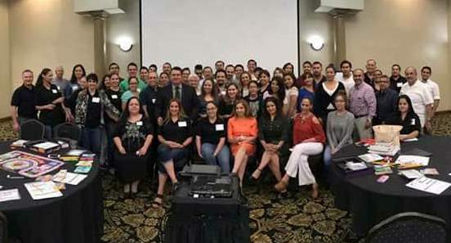
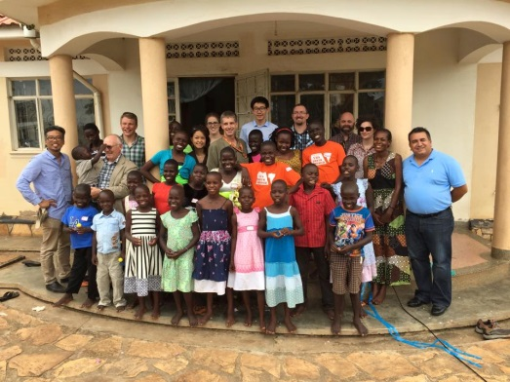
¿Who is Alex Barrón? Christian Capitalist
Graduate of UTEP, Stanford
Family Man
Wall Street Executive
Born in El Paso, TX 1973.
Agape Christian Academy – High School, 1990
UTEP – Civil Engineering, Top 10 Senior, 4.0 GPA
Stanford University – Masters, 1996, Eng. 2001
Franklin Templeton Investments, 2001-2003
JMP Securities, Agency Trading Group, 2004-2009
Housing Research Center, Diamond Crest Capital,
2010 - Present
Son, Husband, Father, Brother
Passions in Life
Teach Financial Freedom & Success
Support the Comunity
Finance & Investments, Personal Development, Exotic Cars, Travel
Financial Freedom & Success Institute
Options 12 Investment Club
Bank on Yourself Advisor, Wealth Heritage
Teach Financial Freedom, University of Success
Dare to Dream Foundation
Great Commission, Compassionate Capitalism, Help Poor Children, Education,
Personal Motto – “Dare to Dream!”

Slide 6
Our Seminars
Our purpose and principal tool is Financial Education thru seminars.
1.) Financial Freedom Seminar
2.) Financial Security Seminar
3.) University of Success
4.) Annual Success Conference Cruise –
The Secret Formula of Success
5.) Wall Street Investments Seminar –
Stocks and Options

Slide 7
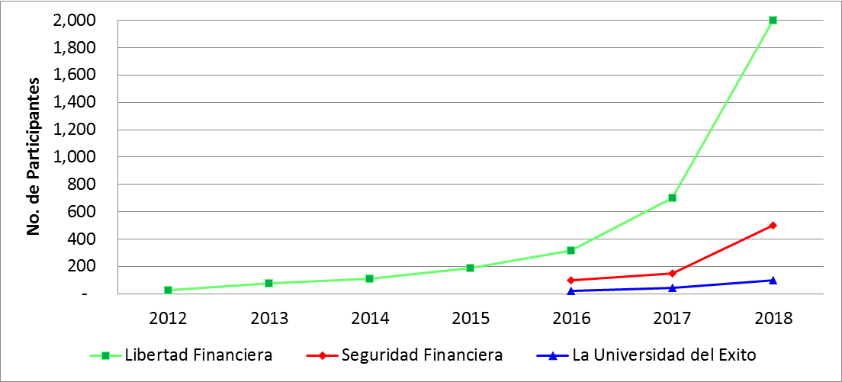
Participants in Seminars
Financial Freedom: 600 -> 2018 Goal: 10,000+
Financial Security: 200 -> 2018 Goal: 500
University of Success: 40 -> 2018 Goal: 100

Slide 8
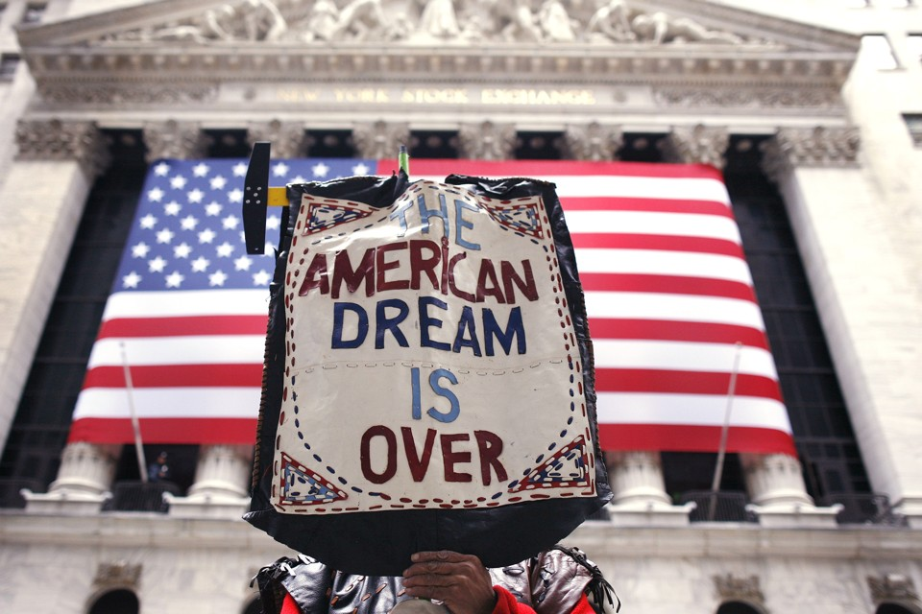
INTRODUCTION:
WHAT HAPPENED TO THE AMERICAN DREAM?
¿Is it still alive?
¿Or is it over?

Slide 9
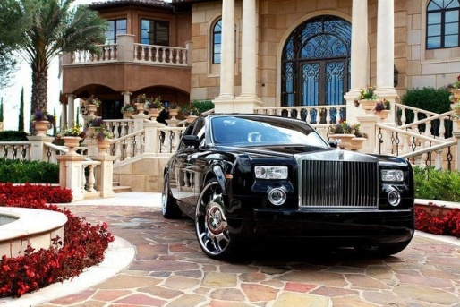
THE AMERICAN DREAM
Buy the House and Car of Your Dreams
Enjoy Financial Freedom & Success
Protect
Your Loved Ones
Give Your Family a Better Life
Enjoy a Pleasant Retirement
Without Worrying about $$
Be Successful in Life and
Be Financially Free!

Slide 10
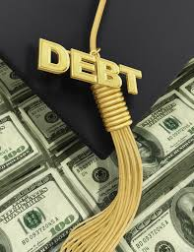
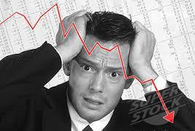
THE SAD REALITY Is this what the American Dream is all about?
Education Costs Too Much?
The Rat Race?
There is Not Enough Money?
Stressed about Finances?
Worried About Having Enough for Retirement?
Investments Are Not Working?

Slide 11
The Great Social Problem
Many of the institutions we trusted in have let us down:
Families – The family should be the bedrock of every nation. Today many families are “broken” – mothers work and fathers are absent. There is not enough money.

Slide 12
The Great Social Problem
Many of the institutions we trusted in have let us down:
Churches – Many churches do not teach right vs wrong. Many leaders do not lead moral lives. Too much emphasis on money. People no longer believe in God.

Slide 13
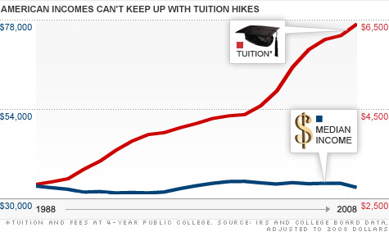
The Great Social Problem
Many of the institutions we trusted in have let us down:
Schools – Schools do not educate. What they teach is not practical. Tuition is expensive and going higher. There are few jobs and most don’t pay well.

Slide 14
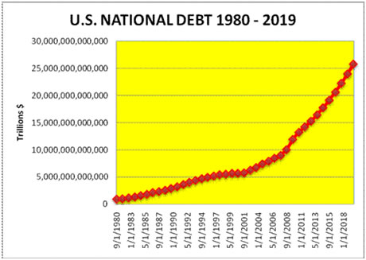
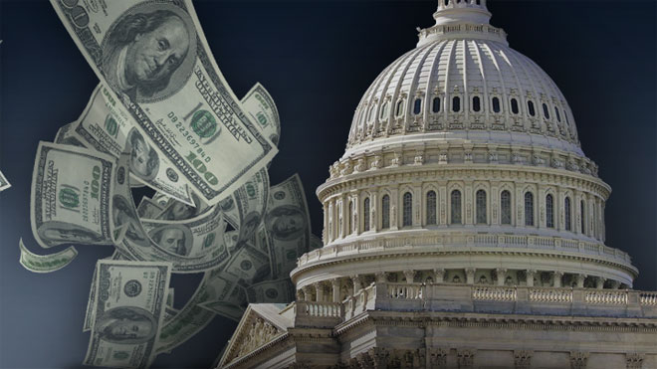
The Great Social Problem
Many of the institutions we trusted in have let us down:
Government – There is no justice. Too much corruption. They charge unfair taxes. They spend ineptly. They put us in debt. They teach socialism. They Buy votes.

Slide 15
Too Many Financial Problems
There are Few Jobs and they don’t pay well
Not enough to pay for Education
Not enough to pay for everything
Everyone is in Debt
Not enough to save for retirement
Stock market goes up and down
Traditional Financial Advice Does Not Work
How Can We Make the Most of Money???

Slide 16
The Cost of Socio-Economic Ignorance
People suffer due to corruption, but even more due to social and economic ignorance.
Due to the ignorance people vote for politicians with socialist mindsets who promise that government is the solution to their problems.
The more the government gets involved in people’s lives, the less Freedom there is.
Government now controls
Education, Commerce, Defense, Healthcare, Social Security, Agriculture, Banks, Social Help
The result is:
Socialist Mindset, Poverty, Wars, Abortion

Slide 17
The Solution: Moral and Financial Education and Personal Development
The world needs hope. The Bible says God wants you to prosper:
“Beloved I desire that you prosper in all things, and be in health, even as your soul prospers.”
– 3 John 2
Our solution is to Create Prosperity through Financial and Moral Education, and through Personal Development – This will result in a new mindset and a positive attitude.
We believe by sharing a positive message that is practical, logical and moral we can take control of our minds and our own finances and can change the world one person at a time – this will result in Personal Prosperity, Greater Happiness and Financial Freedom.

Slide 18
Our Vision
Our Vision at Financial Freedom & Success Institute is to be light in a dark world. Our vision is to create an army of people who are debt free, prosperous and successful - willing to serve others without borders or limits.
We believe a free and prosperous society can be generous and can accomplish many more things than one that is a slave to debt, poverty and consumption and selfish desires.
We want to share financial
education, principles for
living, and the laws of
success in life.

Slide 19
God Wants Your to Prosper, and Be in Health Even as Your Soul Prospers
SOUL
SPIRITUAL
RECREATION
SOCIAL
PERSONAL
EDUCATION
CAREER
PERSONAL
MENTAL
GOD
IDENTITY
FINANCIAL
DEVELOPMENT
BUSINESS
EMOTIONAL
PROSPERITY
ECONOMIC/POLITICAL
HEALTH
RELATIONSHIPS
GIVE
PHYSICAL

Slide 20
Our Mission
Our mission is empowering people to prosper by changing their way of thinking.
We want to teach people the universal and eternal Laws of Success – the principles that lead to individual Liberty, financial freedom, personal development, prosperity, success and abundance.
We want to help people help themselves. To think and grow rich because we become what we think about all the time. We want to change people’s mindset. To see themselves as responsible for their own well being, not the government, or any other person.

Slide 21
Our Mission (cont.)
To know that by continuously observing the principles of financial success and prosperity, they will sow the Tree of Wealth and will eventually rest under its shade the rest of their lives.
And what is most important, we want to teach them that the greatest purpose in life is to Give. We become prosperous not by being selfish, but by giving of ourselves – our time, our money, our knowledge, and our resources.

Slide 22
Our Dream and Our Desire
Our dream is to see the United States go back to its roots – a prosperous people that puts God in the center of their lives.
To see a society that is debt free that is prosperous and entrepreneurial.
To teach moral principles as the backbone of society – faith in God, honesty, integrity, ethical behavior.
To each people to be generous with their abundance towards whose who have needs to make a better world for all!

Slide 23
Our Goals
Our goals for the next decade are:
1.) Share with 10 million people this message of
Financial Freedom and hope.
2.) Help 1,000,000 people become Debt Free and
Give to others.
3.) Empower 100,000 people how to achieve Financial Security
by learning How to Become their Own Bank.
4.) Train 10,000 people to become Entrepreneurs
and Investors who generate Jobs and invest in Others.
5.) Motivate 1,000 people to become
Millonaires with a Purpose.

Slide 24
Moment of Reflection ¿WHY Are You Here?
Take some time to:
Think ¿Why are you interested in leaning about money?
Write down where you are now – ¿What are the things you are struggling with?
¿What is motivating you to take this seminar?
Write ¿What do you hope to learn by the time you finish taking this seminar?

Slide 25
Are you Interested? Or Committed?
Someone Interested
Someone Committed
Will do whatever is Convenient.
Is willing as long as it is easy and does not cost anything.
Is in his comfort zone and is not willing to change.
Does not take risks so he won’t lose.
Will do whatever it Takes.
Is willing to pay the price of success to achieve their goals and dreams!
Steps out of his comfort zone on purpose ready to make the changes that are necessary.
Takes Calculated Risks & Wins!
Are you Committed?

Slide 26
¿What Would You Trade Your Life For?
¿Why do you want to be Financially Free?
“The price of a big dream, or a small dream, or no dream at all is the same … it is your life.” – Peter J. Daniels
“Finally when you expire, whatever you have done with your time that is what you traded your life for.” – Peter J. Daniels
¿What are you willing to trade your life for?

Slide 27
¿Are You Ready for Financial Freedom?
Financial Freedom!

Slide 28
What Will You Decide?
Decide
Commit
Succeed!
Dare to Prosper!

Slide 29
¿Questions? ¿Comments?

