Slide 1
Learning To Lead
Session 2)
What is an
effective leader?

Slide 2
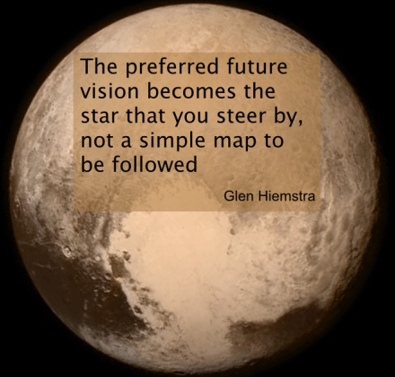
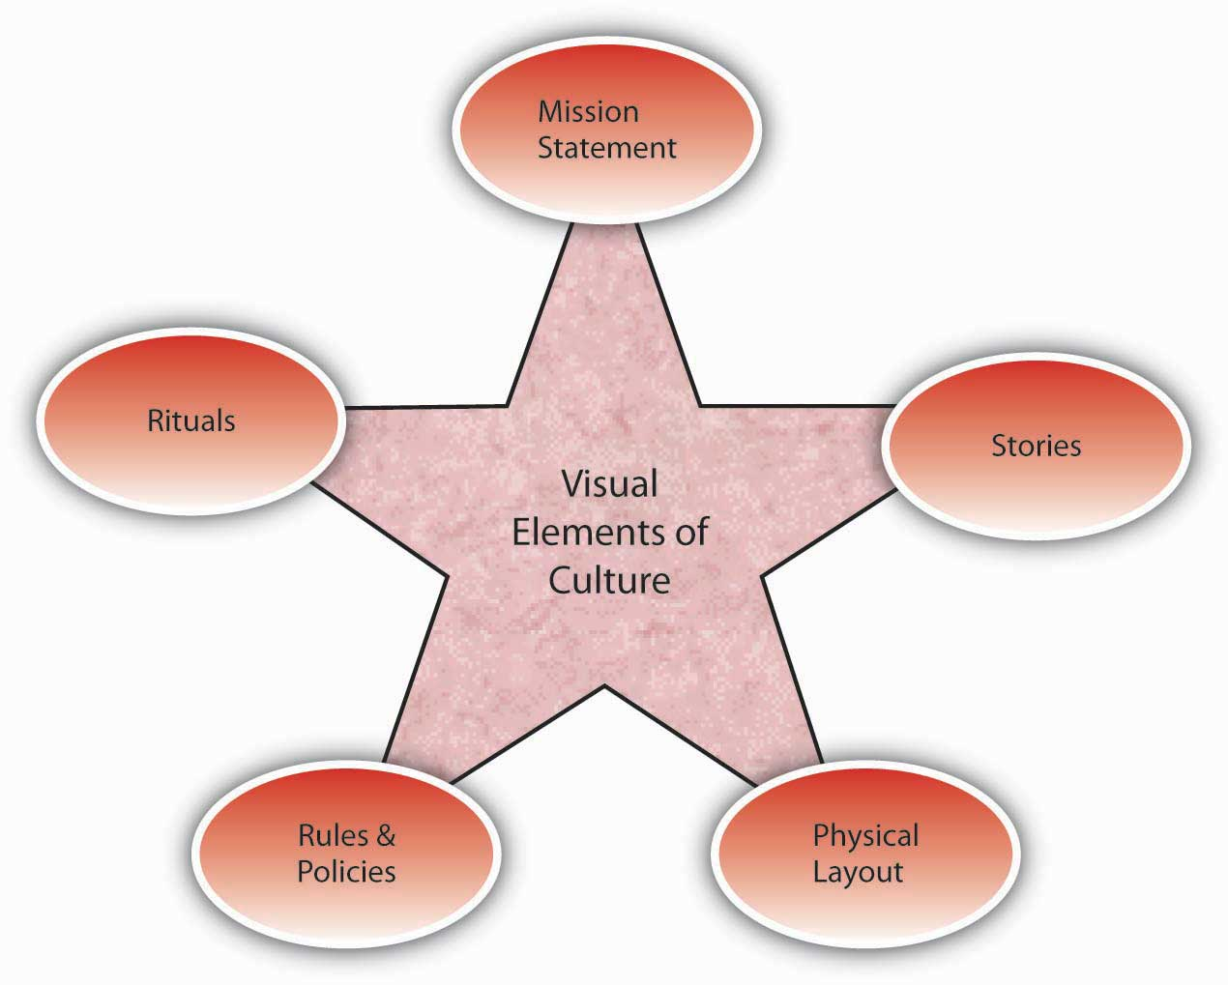
Vision
Culture
Prayer and Planning
Leader

Slide 3
Leader Vs. Manager
Manager Leader
Planning Identifying Purpose
Organizing Identifying Goals
Focused on reaching goals Focused on Big Picture
Allocation of Resources Concepts
Controlling Releasing
Shepherding Ranching

Slide 4
“Everything rises and falls on
Leadership.”
- John Maxwell

Slide 5
Who is an Effective Leader?

Slide 6
Who is an Effective Leader?
Abraham Lincoln Winston Churchill
Franklin Roosevelt Teddy Roosevelt
George Washington Jack Welch
Steve Jobs Bill Gates
Bill Hybels Rick Warren
John Wooden Pete Carrol
Mother Theresa Michelle Rhee
Mary Barra

Slide 7
L Sight
S Skills
A Attitude
C Character

Slide 8
“The longer I live, the more I realize the impact of attitude on life. It is more important than the past, than education, than money, than circumstances, than failures, than successes, than what other people think or say or do. It is more important than appearance, giftedness, or skill. It will make or break a company, a church, or a home. The remarkable thing is that we have a choice every day regarding the attitude we will embrace for that day. We cannot change our past. Nor can we change the fact that people act in a certain way. We also cannot change the inevitable. The only thing we can do is play on the one string we have, and that is our attitude. I am convinced that life is 10 percent what happens to me and 90 percent how I react to it. And so it is with you—we are in charge of our attitudes.”
- Charles Swindoll

Slide 9
Cos Report on American Business
Interviewed Fortune 500 business leaders. 94% attributed their success more to attitude than any other basic ingredient.

Slide 10
Robert Half International
Reasons to fire an employee
Incompetence 30%
Inability to get along with others 17%
Dishonesty or lying 12%
Negative attitude 10%
Lack of motivation 7%
Failure or refusal to follow instruction 7%
All other reasons 8%

Slide 11
Carnegie Institute
Analyzed the records of 10,000 people and concluded that 15% of success is due to technical training. The other 85% is due to personality, and the primary personality trait identified by the research is attitude.

Slide 12
San Francisco Principal
Hot dog seller
4 Minute Mile

Slide 13
Feelings vs. Attitude
People with emotional issues are 144% more likely to have automobile accidents.
One out of every 5 victims of fatal accidents had a quarrel within six hours before his accident.

Slide 14
If you think you are beaten, you are.
If you think you dare not, you don’t.
If you’d like to win, but think you can’t,
It’s almost certain you won’t.
Life’s battles don’t always go
To the stronger or faster man,
But sooner or later, the man who wins
Is the man who thinks he can.
- Arnold Palmer

Slide 15
What are 3 attitudes that are negatively affecting you right now?

Slide 16
Changing Your Attitude
Identify the problem feelings;
Identify the problem behavior
Identify the problem thinking
Identify right thinking
Make a public commitment to right thinking
Develop a plan for right thinking (including accountability)

Slide 17
What lies behind us and what lies before us are tiny matters compared to what lies within us.
- Walt Emerson

