Slide 1
Biblical rationale
“Be fruitful and multiply” – children are an inherent part of the meaning of marriage
The communion of persons in sexual union brings forth a new person (Gen. 4:1)
The nature of male-female bodies
Procreation as the “one flesh” seal of marriage

Slide 2
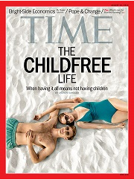
Theological Rationale
Sexual union as covenantal sign
Language of the body and truthful signs
Free
Total
Faithful
Fruitful
Natural family planning vs. contraception

