Slide 1
Sensing & Perceiving:
How We Connect With The World

Slide 2
Sensing & Perceiving:
Perception:
The organization and interpretation of sensations.
Sensation:
Awareness resulting from the stimulation of a sense organ

Slide 3
Sensing & Perceiving:
Absolute Threshold of a Sensation:
The intensity of a stimulus that allows an organism to just barely detect it.
Psychophysics: The study of the effects of physical stimuli on sensory perceptions and mental states.

Slide 4
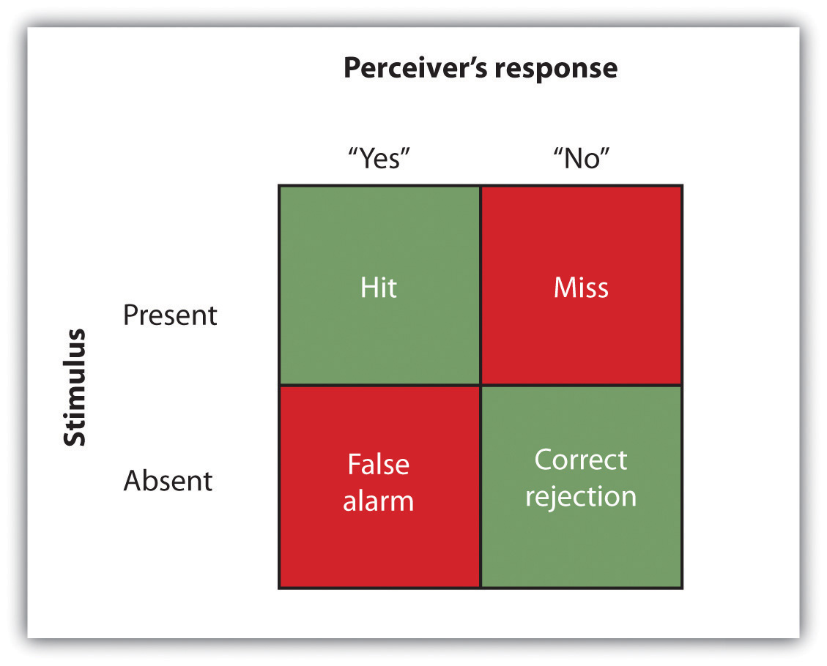
Sensing & Perceiving:
Signal detection analysis:
A technique used to determine the ability of the perceiver to separate true signals from background noise.

Slide 5
Sensing & Perceiving:
Sensitivity:
The true ability of the individual to detect the presence or absence of signals.
Response Bias:
A behavioral tendency to respond “yes” to the trials, which is independent of sensitivity.

Slide 6
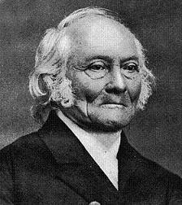
Sensing & Perceiving:
Difference Threshold/
Just Noticeable Difference
[JND]:
The change in a stimulus that
can just barely be detected by
the organism.
(Ernst) Weber’s law:
the just noticeable difference of a stimulus is a constant proportion of the original intensity of the stimulus

Slide 7
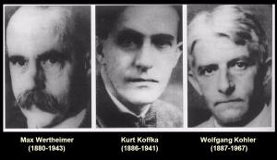
Theorists:
Max Wertheimer
Wolfgang Köhler
Kurt Koffka
Gestalt:
A meaningful
organized whole

Slide 8
Figure & Ground:
What do you see?
Gestalt:
A meaningful
organized whole

Slide 9
Perceiving Depth
What do you see?
Depth cues:
Messages from our bodies and the external environment that supply us with information about space and distance.
Depth perception:
The ability to perceive three-dimensional space and to accurately judge distance.

Slide 10
Perceiving Depth
What do you see?
Convergence:
The inward turning of our eyes that is required to focus on objects that are less than about 50 feet away from us.
Accommodation:
to help determine depth

Slide 11
Perceiving Depth
What do you see?
Convergence:
The inward turning of our eyes that is required to focus on objects that are less than about 50 feet away from us.
Monocular depth cues:
Depth cues that help us perceive depth using only one eye

Slide 12
Perceiving Motion
What do you see?
Phi Phenomenon:
To perceive a sensation of motion caused by the appearance and disappearance of objects that are near each other.
Beta Effect
The perception of motion that occurs when different images are presented next to each other in succession.

