Slide 1
Mongol Conquest
Reading Assignment: Mongol Invasion and Conquests at
https://en.wikipedia.org/wiki/Mongol_Empire

Slide 2
Genghis Khan born c. 1162 – August 18, 1227
Difficult childhood; An important theme of Mongol Empire is that merit rather than birth the road to advancement:
“As he smashed the feudal system of aristocratic privilege and birth, he built a new and unique system based on individual merit, loyalty, and achievement” Genghis Khan and the Making of the Modern World; Jack Weatherford, p. xix

Slide 3
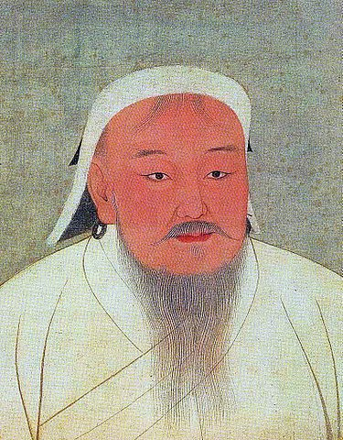
https://upload.wikimedia.org/wikipedia/commons/thumb/3/35/YuanEmperorAlbumGenghisPortrait.jpg/375px-YuanEmperorAlbumGenghisPortrait.jpg

Slide 4
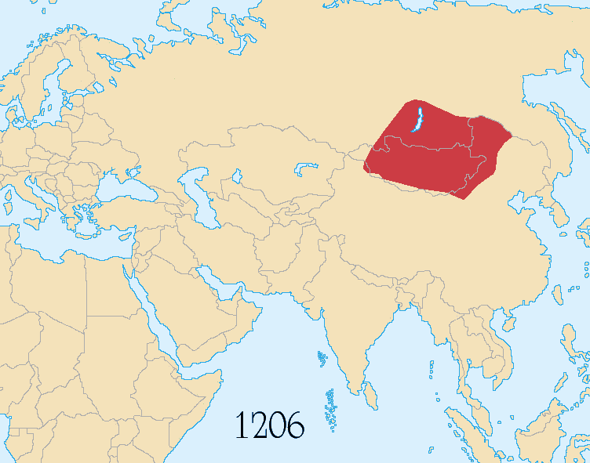
https://upload.wikimedia.org/wikipedia/commons/b/bc/Mongol_Empire_map_2.gif

Slide 5
Ca. 1200 Clan warrior, Temujin, united Mongol clans, in 1206 awarded title, Genghis Khan---universal leader.
Mongol culture—nomadic, horse, laminated bow, harsh climate, family/clan based; sky god chief deity.
Raids on neighboring clans for revenge and “booty”…booty shared by troops, not just clan leaders
Jurchen Jin Empire: 1215-1234

Slide 6
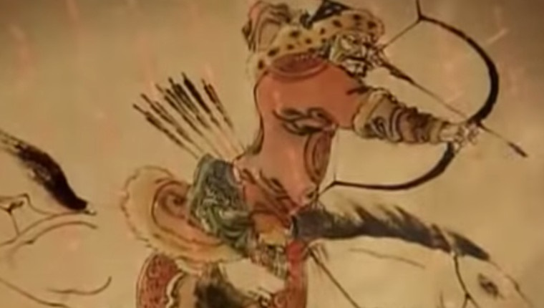
https://upload.wikimedia.org/wikipedia/commons/e/eb/Mongol_warrior_of_Genghis_Khan.jpghttps://upload.wikimedia.org/wikipedia/commons/e/eb/Mongol_warrior_of_Genghis_Khan.jpg

Slide 7
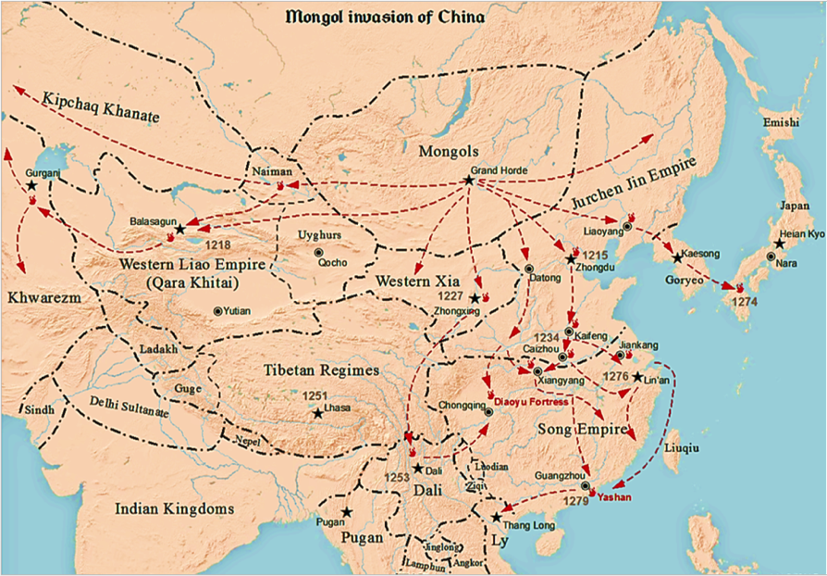
https://upload.wikimedia.org/wikipedia/commons/thumb/9/92/Mongol_Invasion_of_China.png/1024px-Mongol_Invasion_of_China.png

Slide 8
Genghis: South and West to Persia
Western Liao: 1218
Khwarezmain Empire: 1221
Western Xia: 1227

Slide 9
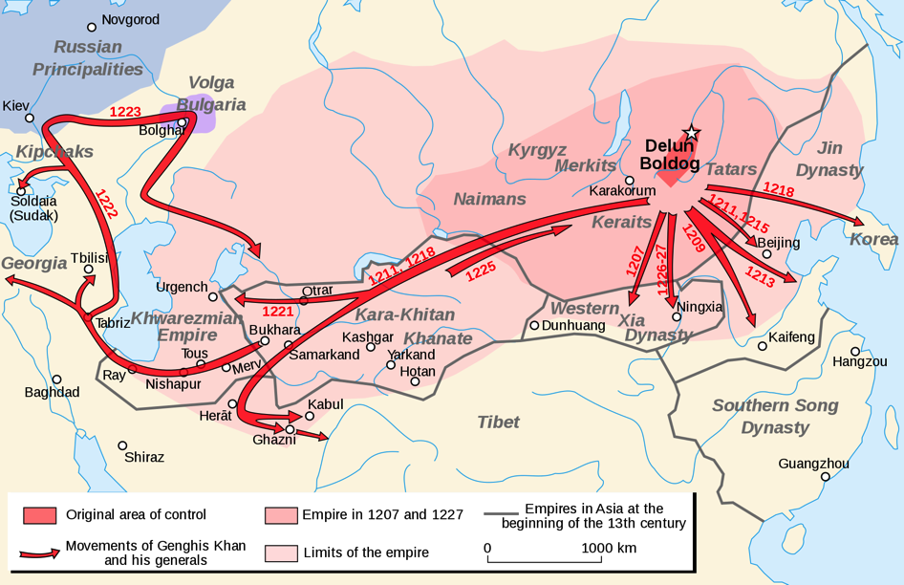
https://upload.wikimedia.org/wikipedia/commons/thumb/f/f3/Genghis_Khan_empire-en.svg/2000px-Genghis_Khan_empire-en.svg.png

Slide 10
Persia
Battle of Bagdad—1258
Mongol warfare: mobile horse, local infantry;
winter warfare; adapt seize technologies along way—esp. from Chinese; surrender or be destroyed
Often left local government in place, tribute and loyalty;

Slide 11
Empire split into four parts
Following death of Genghis Khan, either his sons or grandsons became rulers, however constant dispute over supreme command.
While conquests continued, empire divided into four separate kingdoms:
Golden Horde—north Asia and eastern Europe—1370’s
Cagatai Khanate—central Asia 1600’s
Ilkanate—Middle East--1335
Great Yuan– China and S.E. Asia—1370’s—to Ming Dynasty

Slide 12
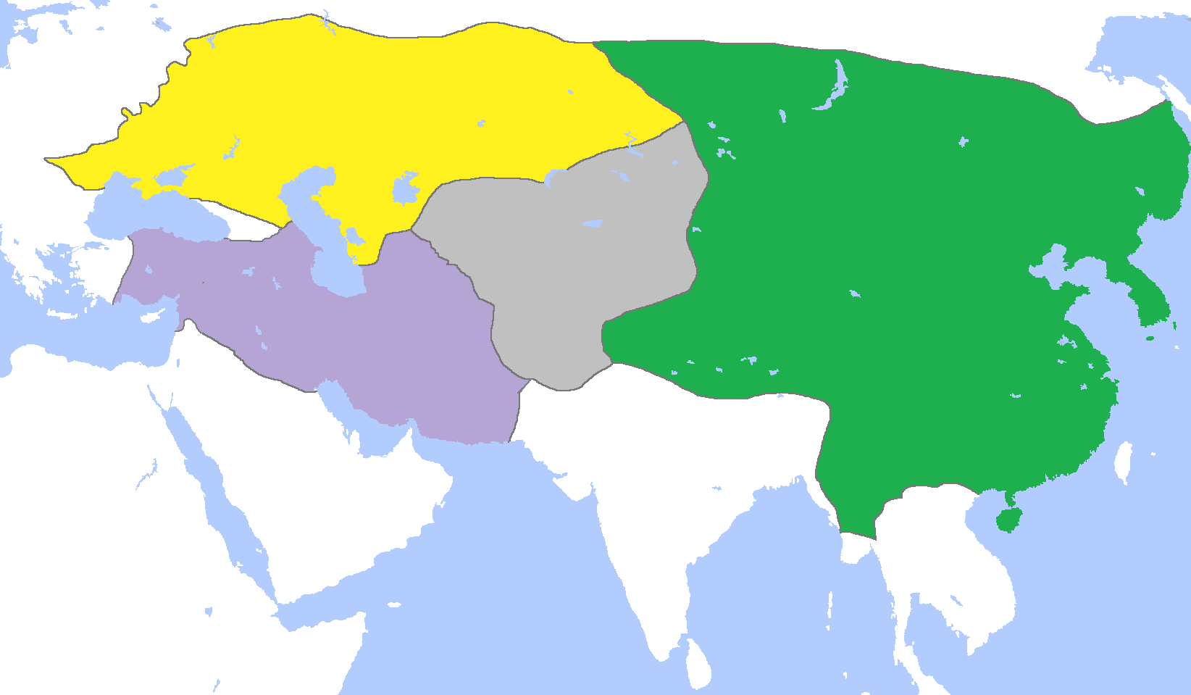
https://upload.wikimedia.org/wikipedia/commons/8/82/MongolEmpireDivisions1300.png
https://upload.wikimedia.org/wikipedia/commons/8/82/MongolEmpireDivisions1300.png

Slide 13
Mongol Legacy Empires
Areas of northern India, Moghuls, descendant of Mongols settle in region. Last until 1600’s.
Tamerlane– from 1370 -1405, based out of central Asia—Islamic re-conquest of much of the Mongolian held regions, except for China.
Ming Dynasty– 1370-1644: time of cultural advancement and political stability.
Ottoman Empire-

Slide 14
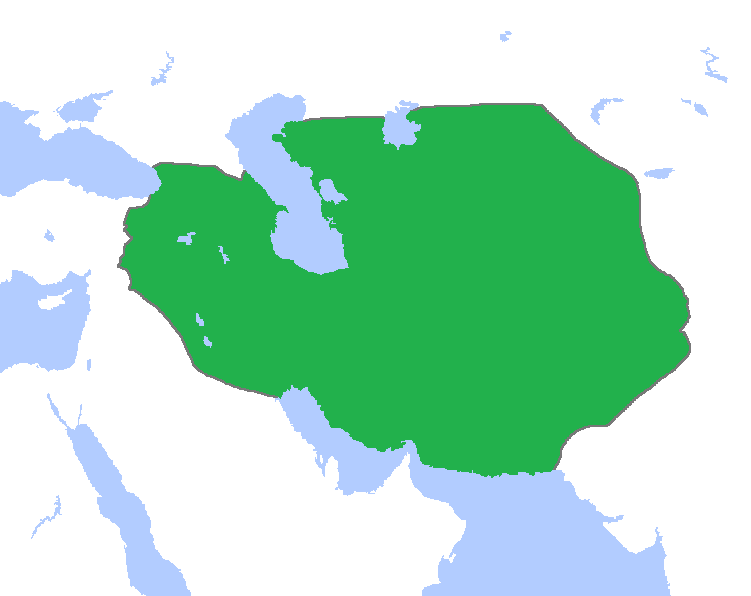
Tamerlane Control Area
https://upload.wikimedia.org/wikipedia/commons/8/87/TimuridEmpire1400.png

Slide 15
Russia and Mongols
Russian—As the evidence stands, the effects of the Mongol invasion were many, spread across the political, social, and religious facets of Russia. While some of those effects, such as the growth of the Orthodox Church generally had a relatively positive effect on the lands of the Rus, other results, such as the loss of the veche system and centralization of power assisted in halting the spread of traditional democracy and self-government for the various principalities. From the influences on the language and the form of government, the very impacts of the Mongol invasion are still evident today. Perhaps given the chance to experience the Renaissance, as did other western European cultures, the political, religious, and social thought of Russia would greatly differ from that of the reality of today. The Russians, through the control of the Mongols who had adopted many ideas of government and economics from the Chinese, became perhaps a more Asiatic nation in terms of government, while the deep Christian roots of the Russians established and helped maintain a link with Europe. It was the Mongol invasion which, perhaps more than any other historical event, helped to determine the course of development that Russian culture, political geography, history, and national identity would take.
Dustin Hosseini http://www.sras.org/the_effects_of_the_mongol_empire_on_russia

Slide 16
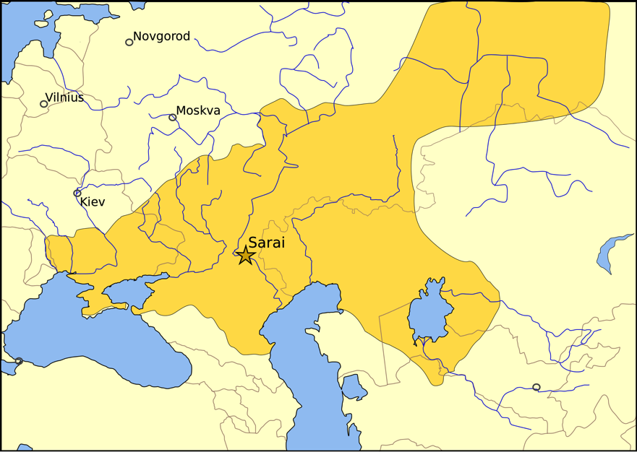
https://upload.wikimedia.org/wikipedia/commons/thumb/d/d5/Golden_Horde_1389.svg/2000px-Golden_Horde_1389.svg.png

Slide 17
Mongol’s Lasting Significance
Largest contiguous land empire in history
Insured safe travel on silk routes---Marco Polo and Kublai Khan---Wealth of China and Europe
Religiously tolerant (within boundaries)
Exchange of technologies—east and west
Exchange of diseases---small pox and bubonic plaque
Advancement based on merit

Slide 18
Lasting significance
Help competing powers in Europe unite against a common enemy—helping to establish “national” identities.
Empire ruled by common law—Yassa—est. by Genghis Khan---rules for nomadic life, later expanded to cover many areas of life.
Empire courier system for dispatches

Slide 19
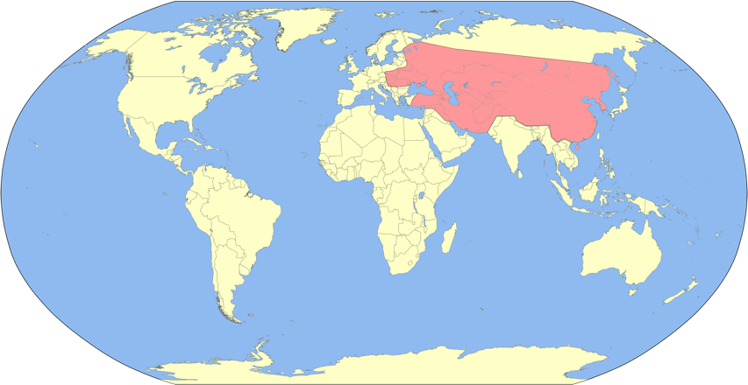
https://upload.wikimedia.org/wikipedia/commons/thumb/9/9b/Great_Mongol_Empire_map.svg/3100px-Great_Mongol_Empire_map.svg.png

Slide 20
Clash of religions
Buddhism/Confucianism
Christian internal conflicts
Christianity/Islam/Judaism

Slide 21
Buddhism in Asia
Reform of Hinduism—500 B.C.
Teaching of Gautama, Buddha, enlightenment to reach Nirvana.
Silk Road and Spice Routes, spread through-out Asia
Between 1000 and 1500, two primary forms, Mahayana and Theravada

Slide 22
Theravada Buddhism
Southern Asia: Thailand, Sri Lanka, Burma, Myanmar, Laos
More traditional form of Buddhism, with emphasis on the person to seek enlightenment.

Slide 23
Mahayana Buddhism
Northern Buddhist predominantly in Tibet, China, Taiwan, Japan, Korea, Mongolia, parts of Southeast Asia.
Along with emphasis on person seeking enlightenment, but much more embrace of both historical and non-historical bodhisattva
Bodhisattva are persons/beings who have completed the path to Nirvana, yet remain behind to help others.

Slide 24
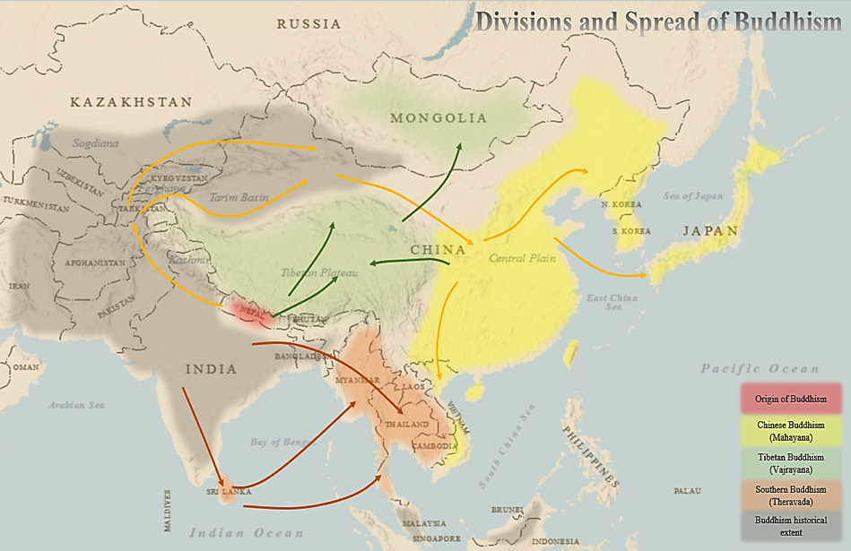
https://upload.wikimedia.org/wikipedia/commons/7/7c/Buddhism_Map.png
https://upload.wikimedia.org/wikipedia/commons/7/7c/Buddhism_Map.png

Slide 25
So major difference is goal of practice
Southern, goal is for person to attain Nirvana
Northern goal is not only for oneself, but to help others reach as well.
Internal conflict between groups for millennia

Slide 26
Buddhism and Confucianism
Struggle between two religions for leadership in Chinese culture and politics
Confucianism often aristocracy, while Buddhism practiced more by the non-royals.
However Confucianism dominant leadership religion----used through the 1930’s as educational instruction and civil service

Slide 27
Christian Internal conflicts 1000-1500
Great Schism: 1054 AD Roman Catholic (Pope of Rome) and Eastern Orthodox (Patriarch of Constantinople); Rome claimed highest authority, theological disputes, liturgical practices. Conflict between Eastern and Western Christianity.

