Slide 1
Perceptual System
Sensory Interaction:
The working together of different senses to create experience.

Slide 2
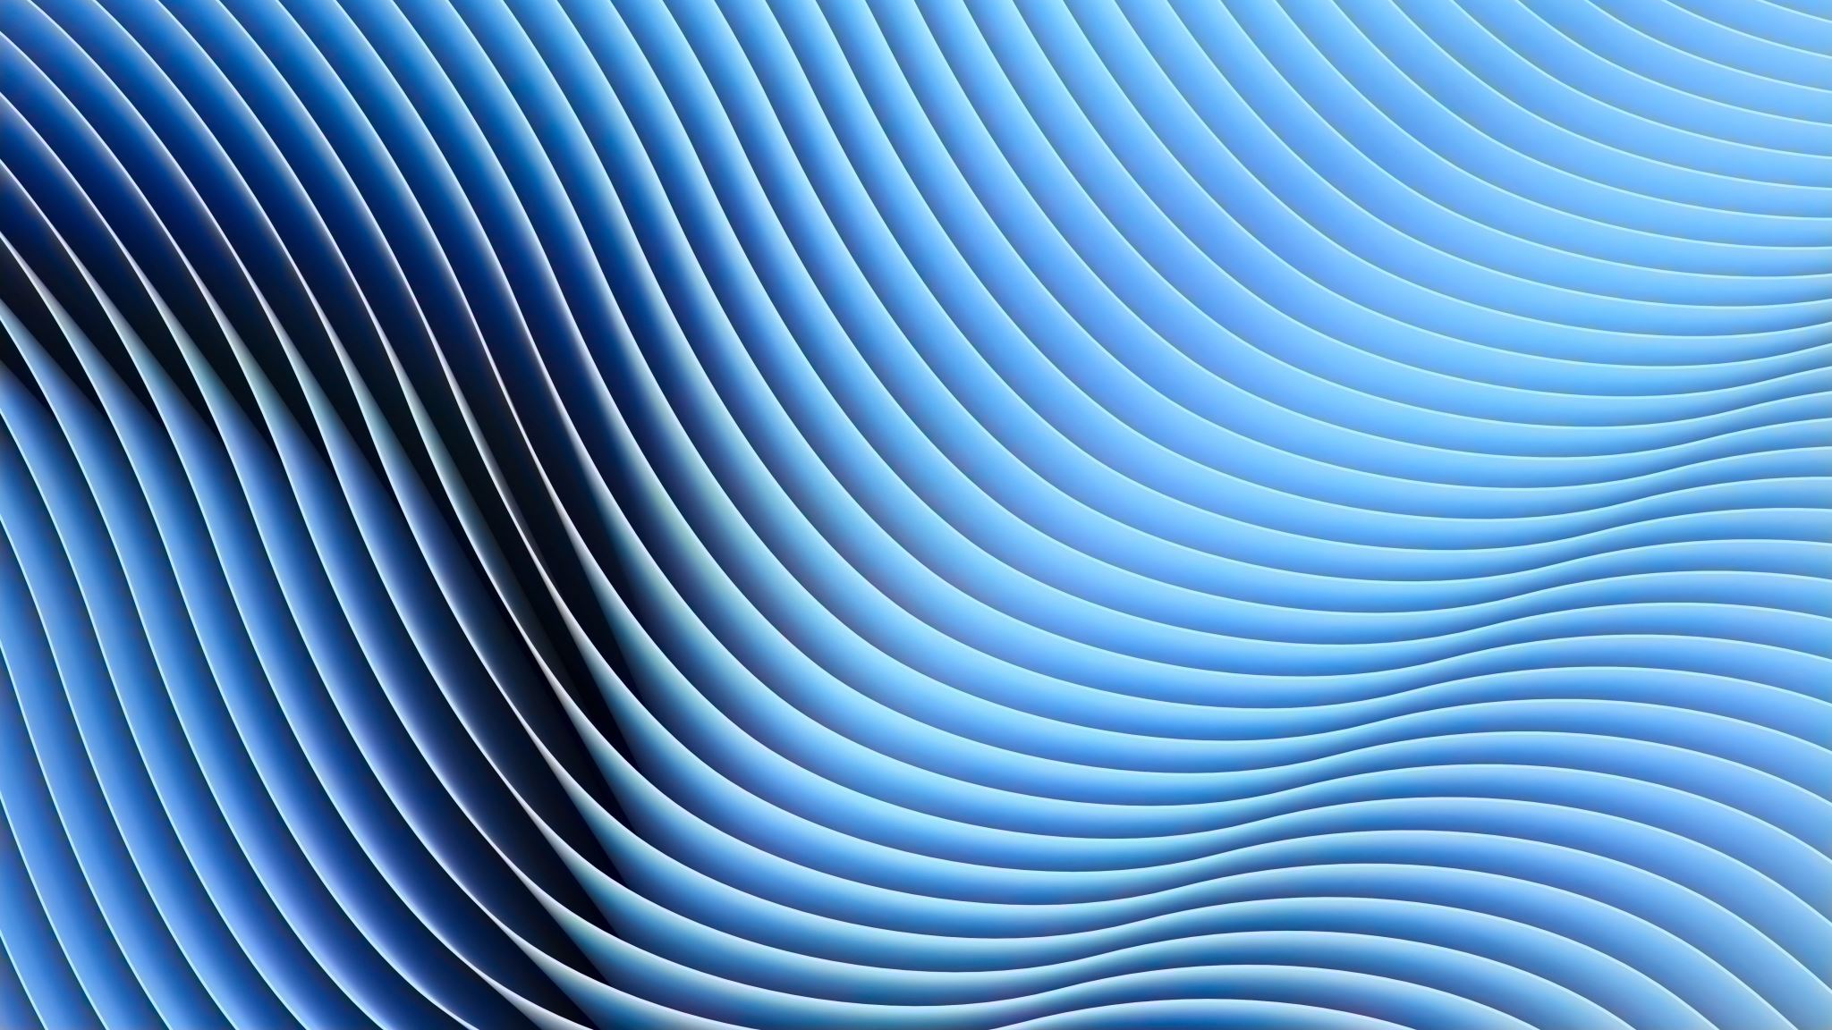
Perceptual System
McGurk Effect
an error in sound perception that occurs when there is a mismatch between the senses of hearing & seeing

Slide 3
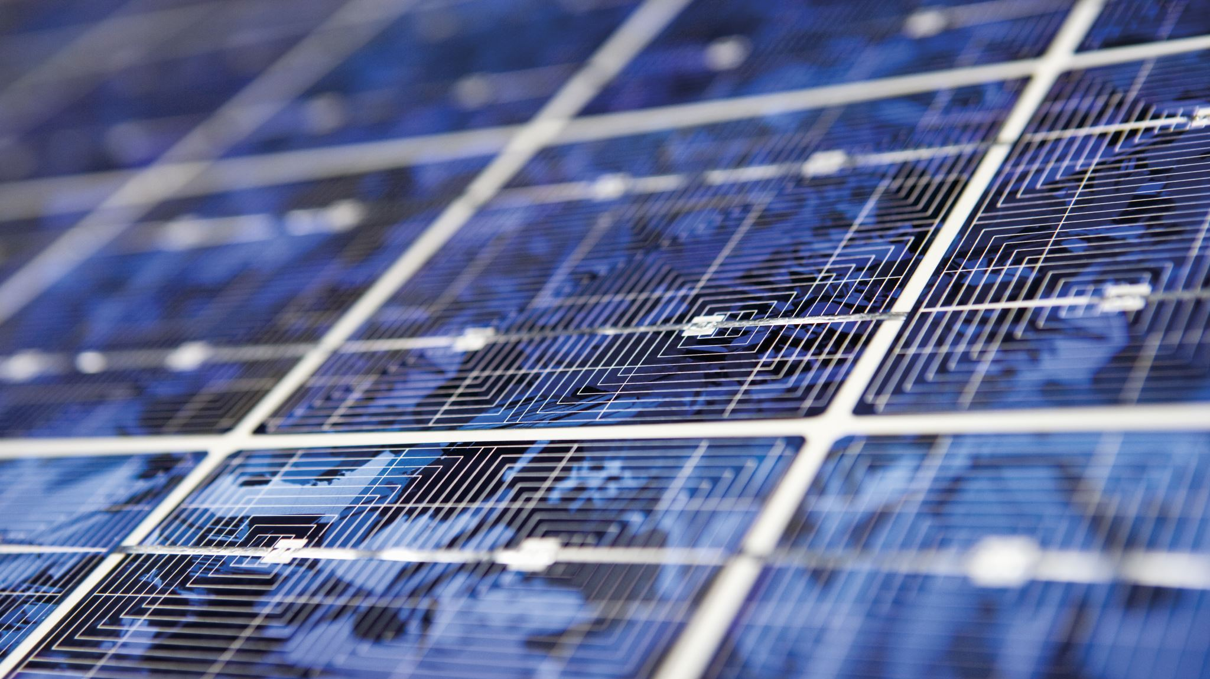
Perceptual System
Selective Attention:
The ability to focus on some sensory inputs while tuning out others

Slide 4
Perceptual System
Synesthesia:
An experience in which one sensation creates experiences in another

Slide 5
Sensory Adaptation:
A decreased sensitivity to a stimulus after prolonged and constant exposure.
Cocktail Party Phenomenon:
Via selective attention, we simultaneously do a lot of unconscious monitoring of the world around us.
Perceptual Constancy:
The ability to perceive a stimulus as constant despite changes in sensation.

Slide 6
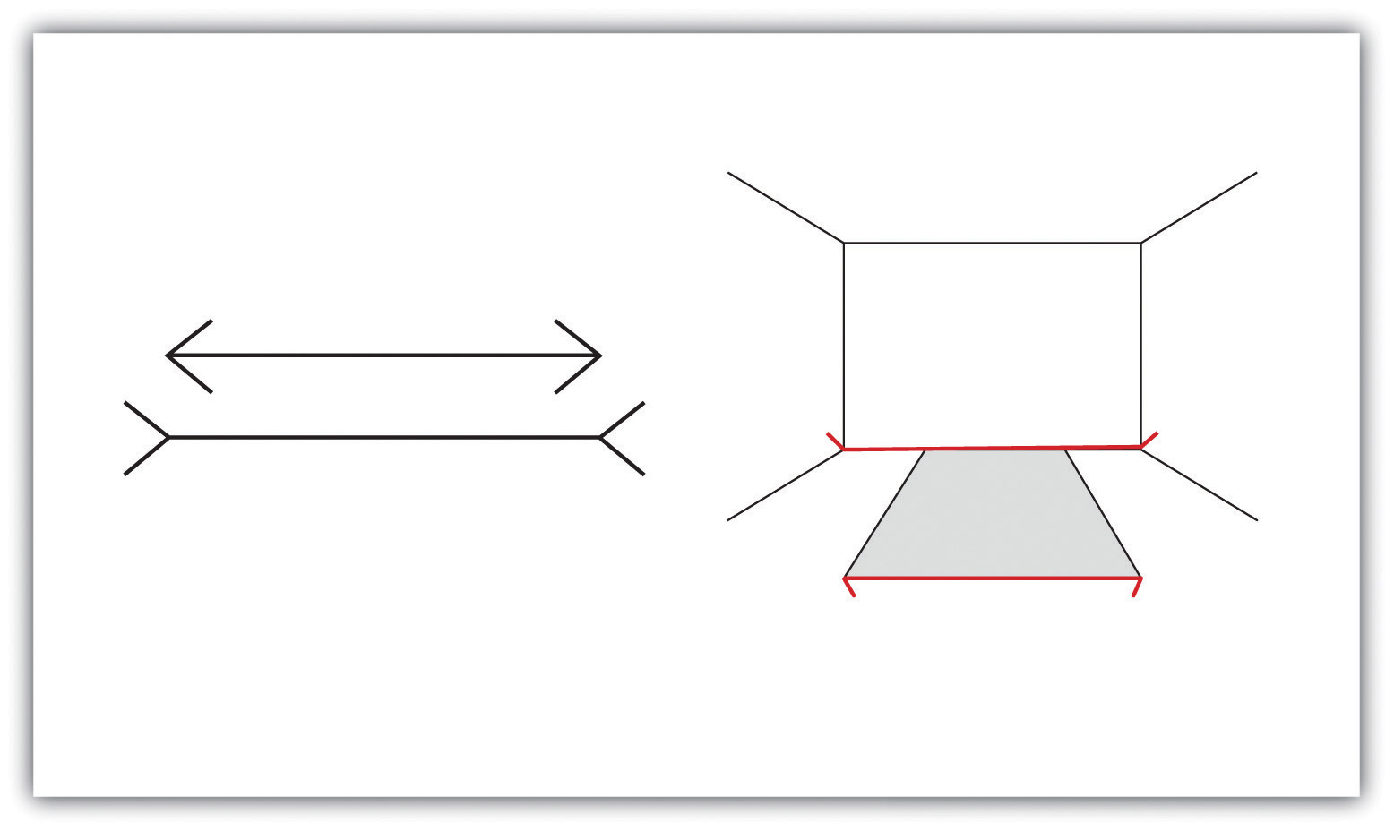
Illusions
The perceptual processes that normally help us correctly perceive the world around us are fooled by a particular situation so that we see something that does not exist or that is incorrect.
Mueller-Lyer illusion
The line segment in the bottom arrow looks longer to us than the one on the top; they are both the same length.

Slide 7
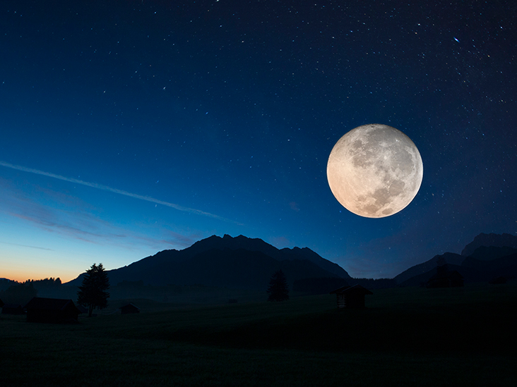
Illusions
The perceptual processes that normally help us correctly perceive the world around us are fooled by a particular situation so that we see something that does not exist or that is incorrect.
Moon illusion
The moon is perceived to be about 50% larger when it is near the horizon than when it is seen overhead; in both cases the moon is the same size and casts the same size retinal image.

Slide 8
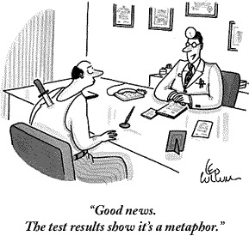
Embodiment
To build into and link the environment with our cognition.
The world around us becomes part of our brain.

Slide 9
