Slide 1
Leadership 20
Going Public

Slide 3
The Rollout
Importance

Slide 4
The Rollout
Communication:
Why there is better than here!
A wakeup call
There
The Solution
Why something must
be done
Why now is the time
Here
The Problem

Slide 5
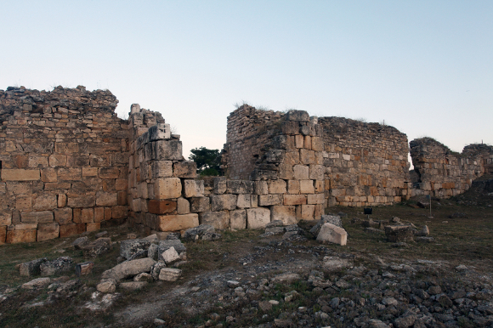

Slide 6
Then I said to them, “You see the trouble we are in: Jerusalem lies in ruins, and its gates have been burned with fire. Come, let us rebuild the wall of Jerusalem, and we will no longer be in disgrace.” I also told them about the gracious hand of my God upon me and what the king had said to me.
They replied, “Let us start rebuilding.”
Nehemiah 2:17-18

Slide 7
The first task of leadership is to define reality.
Max DuPree

Slide 8
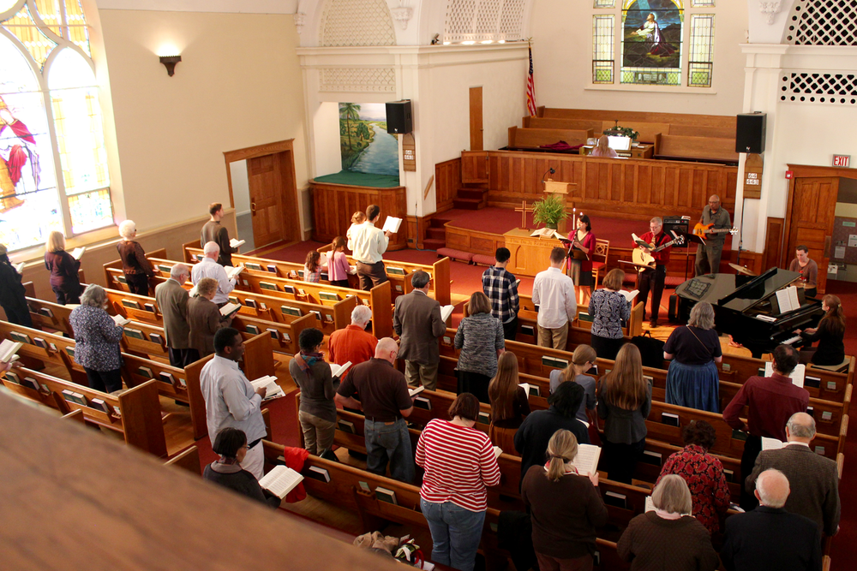
E.g. Thom Rainer

Slide 9
Andy Stanley:
Explanation of the problem engages the mind
Solution engages the imagination
The reasons engage the heart
What difference will it make?
Why should we attempt this?
God is in it how?
1000 to 2000

Slide 10
Communicate to the right people at the right time.
e.g. of fundraising

Slide 11
The Power of Vision

