Slide 1
Preacher, Preparation,
Presentation
A class on making and preaching sermons
Session 12
Preparing
To
Preach
Kinds of Sermons

Slide 2
Euanglizo
Didasko
Laleo
Kerusso – Proclaim the News

Slide 3
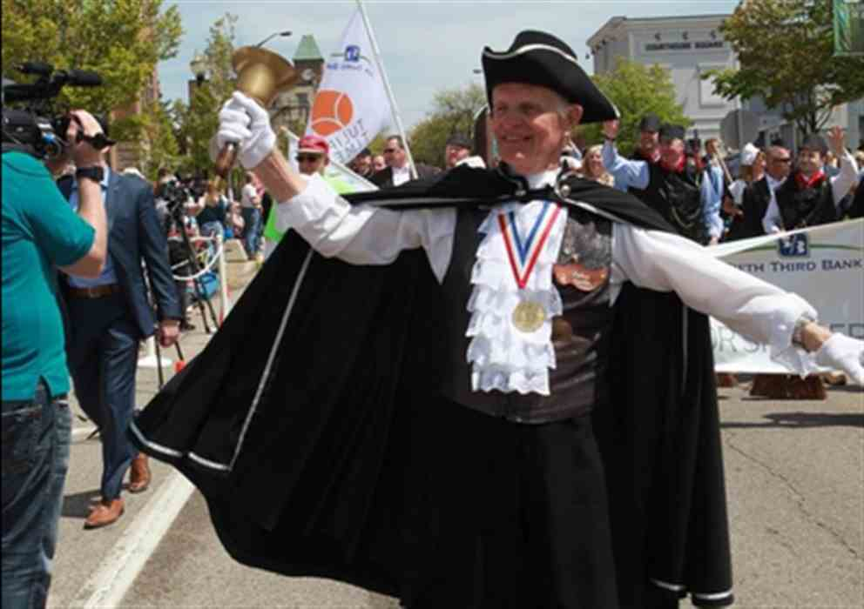

Slide 4
https://youtu.be/jk2D-b91IAU

Slide 5
“Don’t blame me. The king, or city council, or the magistrate told me what to say.”

Slide 6
to be a herald, to officiate as a herald; - to proclaim after the manner of a herald always
with the suggestion of formality, gravity and an
authority which must be listened to and obeyed; - to publish, proclaim openly: something which has
been done; - used of the public proclamation of the gospel and
matters pertaining to it, made by John the Baptist,
by Jesus, by the apostles and other Christian
teachers

Slide 7
New American Standard Version Word Usage - Total: 61 - made proclamation 1,
preach 16, preached 10, preacher 1, preaches 2, preaching 11, proclaim 8,
proclaimed 6, proclaiming 6

Slide 8
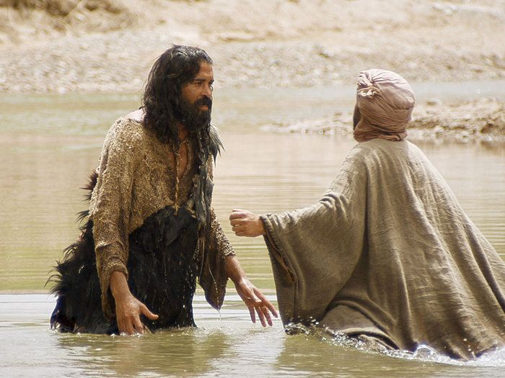

Slide 9
In those days John the Baptist came, preaching in the wilderness of Judea, and saying, “Repent, for the kingdom of heaven has come near.” This is he who was spoken of through the prophet of Isaiah….
Matthew 3:1-3

Slide 10
Proclaiming to the flock

Slide 11
Proclaiming to the flock
- financial downturn
- church downturn
- shocking death

Slide 12
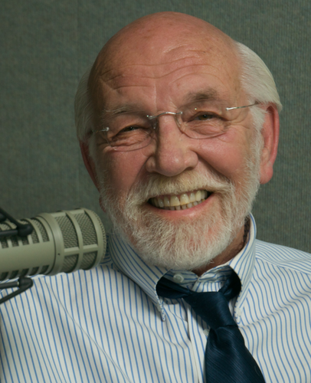
“Outside the Walls”
- to the hopeless
Adam
- to the wondering

Slide 13
https://youtu.be/UVcvniMZUzg

