Slide 1
Christian Internal conflicts 1000-1500
Great Schism: 1054 AD Roman Catholic (Pope of Rome) and Eastern Orthodox (Patriarch of Constantinople); Rome claimed highest authority, theological disputes, liturgical practices. Conflict between Eastern and Western Christianity.

Slide 2
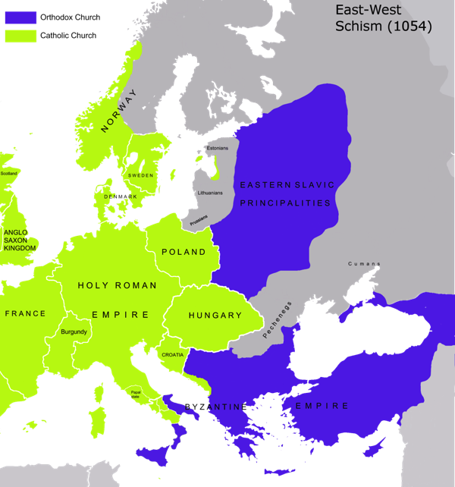
https://upload.wikimedia.org/wikipedia/commons/9/92/Great_Schism_1054_with_former_borders-.png

Slide 3
Papal “Captivity”
Reading Assignment: https://en.wikipedia.org/wiki/Avignon_Papacy

Slide 4
14th Cent struggle between Popes, Kings of France, Italian city states, England, others over the secular power of the Pope.
From 1309, Pope Clement V, French, moves Pope’s enclave to Avignon (France)…stays in France until 1376, then back to Rome.
From 1378-1403 “Antipopes” in Avignon, followed by other antipopes until 1437. Western Schism

Slide 5
In the period of the Schism, the power struggle in the papacy became a battlefield of the major powers, with France supporting the Pope in Avignon and England supporting the Pope in Rome. At the end of the century, still in the state of schism, the papacy had lost most of its direct political power, and the nation states of France and England were established as two of the main powers in Europe.
https://en.wikipedia.org/wiki/Avignon_Papacy

Slide 6
Christianity and Islam
Reconquista of Spain
Crusades to Palestine

Slide 7
Spanish Reconquista
“The Reconquista^{[a]} (Spanish and Portuguese for the "reconquest") is the period in the history of the Iberian Peninsula of about 780 years between the Umayyad conquest of Hispania in 711 and the fall of the Nasrid kingdom of Granada to the expanding Christian kingdoms in 1492. The Reconquista was completed just before the Spanish discovery of the Americas—the "New World"—which ushered in the era of the Spanish and Portuguese colonial empires. “
https://en.wikipedia.org/wiki/Reconquista

Slide 8
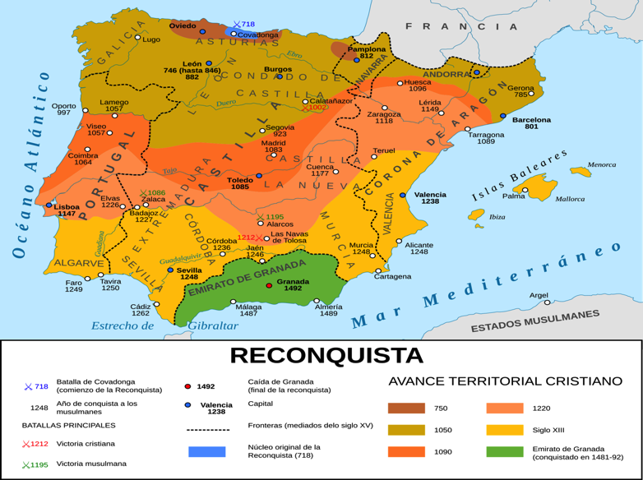
https://upload.wikimedia.org/wikipedia/commons/thumb/b/bf/Progress_of_the_Reconquista_%28718%E2%80%931492%29_-_es.svg/2000px-Progress_of_the_Reconquista_%28718%E2%80%931492%29_-_es.svg.png

Slide 9
Reconquista---results
Spain as exclusively Catholic nation (Inquisition) with Muslims and Jews expelled.
Unifies various kingdoms into Spain and Portugal
Gave example of a Holy War- Crusade
Holy Land Crusades seen as something of an extension.

Slide 10
Reading ASSIGNMENT
https://en.wikipedia.org/wiki/Crusades

Slide 11
Crusades to Palestine
Formally begin in 1095 after Byzantium loses Battle of Manzekert in 1071, Emperor Alexios I requests help of Pope Urban II for military help to protect against the Seljuk Turkish advances into Asia Minor.
Pope Urban II responds with sermons/Church Council calling for European armies to go to war against Turks.

Slide 12
Other Factors for the Crusades
Potential way for Urban II, papacy to assert dominance over Eastern Church—Great Schism
Inter-kingdom warfare in Europe constant conflict, knight class of mercenary warriors ravaging poor. Need to have a unifying and non-European enemy:

Slide 13
“For Pope Urban II, at the Council of Clermont in 1095, the subversion of martial violence is effective in dealing with secular violence:
Oh race of the Franks, we learn that in some of your provinces no one can venture on the road by day or by night without injury or attack by highwaymen, and no one is secure even at home. Let us then re-enact the law of our ancestors known as the Truce of God. And now that you have promised to maintain the peace among yourselves you are obligated to succour your brethren in the East, menaced by an accursed race, utterly alienated from God. The Holy Sepulchre of our Lord is polluted by the filthiness of an unclean nation. Recall the greatness of Charlemagne. O most valiant soldiers, descendants of invincible ancestors, be not degenerate. Let all hatred depart from among you, all quarrels end, all wars cease. Start upon the road to the Holy Sepulchre to wrest that land from the wicked race and subject it to yourselves.”[24] https://en.wikipedia.org/wiki/Peace_and_Truce_of_God

Slide 14
Turks control Silk Roads; Genoa and Venice wanted trade with East and bypass Constantinople.
Spiritual Anxiety over Millennium (Year 1000); plagues; wars…..impending death or end of the world. Seeking of salvation –Heaven– on everyone’s mind. Church grant indulgences—later began to sell them to help pay for Crusades—to all crusaders.

Slide 15
Almost immediately Peter the Hermit led thousands of mostly poor Christians out of Europe in what became known as the People's Crusade.^{[30]} He claimed he had a letter from heaven instructing Christians to prepare for the imminent apocalypse by seizing Jerusalem ^{[31]} The motivations of this Crusade included a "messianism of the poor" inspired by an expected mass ascension into heaven at Jerusalem.^{[32]} Germany witnessed the first incidents of major violent European antisemitism when these Crusaders massacred Jewish communities in what become known as the Rhineland massacres.^{[33]} In Speyer, Worms, Mainz, and Cologne the range of anti-Jewish activity was broad, extending from limited, spontaneous violence to full-scale military attacks.^{[34]} The Crusaders journeyed, despite advice from Alexios' to wait for the nobles, to Nicaea. Only 3000 survived an ambush by the Turks at the Civetot.[35] https://en.wikipedia.org/wiki/Crusades

Slide 16
“The enthusiastic response to Urban's preaching from all classes in Western Europe established a precedent for other Crusades. Volunteers became Crusaders by taking a public vow and receiving plenary indulgences from the Church. Some were hoping for a mass ascension into heaven at Jerusalem or God's forgiveness for all their sins. Others participated to satisfy feudal obligations, obtain glory and honour or to seek economic and political gain.”
https://en.wikipedia.org/wiki/Crusades

Slide 17
Crusades cont.
Frankish Wars;—French (Normans in England)
German some Italian and Spanish
Four in all, 1095-1291…lasting results in Holy Land minimal.
Set Europe against all non-Christian religions, primarily Muslim and Jewish
4th Crusade, one of economics, Italian Cities against Byzantium, Constantinople sacked…cemented division between Eastern and Western Christian Churches.

Slide 18
Culturally, Europe gains knowledge about ancient Hindu, Persian, Greek and Roman worlds as well as mathematics (e.g. algebra), warfare, science, philosophy—scholarship of world preserved in Islamic and Byzantine schools and academies. Paves way for Thomas Aquinas (scholasticism) and later Renaissance in Europe.
Religiously, increases people’s trust in holy sites, relics, and in Church’s power of granting salvation, esp. indulgences.

Slide 19
Christianity and Islam?
Conflict of Crusades seems major part of Christianity's story, less so for Islam.
Geographically limited; Turkish conquest—Turks often at war with other Muslims in Egypt or Syria—not unified Muslim ethos. Mongol invasion soon to follow more overwhelming, after that the Ottoman Empire
For Christians, justification of violence as a means to advance faith; “God wills it!” Religious intolerance European conquests…

