Slide 1
Preacher, Preparation,
Presentation
A class on making and preaching sermons
Session 16
Developing
A Sermon
Expository Preaching

Slide 2
Review
- Preparing to Preach
- Prayer
- Study of the Bible
- Exegesis
- Kinds/Styles of Sermons

Slide 3
Developing a Sermon

Slide 4
Expository Preaching
An exposition is the kind of sermon where the message and aim of the sermon are controlled by the message and aim of the biblical passage being preached.

Slide 5
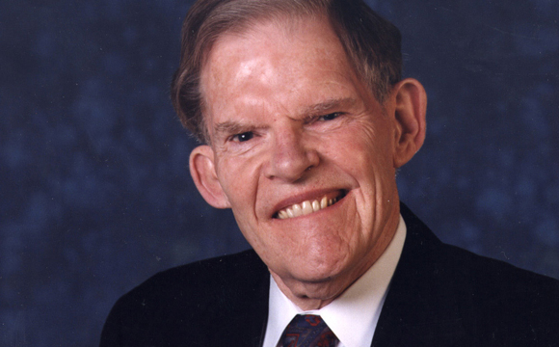
Haddon Robinson

Slide 6
“Expository preaching is the communication of a biblical concept, derived from and transmitted through a historical, grammatical, and literary study of a passage in its context, which the Holy Spirit first applies to the personality and experience of the preacher, then through the preacher, applies to the hearers.”

Slide 7
Communication of a Biblical concept
- approach Bible with a
childlike desire to hear the
story
- understand and experience
what they understand

Slide 8
Historical, grammatical, and literary study of a passage in its context…. - exegesis
- context is king

Slide 9
“I can do all things through him who strengthens me.”
Philippians 4:13

Slide 10
¹² I know what it is to have little, and I know what it is to have plenty. In any and all circumstances I have learned the secret of being well-fed and of going hungry, of having plenty and of being in need. ¹³ I can do all things through him who strengthens me. NRSV

Slide 11
“Submit to God and be at peace with him; in this way prosperity will come to you.” Job 22:21

Slide 12
⁷ After the Lord had said these things to Job, he said to Eliphaz the Temanite, “I am angry with you and your two friends, because you have not spoken the truth about me, as my servant Job has. ⁸ So now take seven bulls and seven rams and go to my servant Job and sacrifice a burnt offering for yourselves. My servant Job will pray for you, and I will accept his prayer and not deal with you according to your folly. You have not spoken the truth about me, as my servant Job has.” Job 42:7-8

Slide 13
Communication of a Biblical concept
- approach Bible with a
childlike desire to hear the
story
- understand and experience
what they understand

Slide 14
Historical, grammatical, and literary study of a passage in its context…. - exegesis
- context is king

Slide 15
…which the Holy Spirit first applies to the personality and experience of the preacher, then through the preacher, applies to the hearers.

Slide 16
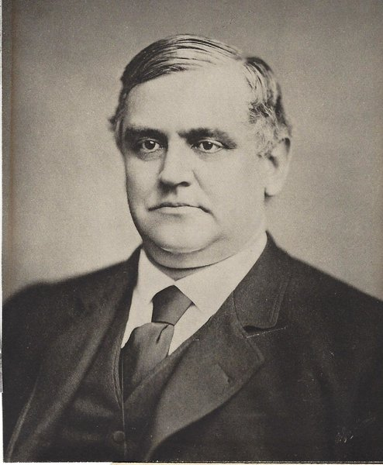

Slide 17
“…communication of truth through personality.”

Slide 18
What this means for me?
- Styles
- Pay attention to spiritual life

Slide 19
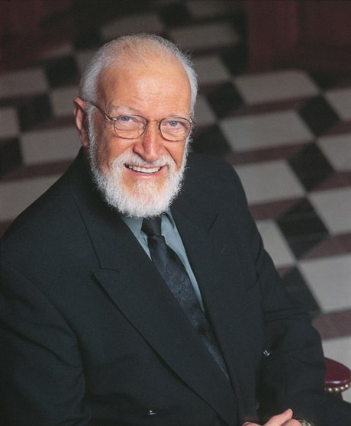

Slide 20
“Congregations ought to feel that their leader is a person of God and that the preacher’s words come from a relationship that is constantly renewing itself. Congregations want to hear God’s word from someone who walks with Christ.”
- Marketplace Preaching, p. 7

