Slide 1
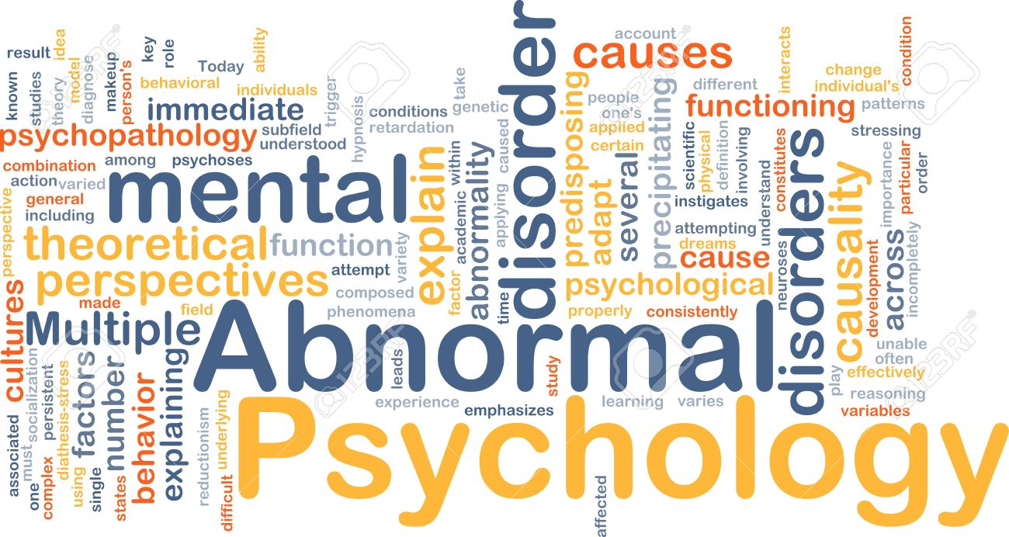
The application of psychological science to understanding and treating mental disorders

Slide 2
Psychological Disorder
An ongoing dysfunctional pattern of thought, emotion, and behavior that causes significant distress, and that is considered deviant in that person’s culture or society

Slide 3
Bio-psycho-social model of illness
A way of understanding disorder that assumes that disorder is caused by biological, psychological, and social factors

Slide 4
Social Component
The influences on disorder due to social and cultural factors such as socioeconomic status, homelessness, abuse, and discrimination.

Slide 5
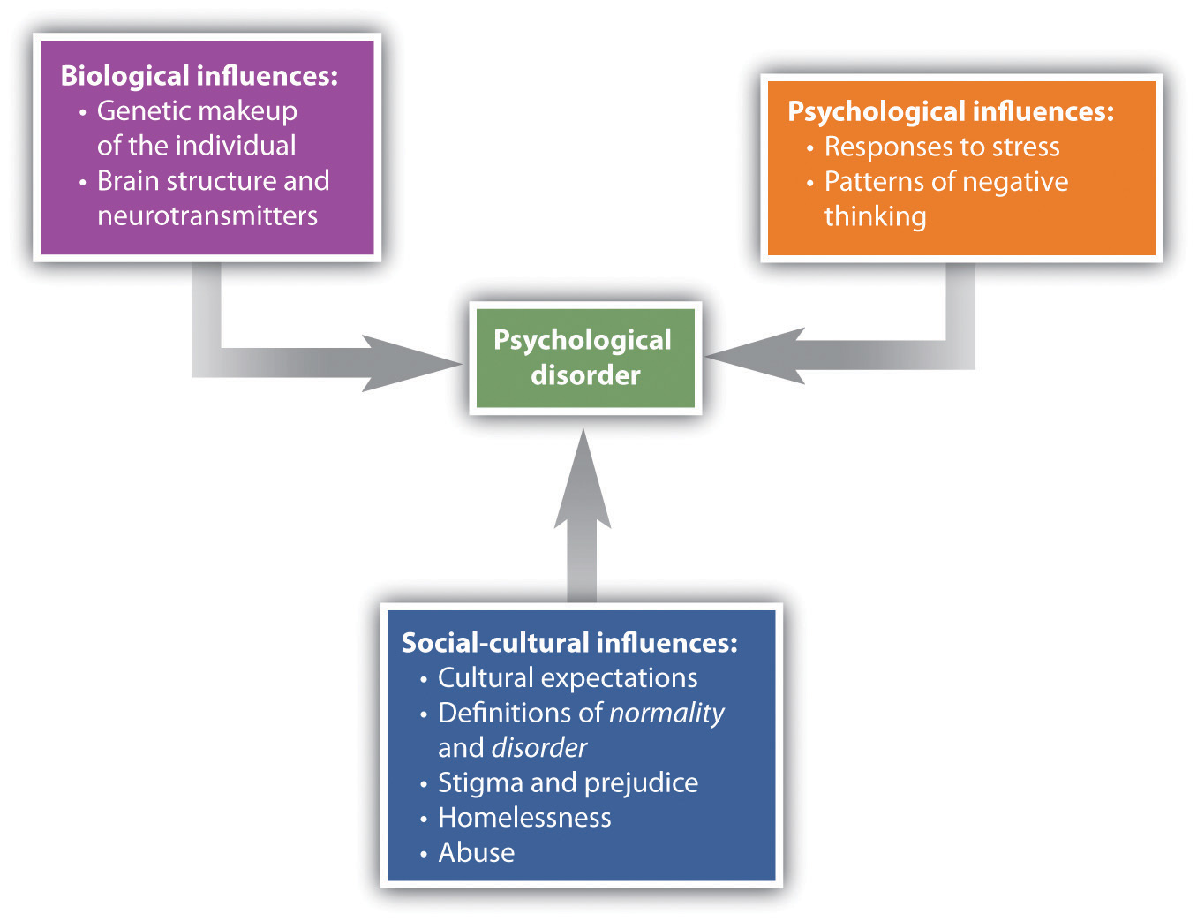

Slide 6
Maladaptive
The extent to which it causes distress (e.g., pain and suffering) and dysfunction (impairment in one or more important areas of functioning) to the individual

Slide 7
When people who suffer from one disorder also suffer at the same time from other disorders.
Comorbidity

Slide 8
A disgrace or defect that indicates that person belongs to a culturally devalued social group
Stigma

Slide 9
Diagnostic and Statistical Manual of Mental Disorders (DSM)
The MAIN document that provides a common language and standard criteria for the classification of mental disorders.

Slide 10
Attention-Deficit/hyperactivity disorder
A developmental behavior disorder characterized by problems with focus, difficulty maintaining attention, and inability to concentrate, in which symptoms start before seven years of age.

Slide 11
Autism
A disorder of neural development characterized by impaired social interaction and communication and by restricted and repetitive behavior, and in which symptoms begin before seven years of age.

Slide 12
Asperger’s disorder
A developmental disorder that affects a child’s ability to socialize and communicate effectively with others and in which symptoms begin before seven years of age.

