Slide 1
Leadership 31
Dealing with Conflict

Slide 2
Acts 15:36-40

Slide 3
Conflict Positives
- Introduces opportunity for change
- Sometimes God’s Plan
e.g. of Peter Wagner
- Opportunity to clarify vision and
values

Slide 4
Personal Conflict
First call
Organizational Conflict
“I think you are wrong”
Advocating conflict

Slide 5
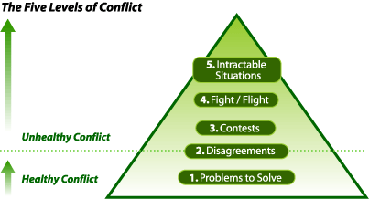
Speed Leas

Slide 6
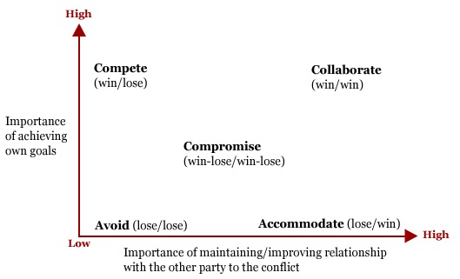

Slide 7
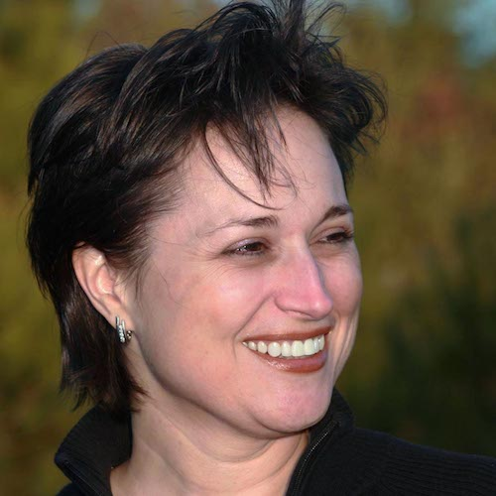
Lyssa Adkins

Slide 8
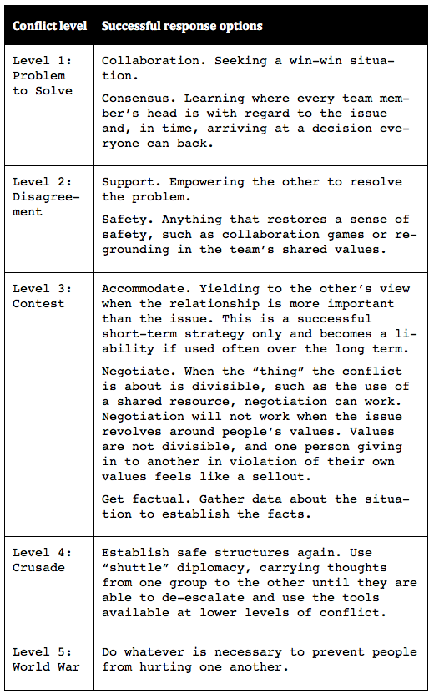
Problem
Person
Program (use
of rooms)
Counselor

Slide 9
The Pastor’s Role
Teach Matthew 18:15-20
Make sure all sides are heard
Avoid Triangulation

Slide 10
The Pastor’s Role
Teach Matthew 18:15-20
Make sure all sides are heard
Avoid Triangulation

Slide 11
The Pastor’s Role
Teach Matthew 18:15-20
Make sure all sides are heard
Avoid Triangulation
Define the issues– Surface them
Explore assumptions
Even ask! Are they valid?
Explore alternatives
Push toward reconciliation

Slide 12
