Slide 1
SEGMENTATION

Slide 2
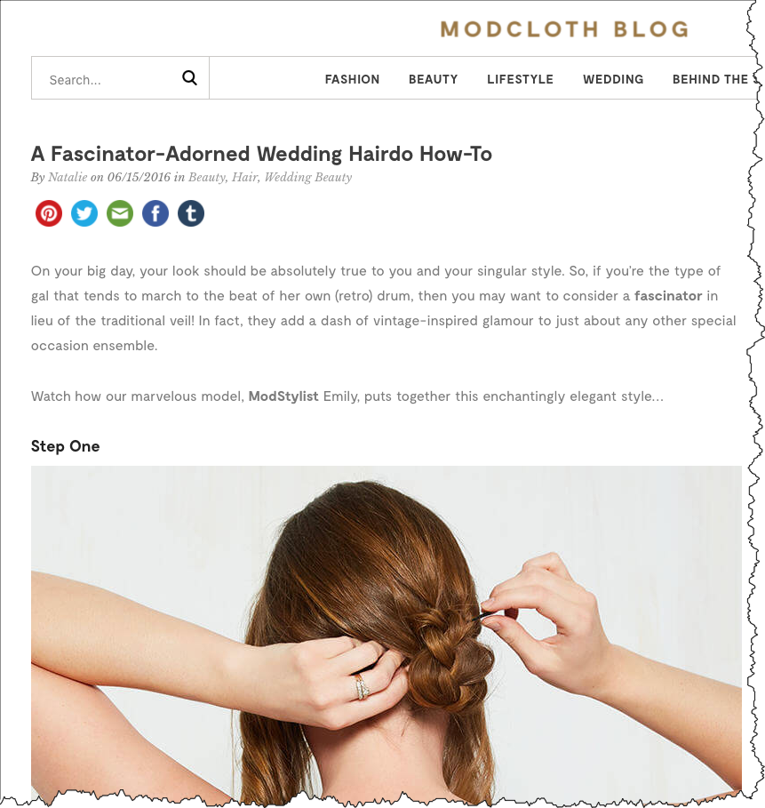
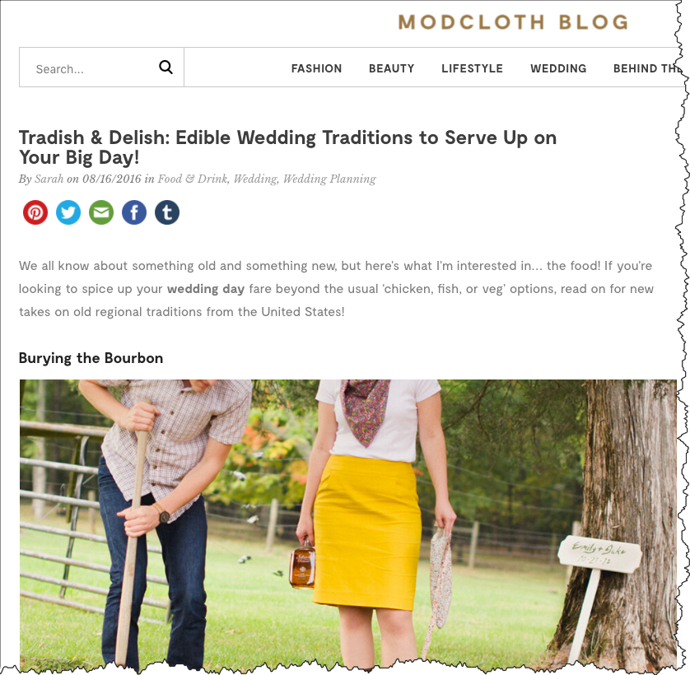
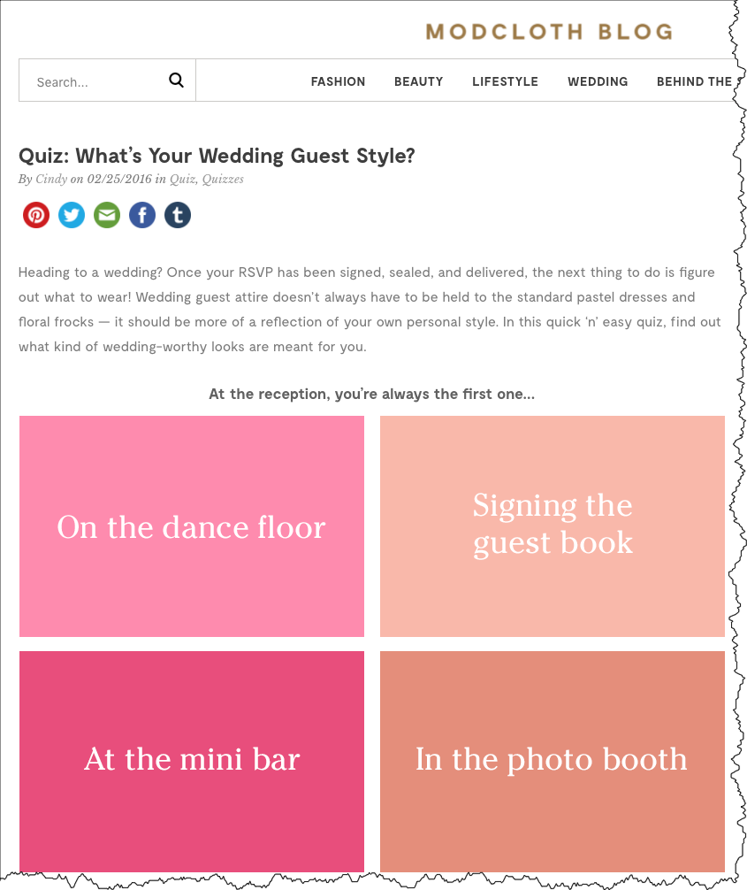
What do we know about people reading these Modcloth articles at the TOFU?

Slide 3
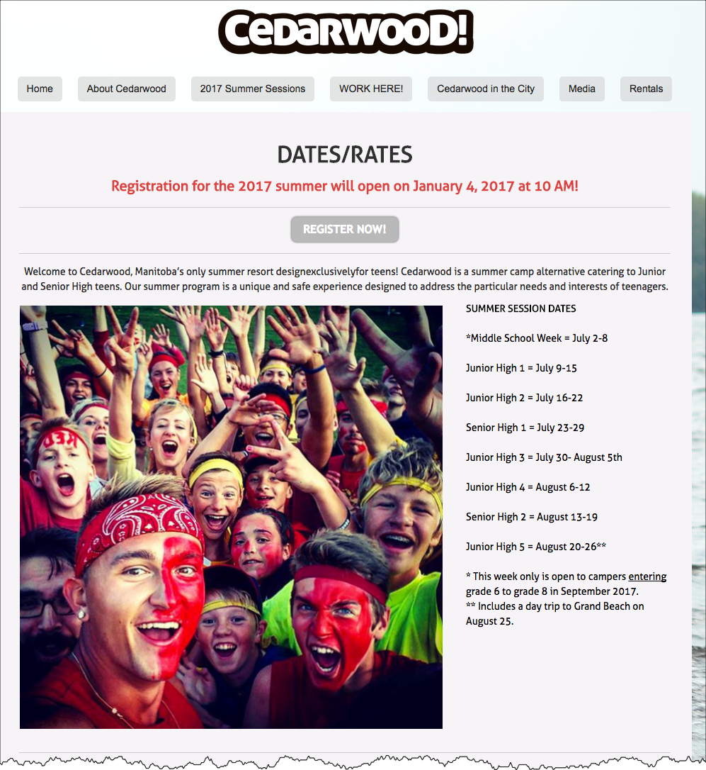
What do we know about people looking at dates and rates in the MOFU?

Slide 4
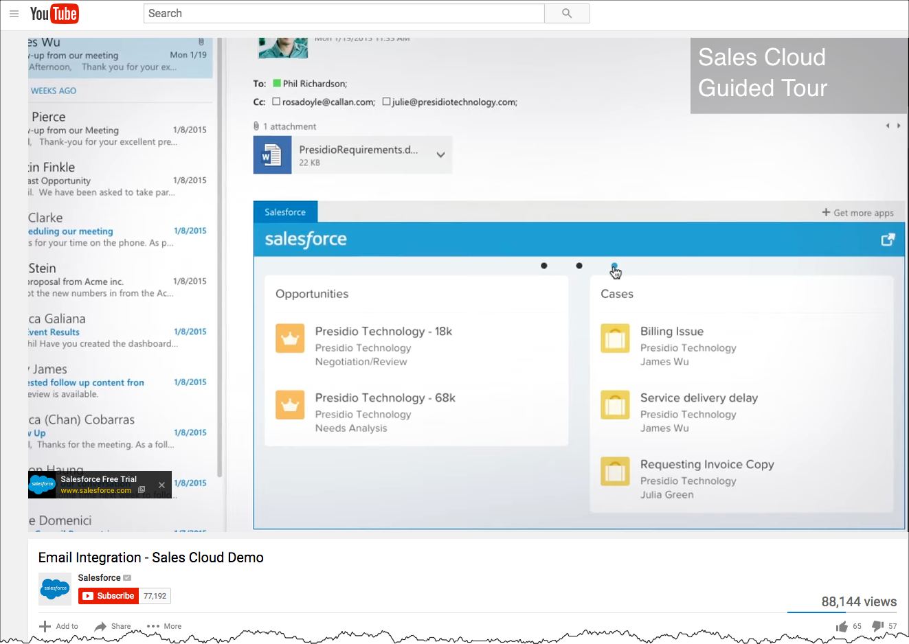
What do we know about watching this Salesforce demo at the BOFU?

Slide 5
WOULDN’T IT BE INCREDIBLE IF...

Slide 6
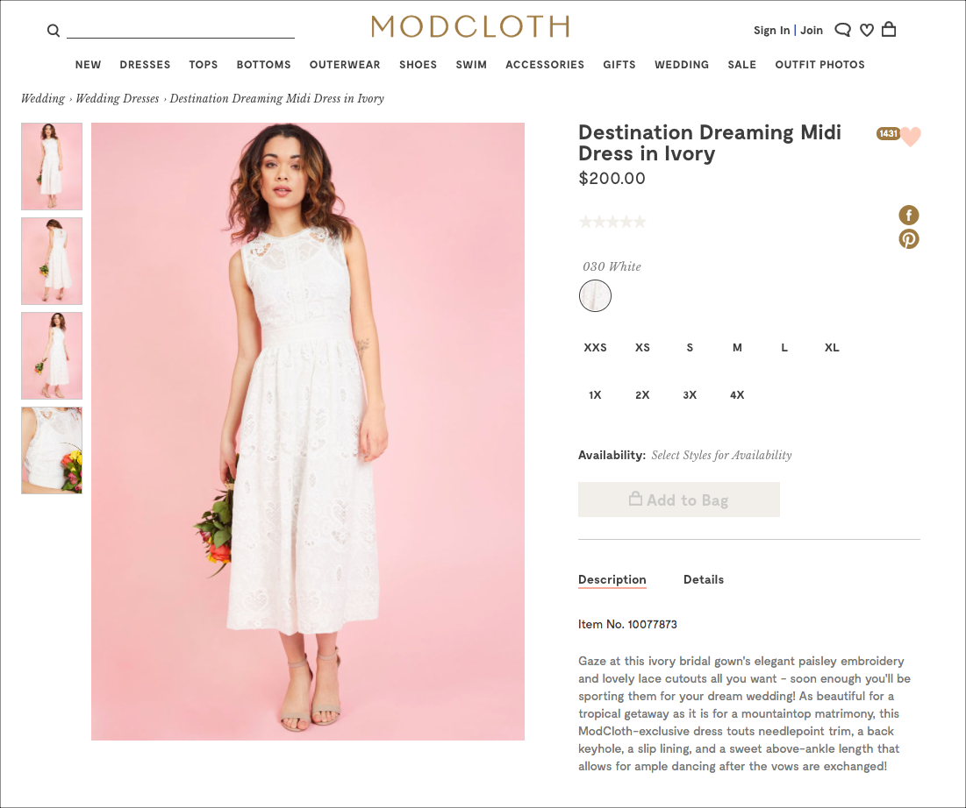
Modcloth could make those readers this offer…

Slide 7
WOULDN’T IT BE INCREDIBLE IF...

Slide 8
Camp Cedarwood could make visitors to the dates and rates page this offer…

Slide 9
WOULDN’T IT BE INCREDIBLE IF...

Slide 10
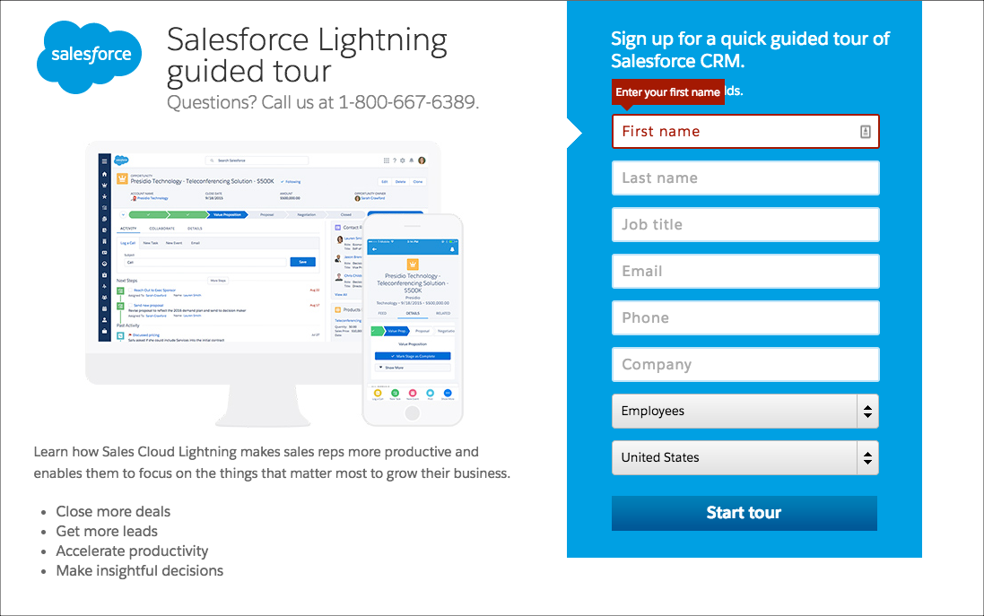
Salesforce could make demo watchers this offer…

Slide 11
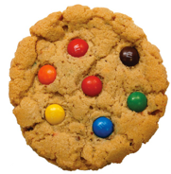
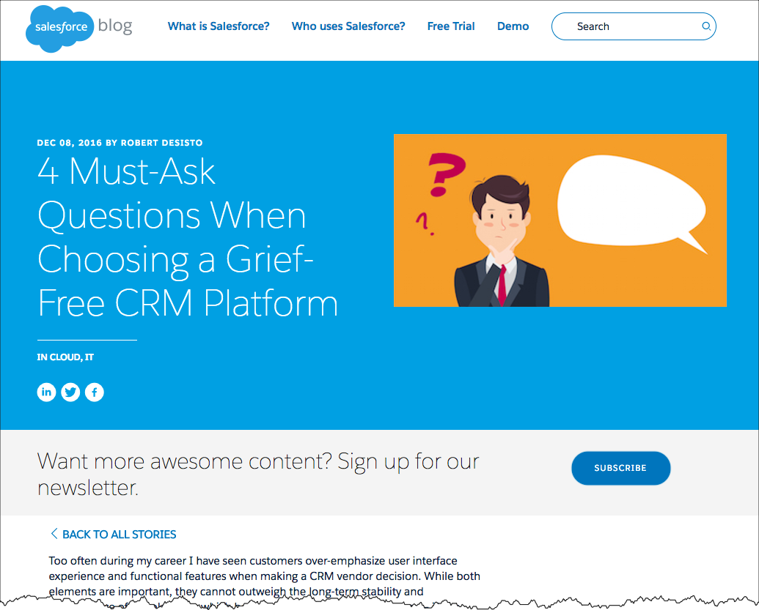
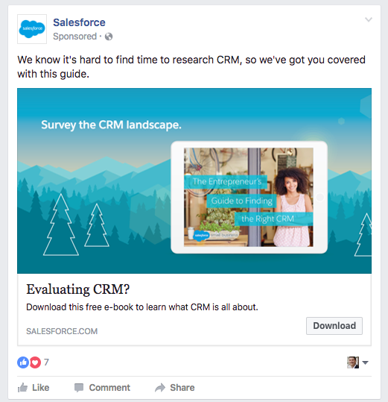
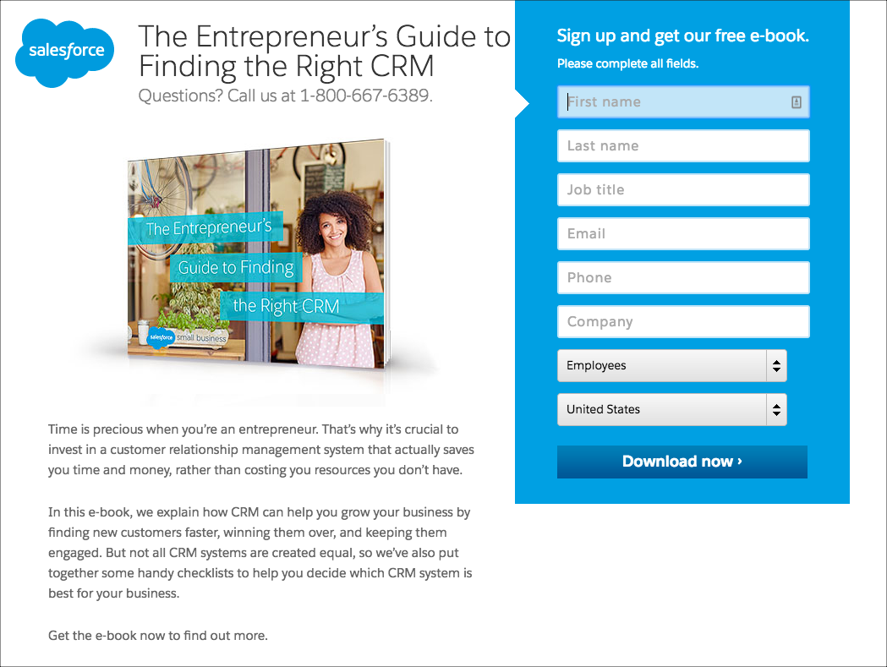

Slide 12
ARE YOU SEEING HOW POWERFUL THIS STUFF IS?

Slide 13
THE LINGO
The Language of a Content Marketer

Slide 14
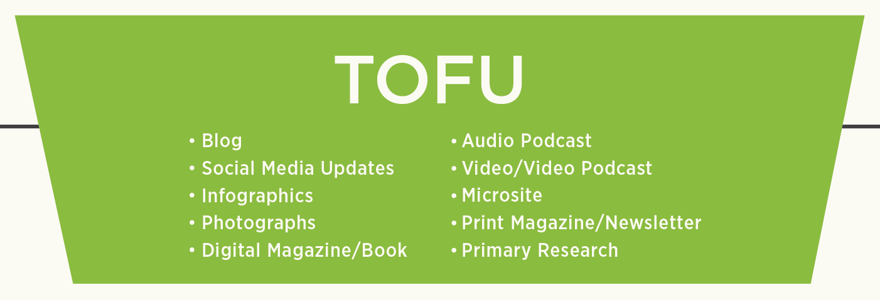
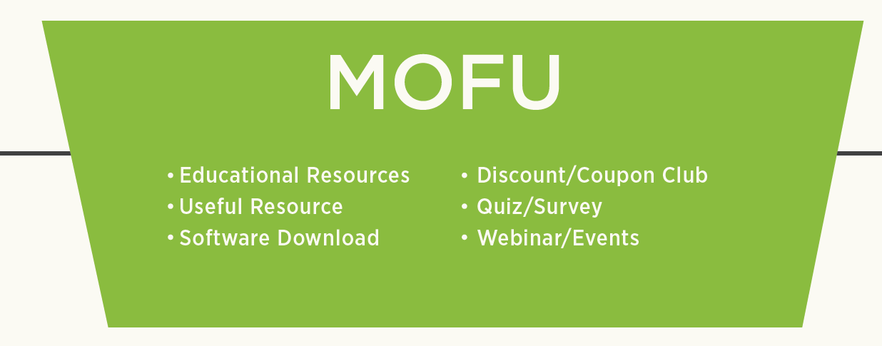
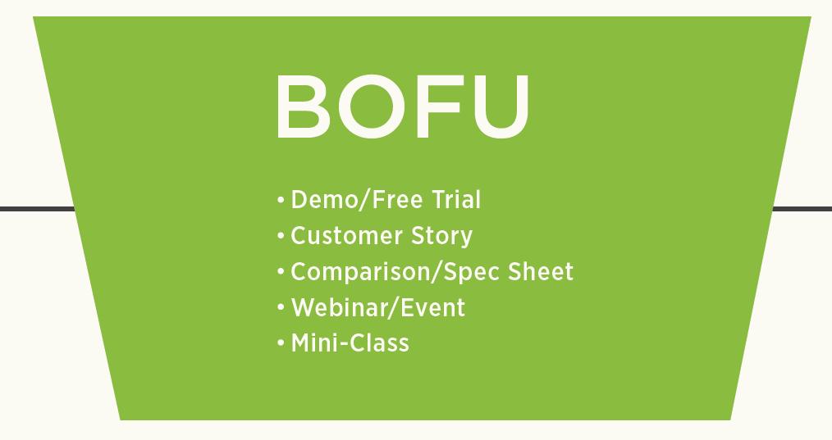
Refer to your content as…
TOFU
MOFU
BOFU

Slide 15
THE METRICS
How Content Marketing is Measured

Slide 16
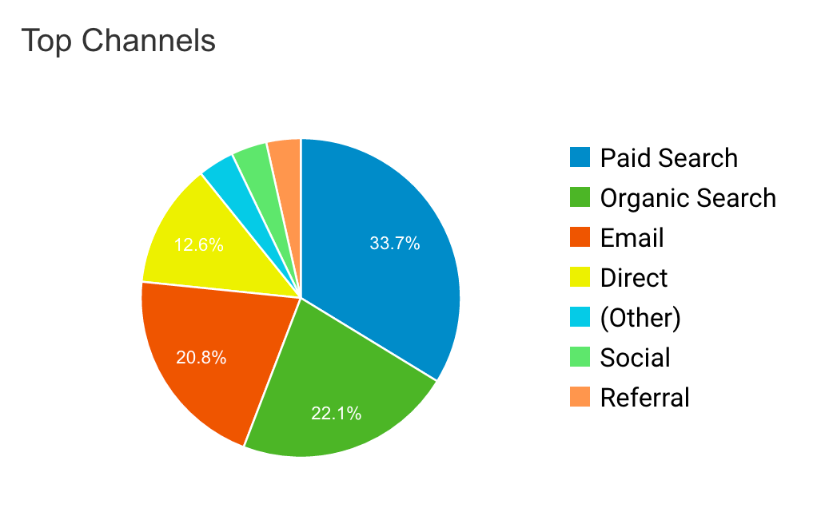
At the TOFU, measure traffic and social sharing…

Slide 17
In the MOFU, measure conversion rates on lead forms…

Slide 18
At the BOFU, measure sales page conversions…

Slide 19
THANK YOU!

