Slide 1
by
Financial Freedom & Success Institute
Presents
Alex Barrón

Slide 2
LESSON 11: PROTECT YOUR CAPITAL FROM LOSS – LOANS, INSURANCE, ASSET PROTECTION, ESTATE PLANNING

Slide 3
LOANS
¹² The Lord will open to you His good treasure, the heavens, to give the rain to your land in its season, and to bless all the work of your hand. You shall lend to many nations, but you shall not borrow. ¹³ And the Lord will make you the head and not the tail; you shall be above only, and not be beneath, if you heed the commandments of the Lord your God, which I command you today, and are careful to observe them. - Deuteronomy 28:11-13
The wicked borrows and does not repay, But the righteous shows mercy and gives. - Psalms 37:21
The rich rules over the poor, And the borrower is servant to the lender. - Proverbs 22:7

Slide 4
Read: The Gold Lender of Babylon
Before you lend of invest your hard-earned dollars follow the following steps:
1.) Realize people who don’t have $ will approach you with “ideas” or “needs” they have who want to borrow your money.
2.) Run it by someone who cares about your financial well-being.

Slide 5
Read: The Gold Lender of Babylon
3.) Don’t harden your heart. Be open to genuine needs, but watch your money closely from those who would “share” it with you.
4.) Ask them to write out why they need it and how and when they plan to pay it back. Get them to sign and date it.
5.) Ask for collateral.
6.) If possible, GIVE them the money instead of lending it. Otherwise you might lose, both your friend and your money.

Slide 6
Advice on Lending
"From each person to whom I lend, I do exact a token for my token chest, to remain there until the loan is repaid. When they repay I give back, but if they never repay it will always remind me of one who was not faithful to my confidence.
The safest loans, my token box tell me, are to those whose possessions are of more value than the one they desire.
Humans in the throes of great emotions are not safe risks for the gold lender.
If someone borrows for purposes that bring money back to them, they insist on repaying promptly. But if they borrow because of their indiscretions, I warn you to be cautious if you would ever have your gold back in hand again.
- The Richest Man in Babylon

Slide 7
Advice on Lending
If someone comes to me and ask to borrow gold I should ask him for what purpose he would use it. "What knowledge have you of the ways of trade? Do you know where you can buy at lowest cost? Do you know where you can sell at a fair price?" Could he say 'Yes' to these questions. If not, then would I say to him that his purpose was not wise. His ambition, though worthy, is not practical and I would not lend him any gold.
Gold is the merchandise of the lender of money. It is easy to lend. If it is lent unwisely then it is difficult to get back. The wise lender wishes not the risk of the undertaking but the guarantee of safe repayment.
- The Richest Man in Babylon

Slide 8
PREPARING FOR THE UNKNOWN FUTURE - INSURANCE

Slide 9
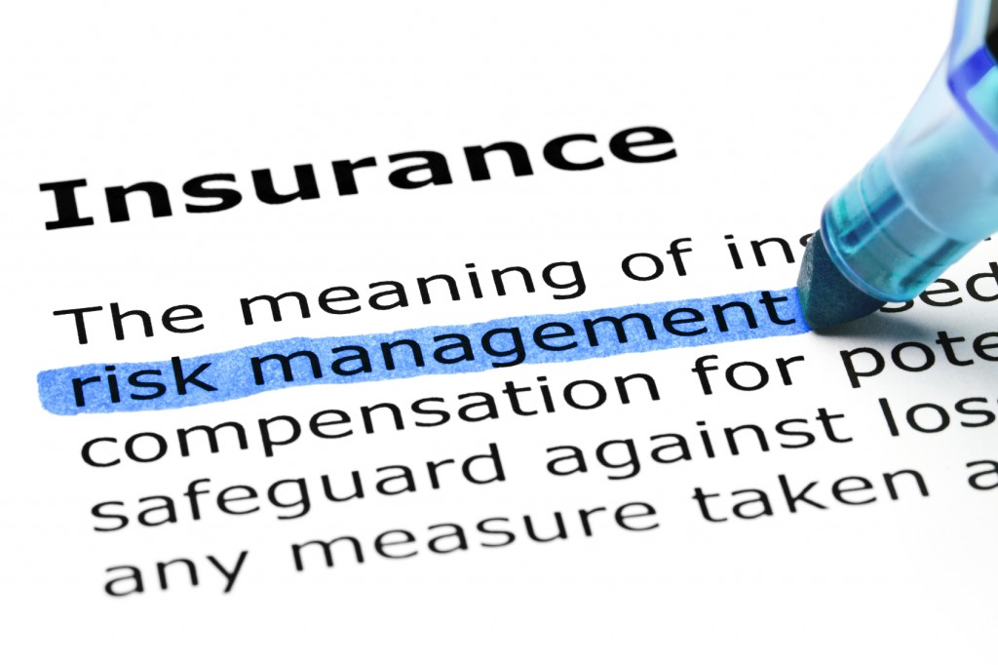
In This World There is a Lot of Uncertainty
To mitigate against catastrophic risks people buy insurance.
Many Types of Insurance:
Car Insurance - Accident
Home Insurance - Fire
Property Insurance - Theft
Healthy Insurance – Illness
The Purpose of Insurance: To eliminate exposure to a small probability of losing a large amount of $ by exchanging a small certain amount of $ (the premium).

Slide 10
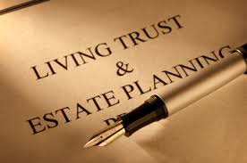
ASSET PROTECTION & ESTATE PLANNING

Slide 11
Asset Protection 101
As you become more successful, more “predators” will seek to take your money. This can mean you may be exposed to:
More “get rich quick” schemes or scams
More “investment opportunities”
Frivolous lawsuits - When starting a business, create a corporation or LLC.
Divorce.
A life insurance policy may be your “first line of defense” against lawsuits. In some states like TX the cash value is creditor-protected by statute to an unlimited dollar amount.
The key is timing – you have to do it BEFORE the lawsuit.
Your money may be safer in a life insurance policy than sitting at a bank where it can get lose thru bank failure – “bail-in”.

Slide 12
Estate Planning 101
Everyone should plan for when they are no longer with us.
Get a Will
- Clearly express your wishes. Minimize creating conflict among your heirs and beneficiaries.
Designate an executor and guardian for your children.
Get a Living Trust
Minimize estate taxes
Avoid probate
Place trustees who will distribute your assets according to your wishes.
Give away your money while you are alive.

Slide 13
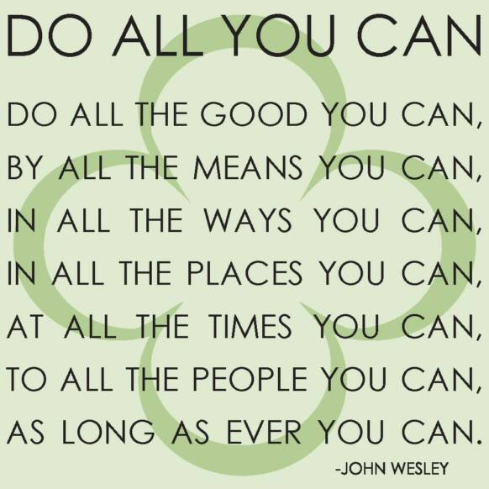
Conclusion: Be a Good Steward of The Resources Entrusted to You
Investing Money is hard work. Be careful where you lend it, how you invest it. Do your best to protect it from Loss. Get Life Insurance, Protect Your Assets & Plan Your Estate

