Slide 1
Leadership 27
Our Iceberg Is Melting

Slide 2
Leading Change 8 Steps
Establishing a Sense of Urgency
Creating a Guiding Coalition
Developing a Vision and Strategy
Communicating the Change Vision
Empowering for Broad-based Action
Generating Short-term Wins
Consolidating Gains and Producing
More Change
8. Anchoring the New in the Culture

Slide 3
Slideshare.net

Slide 17
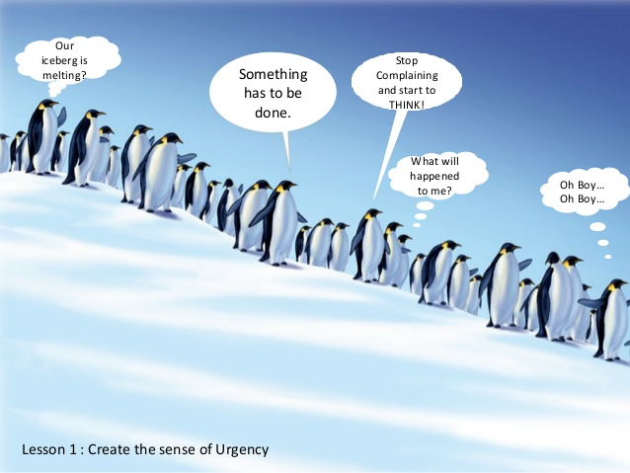

Slide 25
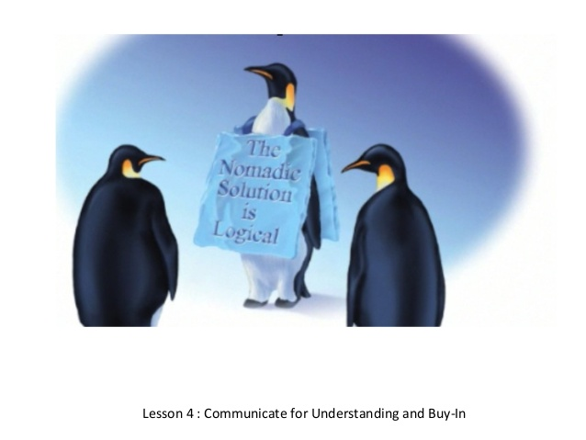

Slide 26
