Slide 1
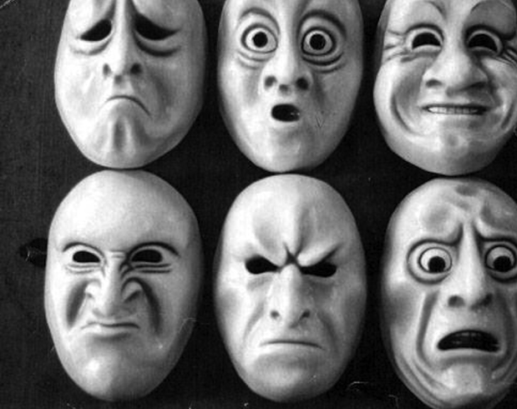
Emotion & Motivation

Slide 2
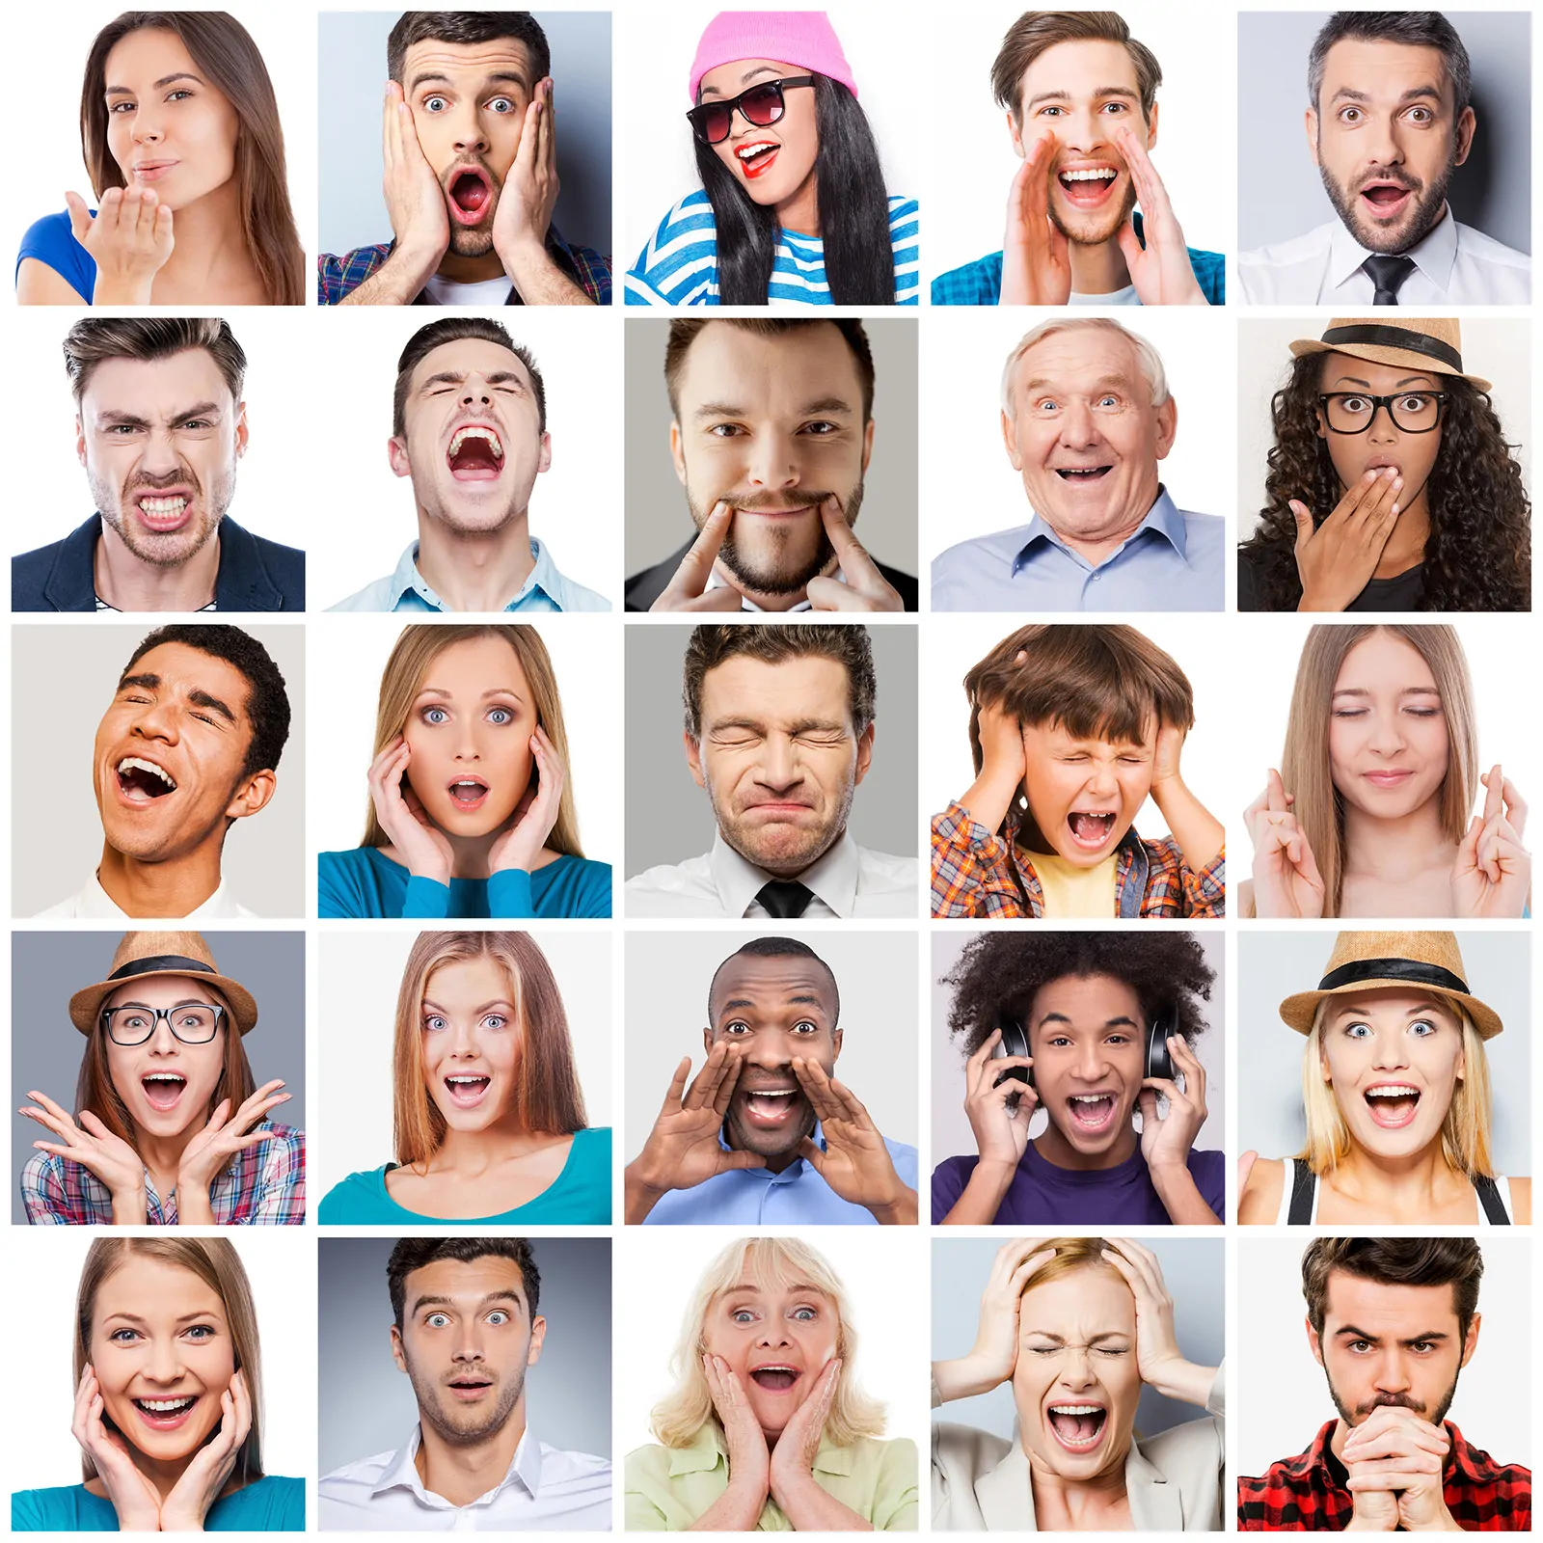
Emotion
Mental and physiological feeling state that directs our attention and guides our behavior.

Slide 3
MOTIVATION
The process that initiates, guides, and maintains goal-oriented behaviors. It is what causes you to act, whether it is getting a glass of water to reduce thirst or reading a book to gain knowledge.

Slide 4
Drive
Internal states that are activated when the physiological characteristics of the body are out of balance
Goal
Desired end states that we strive to attain

Slide 7
Arousal
The state of being activated, either physiologically or psychologically, and is one dimension of our affective response to emotional stimuli.

Slide 8
