Slide 1
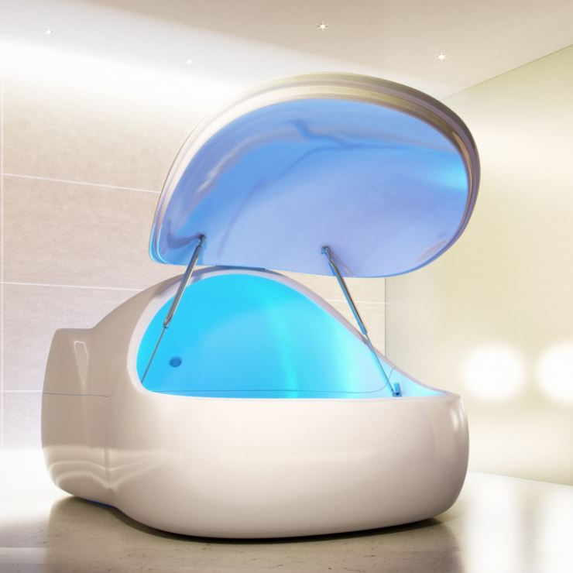
Altering Consciousness Without Drugs
Hypnosis
Sensory Deprivation
Meditation

Slide 2
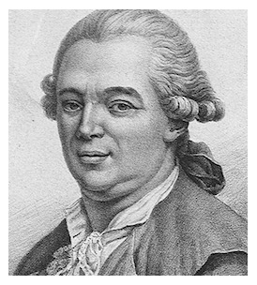
Franz Anton Mesmer
Austrian doctor who believed that all living bodies were
filled with magnetic energy
Passed magnets over the bodies of patients.
“Mesmerized”

Slide 3
Hypnosis
A trancelike state of consciousness, usually induced by a procedure known as hypnotic induction, which consists of heightened suggestibility, deep relaxation, and intense focus.

Slide 4
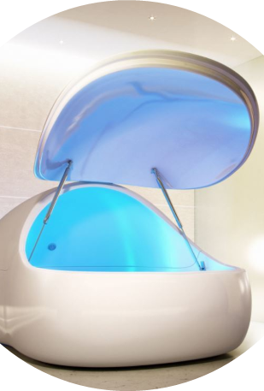
Sensory deprivation
The intentional reduction of stimuli affecting one or more of the five senses, with the possibility of resulting changes in consciousness.
Sensory Deprivation Tank
In 1954, John Lilly, a neurophysiologist at the National Institute of Mental Health, developed the sensory deprivation tank.

Slide 5
Meditation
Techniques in which the individual focuses on something specific, such as an object, a word, or one’s breathing, with the goal of ignoring external distractions, focusing on one’s internal state, and achieving a state of relaxation and well-being.
Altered state of consciousness
Mind changing after long term practice

