Slide 1
Sound
The 8 most common problems and how to fix them
Steve Elzinga

Slide 2
Sound – The 8 most common problems and how to fix them
Nehemiah 12:43 (NIV) And on that day they offered great sacrifices, rejoicing because God had given them great joy. The women and children also rejoiced. The sound of rejoicing in Jerusalem could be heard far away.

Slide 3
1. Not enough power
Years ago, the power (rated in watts, but called amps) was expensive, so speakers were made really efficient. Now, powerful amps are relatively cheap and so speakers are made more cheaply, thus requiring a lot of power. Most churches do not have enough power for the speakers they are running and the volume level they are running them at.
The result is a lot of feedback and distorted sound.

Slide 4
The fix
Check the power rating of your speakers and double it when looking for a new amp.

Slide 5
2. Distortion problems
Might be lack of power or it might be you are too high on the gain volume level for some or all of the channels on your sound board (or mixing board)

Slide 6
The fix
Gain
Why is Gain needed:
Mics and sometimes guitars have little amplification in themselves and need a boost

Slide 7
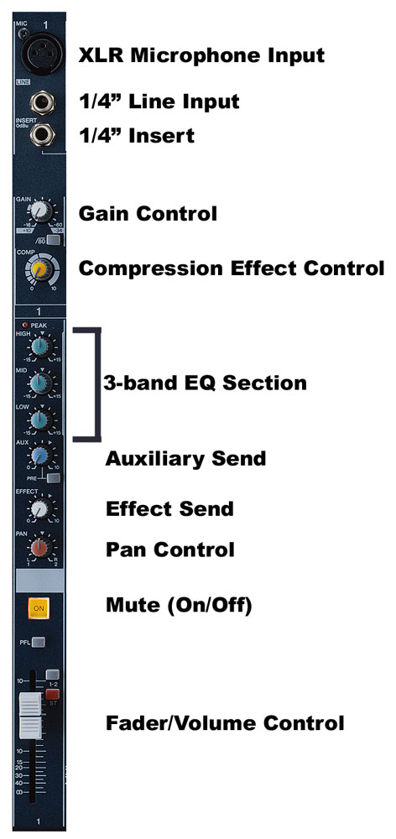
The fix
Turn down the volume level on the instrument
Turn down the volume level on the Gain Control

Slide 8
3. Harsh sound, harmonies don’t blend, hard to sing
i.e. library vs. shower

Slide 9
The fix
Reverb
Why reverb is needed:
Most singers are a bit off with pitch and reverb spreads the pitch out – makes it bigger, less accurate
Helps blend different voices into one sound

Slide 10
4. Unclear words in the songs, tin can sound or like the sound is distant, booming sound, harsh ear splitting sound

Slide 11
The fix
EQ
Why is EQ needed:
All rooms absorb different frequencies at different rates (frequencies give notes their pitch, high or low), so sound boards can add or take away certain various frequencies. Each channel strip will have at least 3 frequencies that can be added to or taken away = high, mid, and low.
32 Band EQ

Slide 12
How to diagnose and fix sound problems with EQ
If sound is not clear, but muddy, hard to understand words, dull …. Add high on the EQ
If sound is screechy, or harsh, or piercing so that your ears hurt …. Turn down high on the EQ
If the sound seems like it is coming out of an old speaker, or is coming from a different room, distant … Turn down the mids on the EQ
If the sound, especially the voices lack warmth … Turn up the mids
If the sound is lacking depth, thump ... Turn up bass.
If the sound is boomy … turn down the bass

Slide 13
5. Unclear, distant sound, like the sound is coming from another room

Slide 14
The fix
Monitor issues
Escalation of sound on the stage.
The sound person hears the combined volume of the sound on the stage, which bounces off from the front wall, and the main speakers that are pointed at the congregation. Because the sound on the stage gets louder and louder, the sound man has to turn down main speakers.
Soon half the sound that the congregation hears is the monitors bouncing off the front wall. That sound is poor quality.

Slide 15
How to fix the monitor issue
The best solution is an “in ear” monitor system. This system is expensive, but it is coming down in price because of digital mixing boards. The “in ear” monitor system sends a signal from the sound board to the stage via a cat 5 wire to a box that has 16 channels. Each person on the stage gets one of these boxes. With this box each person on stage can make their own monitor mix that is delivered to them via ear buds. Thus illuminating noise on the stage.
The next best solution is to get everyone on stage used to less overall monitor on the stage. Especially those who have control over their own amp. i.e. guitar players

Slide 16
6. When a single voice starts a song, or maybe just a piano, and the sound is really soft compared to when the whole band joins in

Slide 17
The fix
The Problem
Sound board operators tend to set the volume of each singer or instrument based on the total volume of all the singers singing at one time and all the instruments playing at one time. So when a song starts out with just a piano, the overall sound is now really low. Or if the song starts out with one singer, again the overall sound is really low.

Slide 18
How to fix the lack of volume issue
The sound board operator has to temporarily boost or turn up the volume of the single instrument or singer, and then when the rest of the band joins in, he or she must adjust them back down in volume.
i.e. the making of a CD
Compression

Slide 19
7. The overall sound is too loud according to some people in the congregation and too soft for others

Slide 20
The fix
Buy a sound meter or find an app on your phone that measures decibels.
The average contemporary church service runs at not more the 95 db. A rock concert is about 120 db.

Slide 21
8. Mics not on when person sings or the solo instrument is not loud enough

Slide 22
The fix
Sound operator does not know the music well enough. Should have marked lead sheet, listened to tape where possible, and come to practice.
Sound operator needs to clearly label each channel on the sound board for every singer and instrument player.

