Slide 1
Leadership Session 8
Generational Culture
An Interview with
John Burden

Slide 2
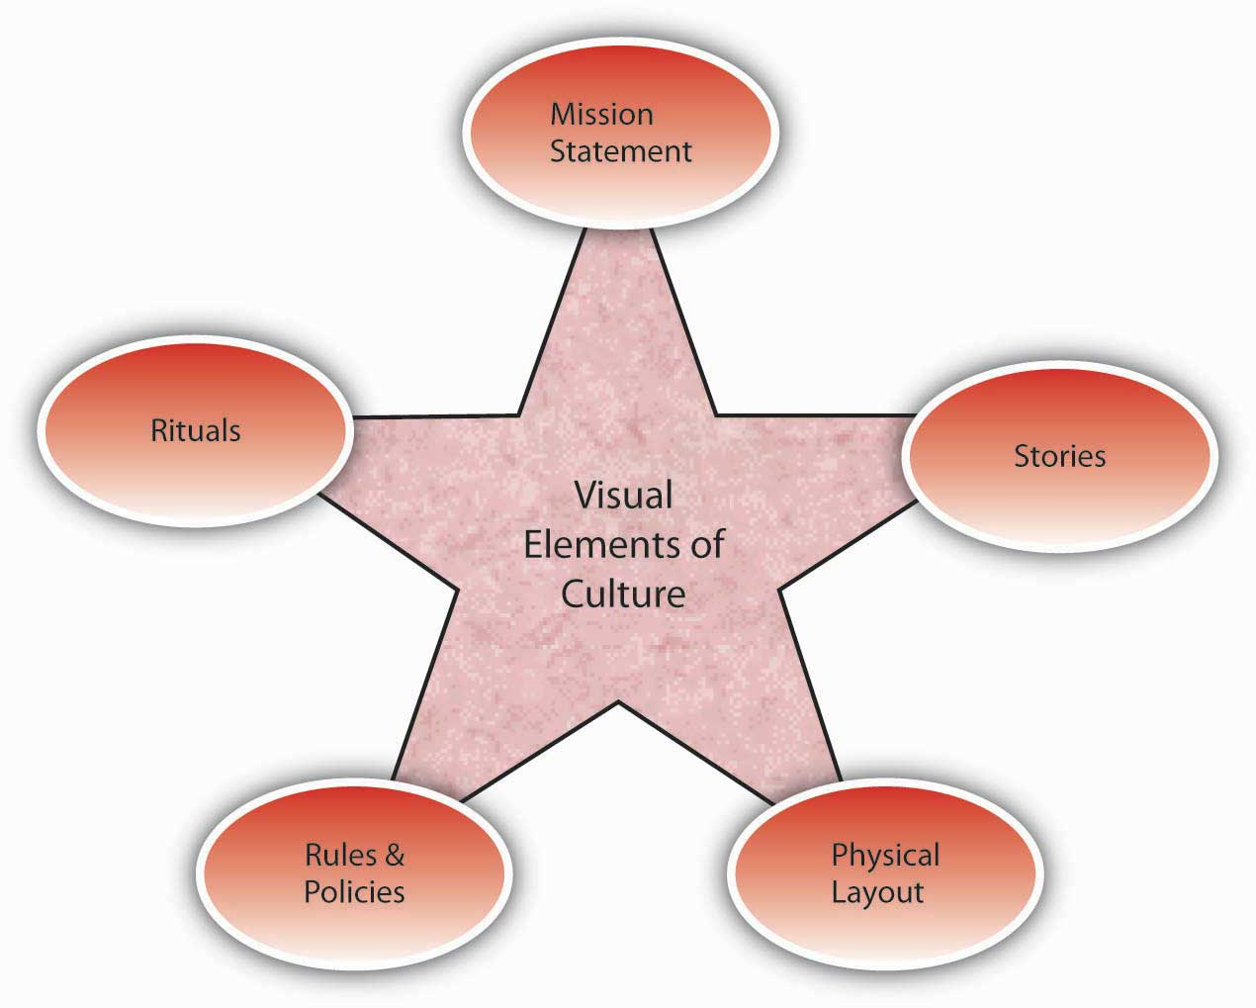
Vision
Culture
Prayer and Planning
Leader

Slide 4
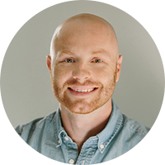
John Burden

