Slide 1
THE METHOD
The Principles of Well-Executed Email Marketing Strategy

Slide 2
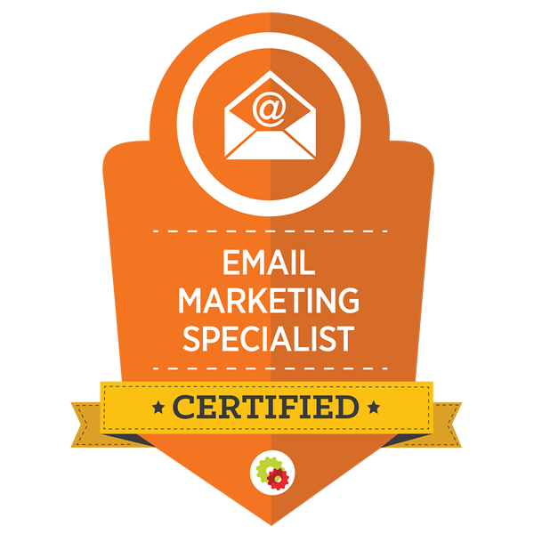
THE FIVE PHASES OF EMAIL
INDOCTRINATION
ENGAGEMENT
ASCENTION
SEGMENTATION
RE-ENGAGEMENT
MARKETING

Slide 3
INDOCTRINATION CAMPAIGN
A Triggered Campaign Sent Immediately Following Initial Subscription That Is Designed To Engender The Brand To The New Subscriber

Slide 4
ENGAGEMENT CAMPAIGN
A Interest Based, Triggered Campaign Sent Immediately Following An Action Designed To Make A Relevant Offer (And Sale) To Your Subscriber

Slide 5
ASCENSION CAMPAIGN
A Interest Based, Triggered Campaign Sent Immediately Following An Action Designed To Make A Relevant Offer (And Sale) To Your Subscriber

Slide 6
SEGMENTATION CAMPAIGN
A Manual Campaign Sent To Your Entire Database As A Promotion That Is Designed To Segment Your Subscribers By Interest

Slide 7
RE-ENGAGEMENT CAMPAIGN
A Triggered Campaign Sent To Any Subscriber Who Has Not Opened Or Clicked An Email In The Last 30 - 60 Days Designed To Re-Engage The Subscriber With The Brand

Slide 8
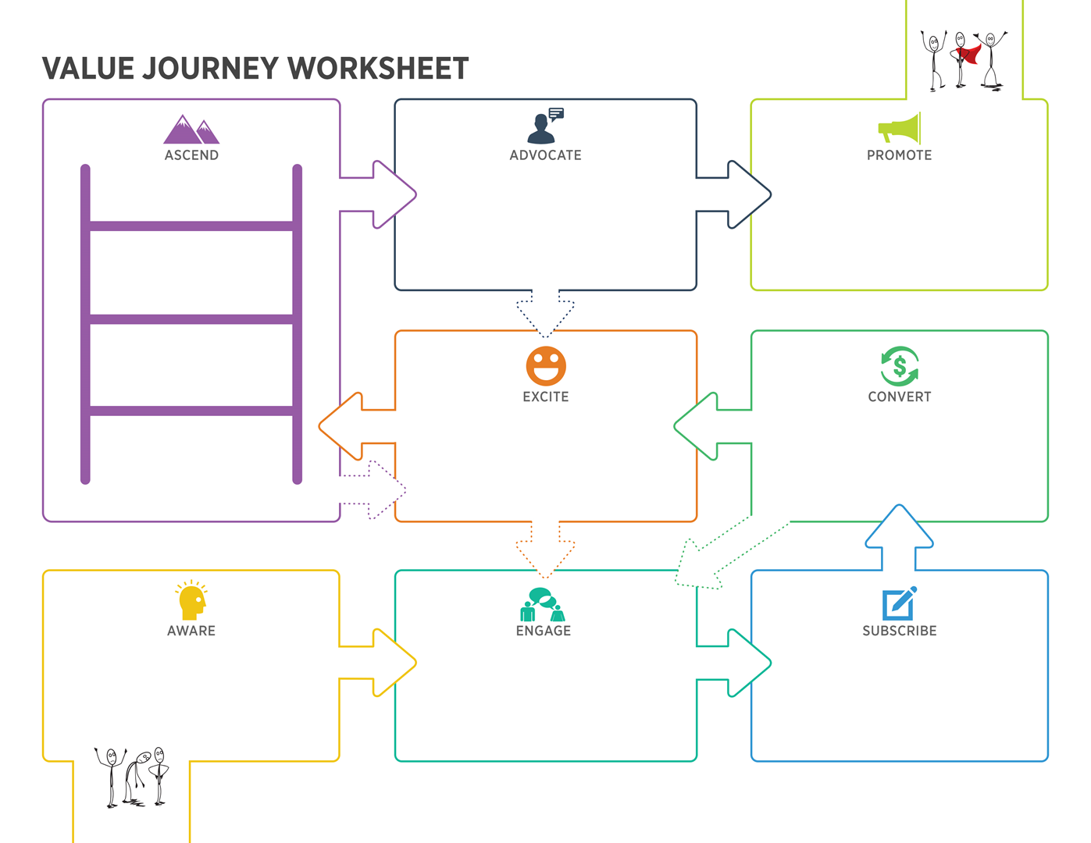
JOURNEY STEPS:
Become Aware
Engage
Subscribe
Convert
Excite
Ascend
Advocate
Promote

Slide 9
The Role of The
INDOCTRINATION CAMPAIGN
To Welcome New Subscribers, Tell Them What They Can Expect And What They Need To Do Next To Get The Biggest Benefit From You And Your Brand.

Slide 10
SOMEONE HAS SUBSCRIBED TO YOUR EMAIL LIST BUT THEY DON’T YET RECOGNIZE YOUR NAME IN THEIR INBOX OR LOOK FORWARD TO HEARING FROM YOU.

Slide 11
Welcome and introduce new subscriber to your brand…
Restate the benefits of being a subscriber…
Tell them what to expect…
Tell them what to do next…
Encourage whitelisting…
Put your best foot forward…
Campaign length 1 - 3 emails
STORYBOARDING YOUR
INDOCTRINATION CAMPAIGN

Slide 12
The Role of The
ENGAGEMENT CAMPAIGN
To Turn Subscribers Into BUYERS By Prescribing The Next Logical Step Based On What You Know They’re Currently Interested In!

Slide 13
NOW THAT YOUR SUBSCRIBER KNOWS WHO YOU ARE AND YOU KNOW WHAT THEY’RE INTERESTED IN RIGHT NOW…

Slide 14
Turns subscribers into converts (WHAT IS A CONVERSION?)
References the previous POSITIVE action…
Overcomes (or inoculate against) KNOWN objections…
Prescribes the next logical step…
Asks for the order…
STORYBOARDING YOUR
ENGAGEMENT CAMPAIGN

Slide 15
The Role of The
ASCENSION CAMPAIGN
Expedite And Accelerate The Value Journey And Turn New Buyers Into Multi Buyers By Prescribing The Next Logical Step Or Nurturing And Exciting Until It Appropriate To Take That Step.

Slide 16
References the previous POSITIVE action…
Overcomes (or inoculate against) KNOWN objections…
Prescribes the next logical step…
Turns ordinary buyers into multi-buyers…
Increase the trust & authority they feel for your brand
Ascends them from a customer into a raving fan…
STORYBOARDING YOUR
ASCENSION CAMPAIGN

Slide 17
ITS TIME TO ASK YOURSELF TWO IMPORTANT QUESTIONS…

Slide 18
QUESTION #1:
”What is the next step I want them to take?”

Slide 19
QUESTION #2:
”Do I have any reason to believe they are ready to take that next step?”

