Slide 1
Preacher, Preparation,
Presentation
A class on making and preaching sermons
Session 10
Preparing
To
Preach
Kinds of Sermons

Slide 2
Euangelizo = Preach the Gospel

Slide 4
Euangelizo = Preach the Gospel
Didasko = To Teach

Slide 5
97 times
KJV “Teach”
Formal teacher-student
relationship
Informal Instruction

Slide 6
To convey facts or truths in a way that causes students to learn.

Slide 7
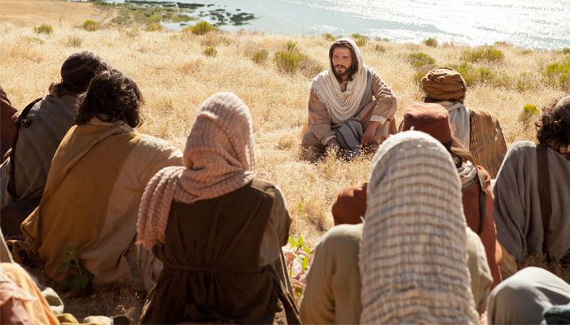

Slide 8
Matthew 4:23
Matthew 9:35
Luke 5:3

Slide 9
Disciples:
Acts 4:18: And when they had summoned them, they commanded them not to speak or teach at all in the name of Jesus.

Slide 10
Acts 5:42: And every day, in the temple and from house to house, they kept right on teaching and preaching Jesus as the Christ.

Slide 11
Acts 20:20: …how I did not shrink from declaring to you anything that was profitable, and teaching you publicly from house to house….

Slide 12
So what?

Slide 13
So what?
Choosing of target Scriptures
Illustrations
Follow-up materials
Testing?

Slide 17
Prayer
Jim

Slide 18
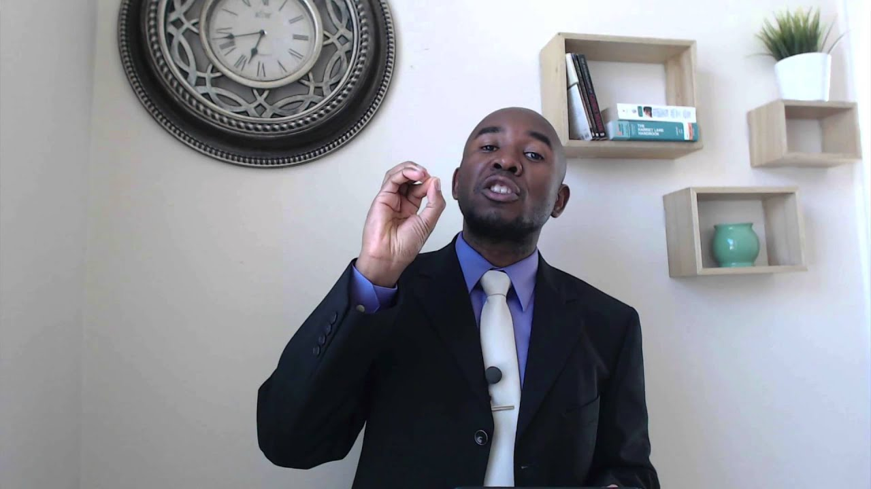
Preaching and Teaching
Dr. Kenneth Acha
Austin Bible Institute

Slide 19
https://youtu.be/0LZKO02w9xA

