Slide 1
THE LINGO
The Language of a Content Marketer

Slide 2
Technical SEO - Optimizing the structure and code of a website so that search engines can find, understand, and send traffic to that website.

Slide 3
Intent - The relevant goals of your ideal customer that lead to queries on the web. The intent of a hungry New Yorker might be typed into Google as, “thai food near central park.”

Slide 4
Asset - Content produced to satisfy the intent of a customer or prospect including blog posts, product pages, social media profiles, podcasts, videos, and more.

Slide 5
Channel - The digital "home" of an asset designed to meet the intent of a customer or prospect. Assets might live on a website or blog but also on large hubs like Amazon, Pinterest, iTunes and TripAdvisor.

Slide 6
THE METRICS
How Content Marketing is Measured

Slide 7
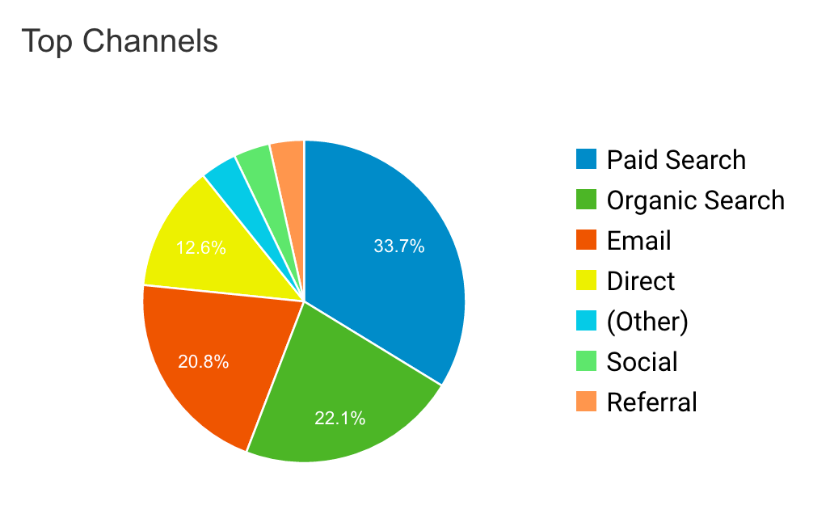
Measure Traffic by Channel…

Slide 8
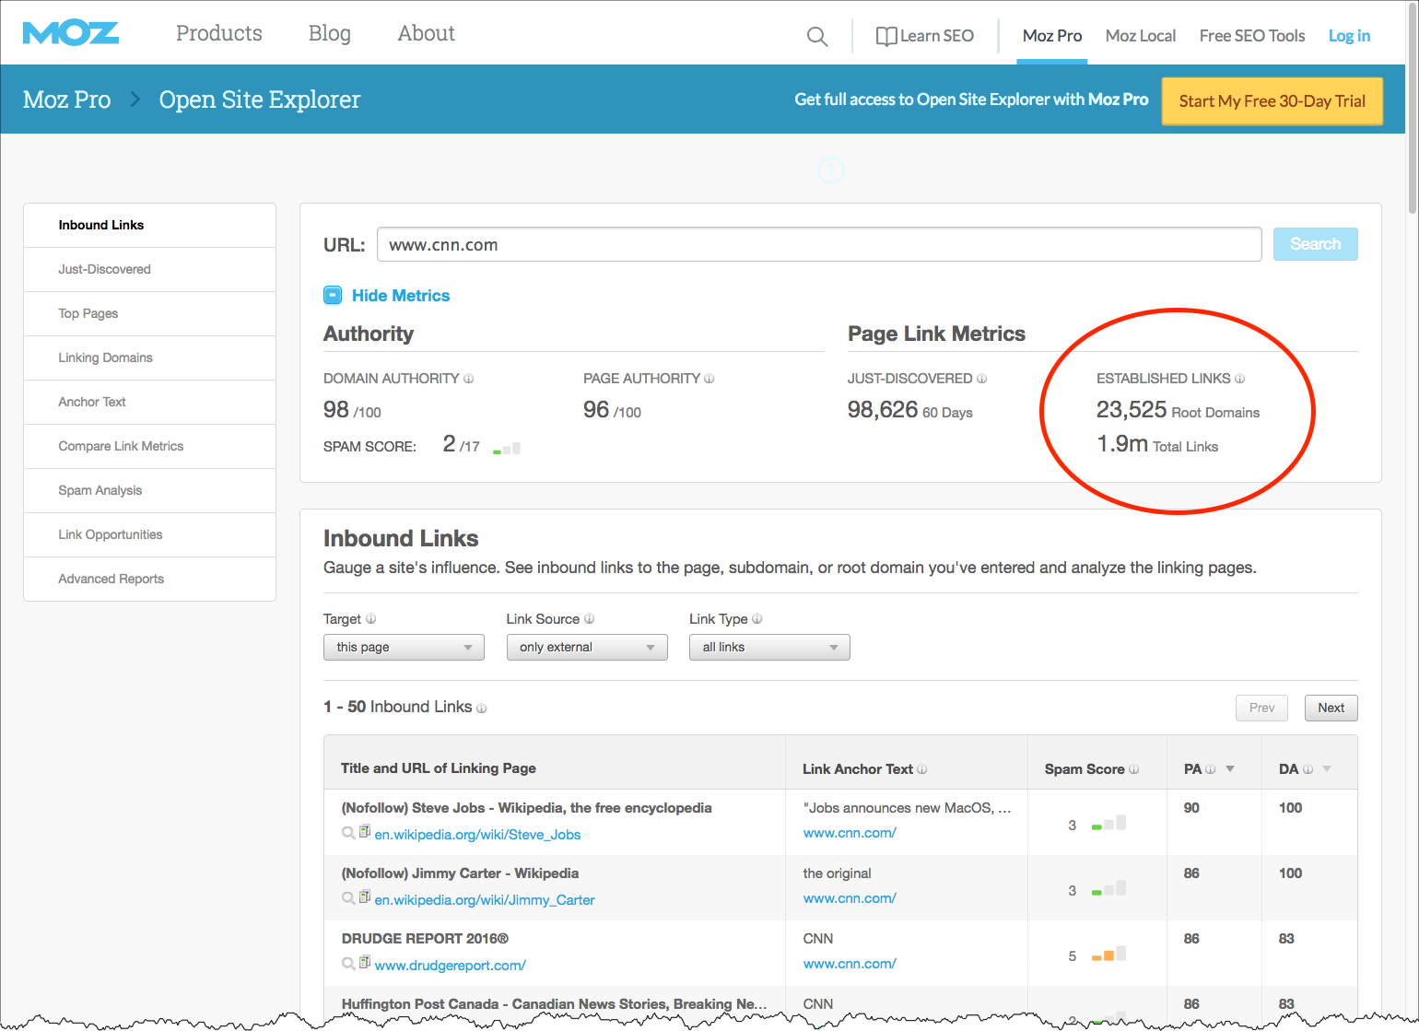
Measure quantity/quality of back links…

Slide 9
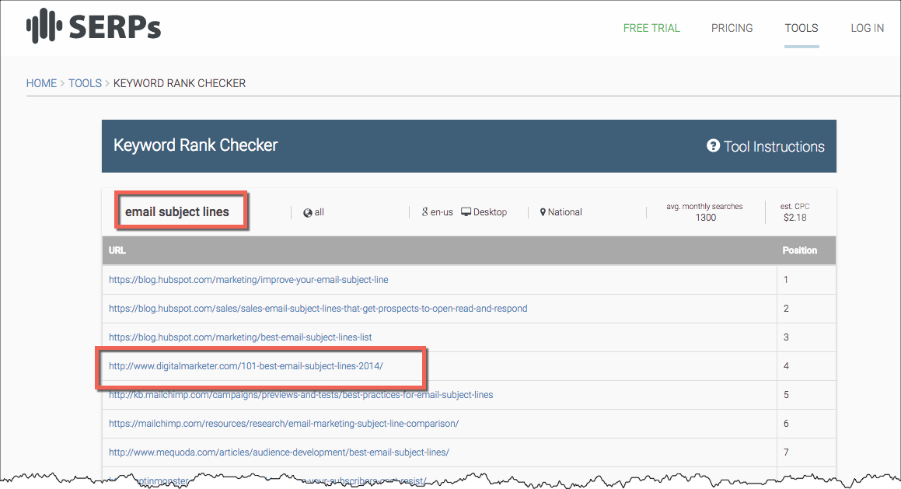
Measure keyword rankings…

Slide 10
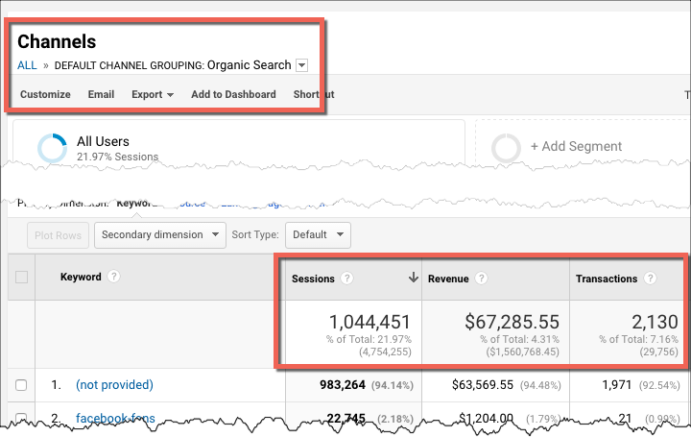
Measure conversions from search…

