Slide 1
Worship Space
Steve Elzinga

Slide 2
The physical space where you worship can communicate your Church vision
Common Church Vision: To walk with God, to walk with God’s people, and to share our God walk with those who do not have a walk with God.

Slide 3
Space and our walk with God
Creation
Genesis 3:8 Then the man and his wife heard the sound of the Lord God as he was walking in the garden in the cool of the day
Holy Ground
Exodus 3:5 God said. “Take off your sandals, for the place where you are standing is holy ground.
The Temple

Slide 4
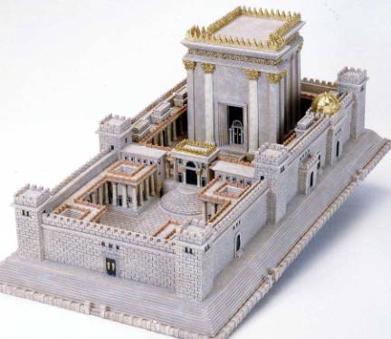

Slide 5
Space and our walk with God
Creation
Genesis 3:8 Then the man and his wife heard the sound of the Lord God as he was walking in the garden in the cool of the day
Holy Ground
Exodus 3:5 God said. “Take off your sandals, for the place where you are standing is holy ground.
The Temple
Cathedrals

Slide 6
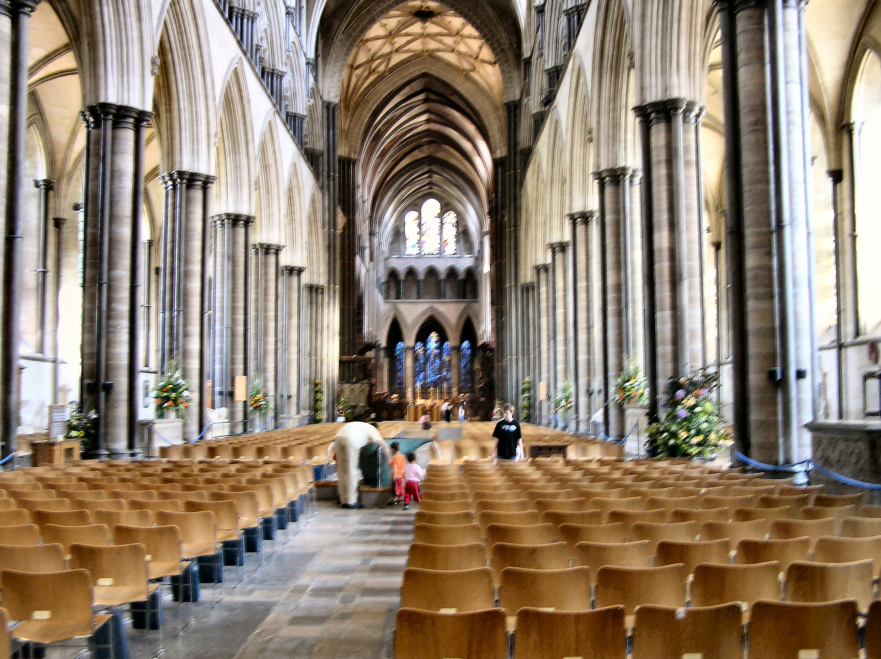

Slide 7
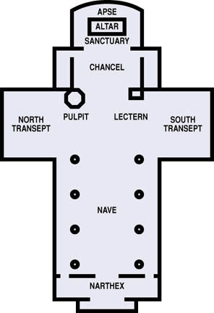

Slide 8
Space and our walk with God
Churches
High ceiling
Furniture
Pulpit
Baptismal Font
Lord’s Table

Slide 9
Space and our walk with each other
In the home
Small group
Group of 50 or more
Note: most churches were built in the portrait orientation
New churches tend to build in the landscape orientation

Slide 10
The advantages of the landscape orientation
The people see each other and feed off from each other (i.e. a football stadium)
You can still see what is happening on the stage but the stage is not everything
The people can be closer to the front of the stage

Slide 11
The disadvantages of the landscape orientation
Controlling sound is more difficult
People on stage must be aware of angle as people are more spread out

Slide 12
Space and the sharing of our walk with God with those who do not yet have a walk
Back rows are for visitors, not church members
Create worship space that is inviting
Create worship space that is not intimidating

