Slide 1
Roman Government in Republic
Various Assemblies—representative government —Senate (only from Patrician families-served for life) and Committee of 100 and the Council of the Plebs (only from the freemen classes, aka the Plebeians); various offices enact laws.
Each “elected” officials, the Council of Plebs chose the Tribunes. Committee of 100-chose 2 Consuls, -one year term. Senate “advised” the Consuls.
Consuls(2) select the generals, in times of emergency, appoint a “dictator”

Slide 2
Roman Society during Republic
Family background—Patrician or Plebian
Citizenship key: extended to all Italy—later to Spain and Gaul—Julius Caesar
Free or slave: wealthy or poor: city or farm
Army and navy

Slide 3
Roman Legions
Citizen, self funded army : Legion Republic, 5000—each Consul commanded a Legion—others called up when needed...under direction of Senate. Later in Republic—funded by “generals”—legions more loyal to general than to Rome…Julius Caesar, Marc Anthony, Octavian…
Life long legionaries, auxiliaries (way to become a citizen), knights (wealthy class), camp followers, including families—10,000? Founded cities and towns.
Most occupied or conquered areas allowed to govern themselves, provided taxes paid/troops provided: often Rome appointed local leaders—e.g. Herod the Great in Judaea

Slide 4
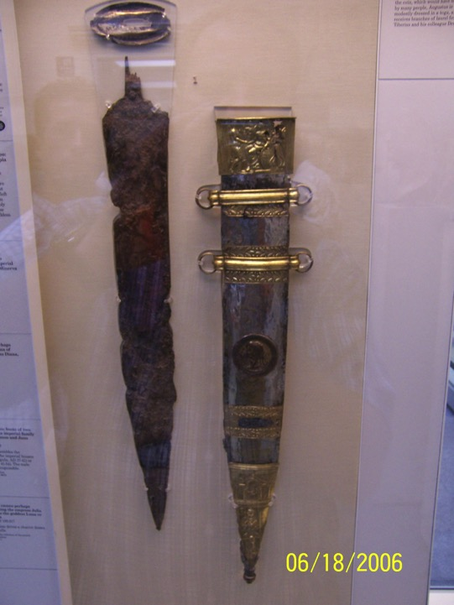

Slide 5
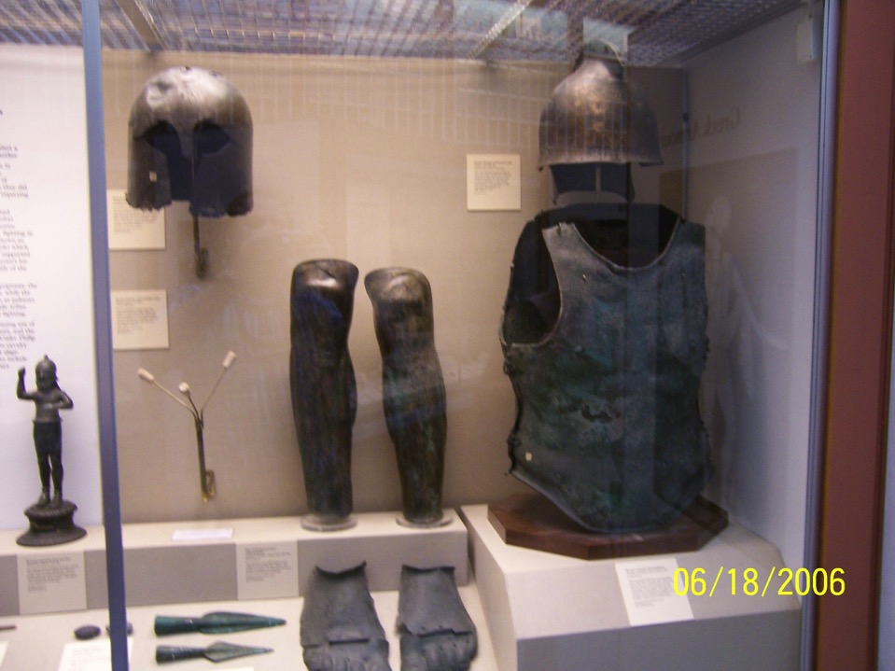

Slide 6
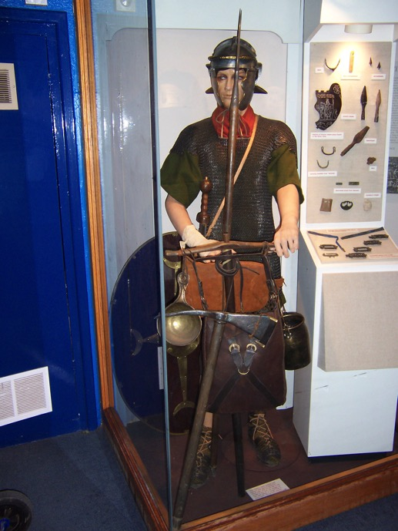

Slide 7
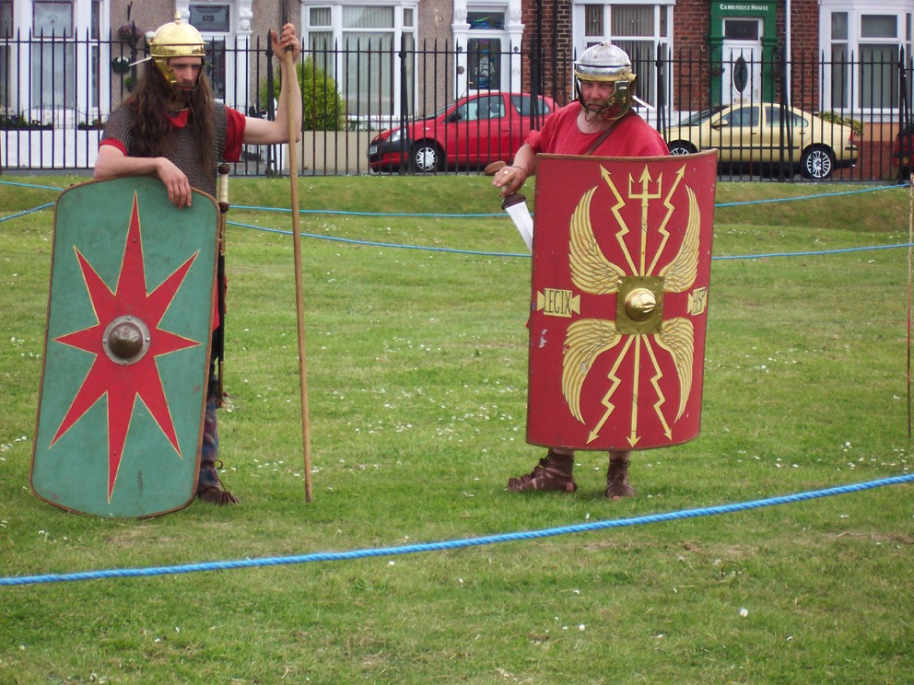

Slide 8
Social Life
Class society, with wealthy families in control
Some free citizens—small businesses
Slave based ---varied social status

Slide 9
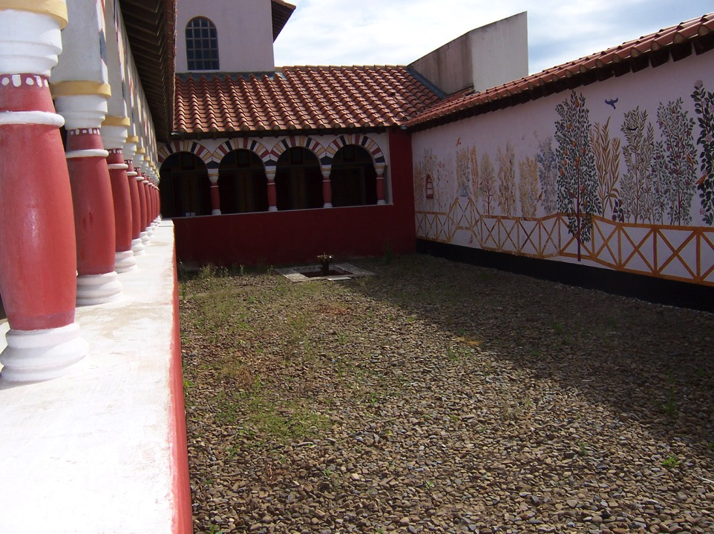

Slide 10
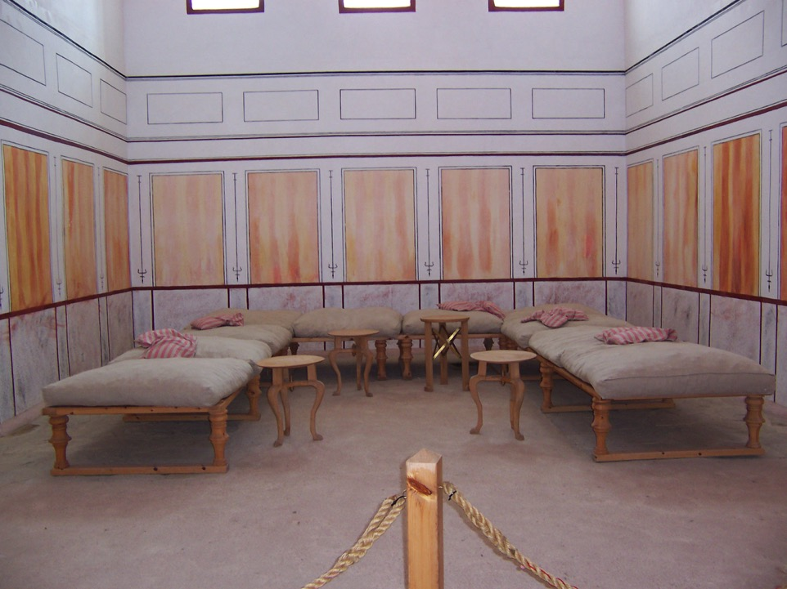

Slide 11
End of Republic
1. Wealthy, “private armies”, Pompey, Crassus, Julius Caesar. Civil Wars—wars among wealthy.
2. Lepidus, Marc Anthony, Octavian: Octavian finally defeats

Slide 12
Roman Empire 31 B.C.-476 A.D.
Julius Caesar---Dictator, control of Rome, dictator 49 B.C.
Octavian, heir, named Emperor 31 B.C.; Caesar Augustus.
Senate control provinces—appointed governors; Imperial provinces—owned directly by Augustus; e.g. Egypt breadbasket of Rome

Slide 13
Imperial Expansion
Legions under order of Emperor and Senate.
Solidified grip on Med., expanded north to North Sea and Britain; East into Germany and central Europe.
Legions, not war, guarding borders, construction crews---roads, water systems, buildings---slave labor too.
Mercenaries: become citizens

Slide 14
Roman Culture
Technicians and adapters—builders-concrete, design-arch; lawyers- rhetoric; artisans: Greek/Egyptian themes; writers-Greek forms (exception of satire); religion-pantheon mostly adapted from neighbors-mostly tolerant as long a loyal to Rome and Emperor—religion provided order, control; threats stamped out--
Slave based; urban poor entertained with games and the “dole”

Slide 15
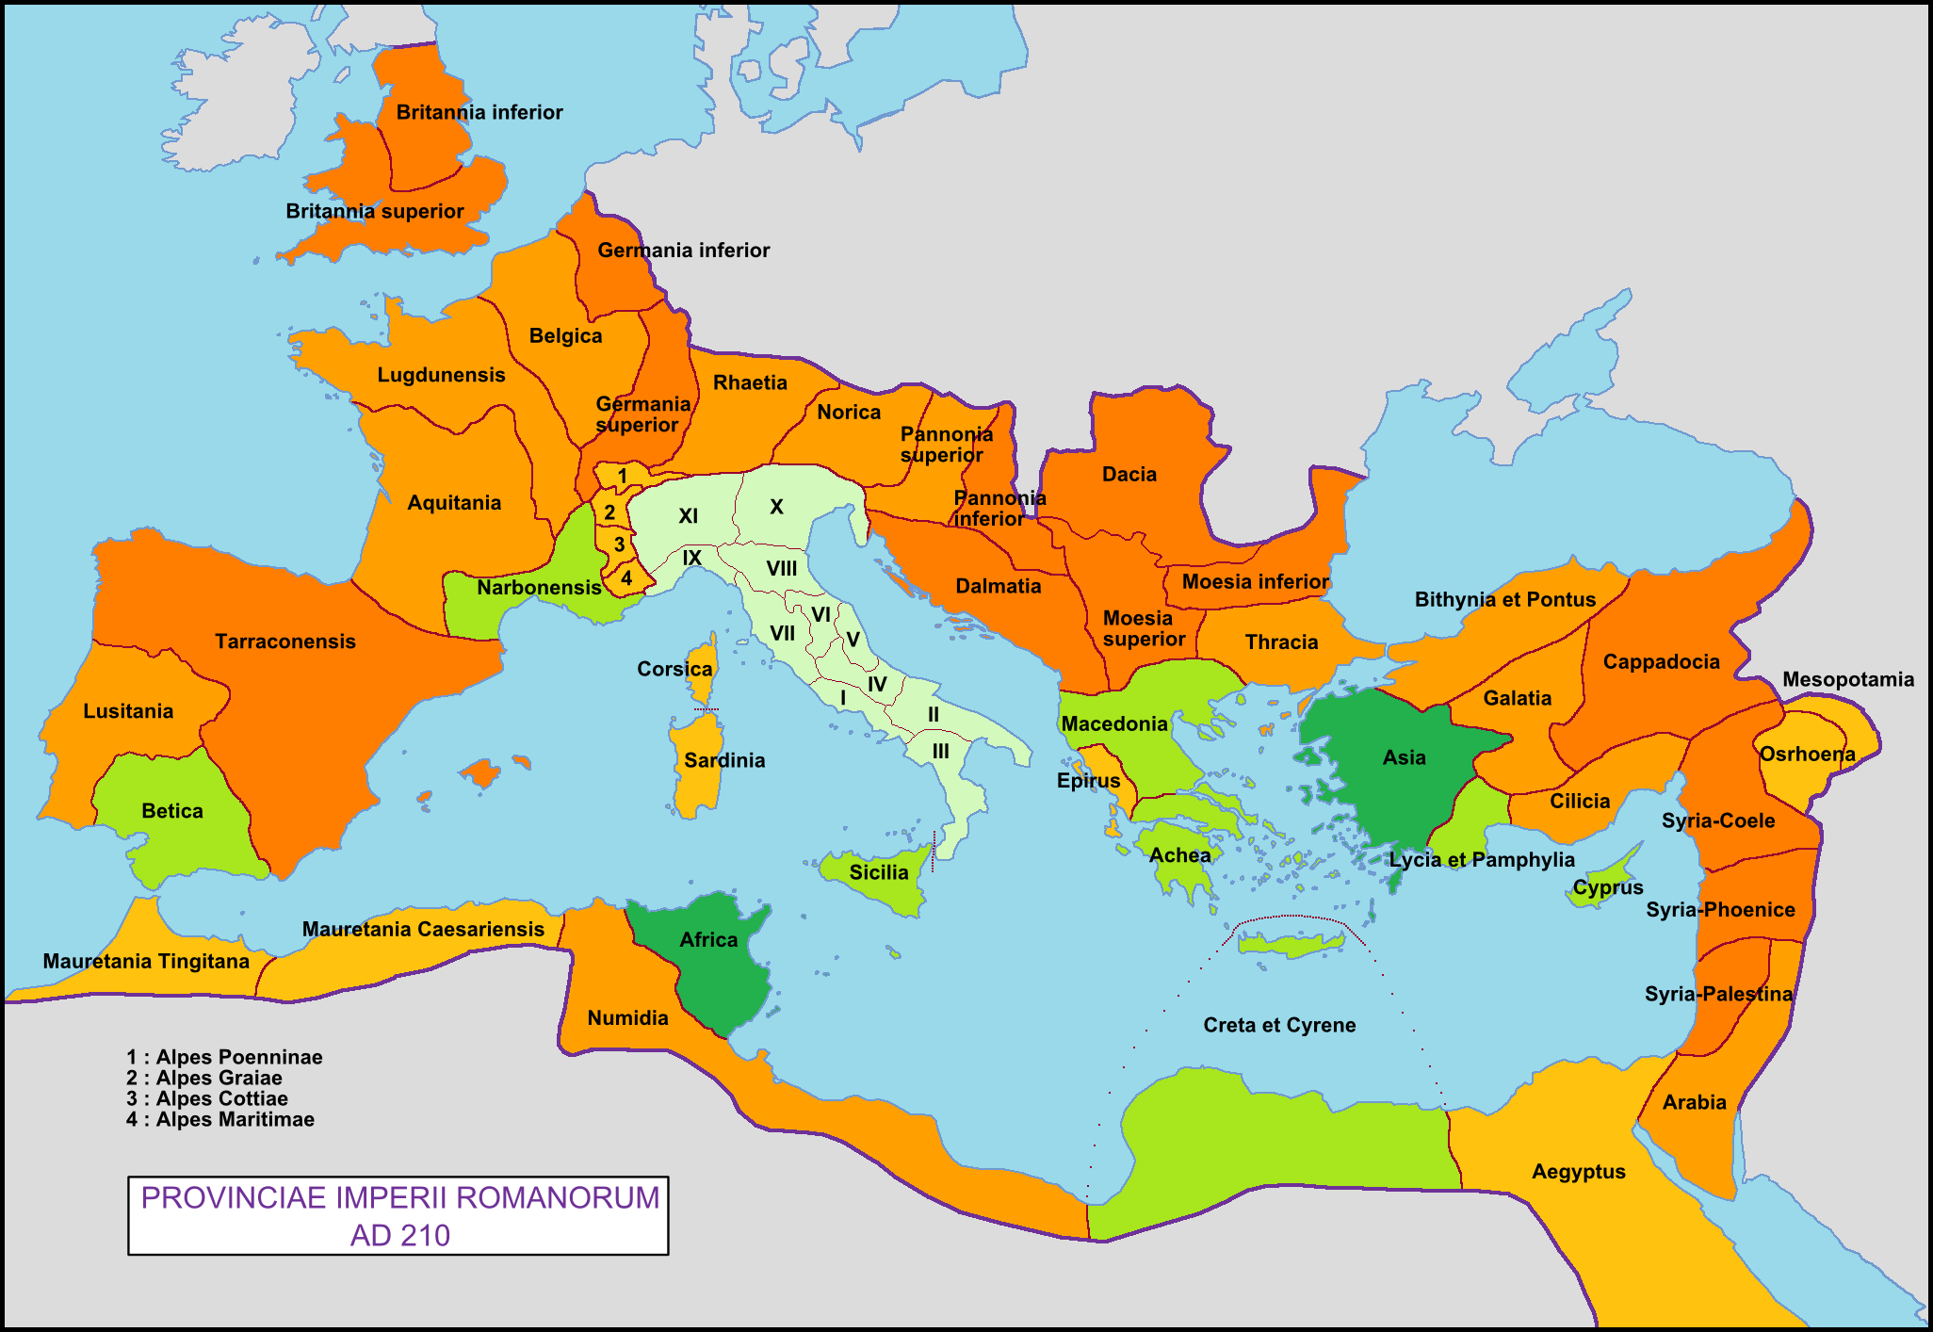
https://upload.wikimedia.org/wikipedia/commons/9/93/Roman_Empire_with_provinces_in_210_AD.png

Slide 16
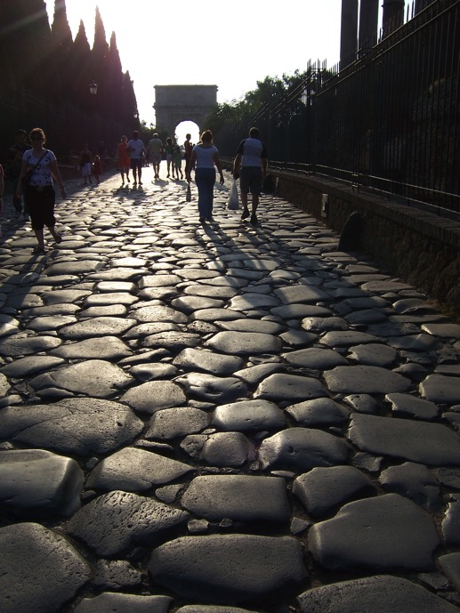

Slide 17
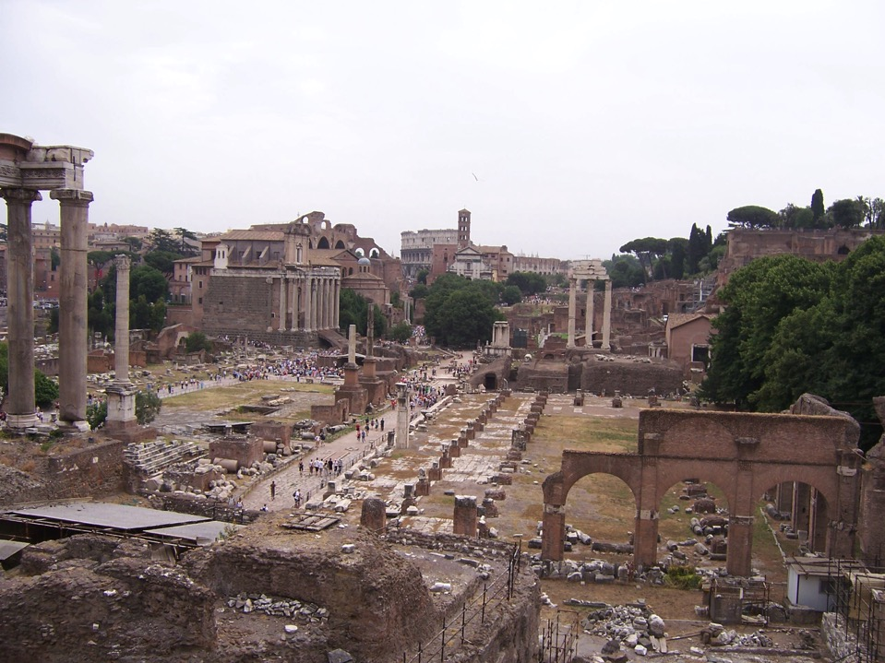

Slide 18
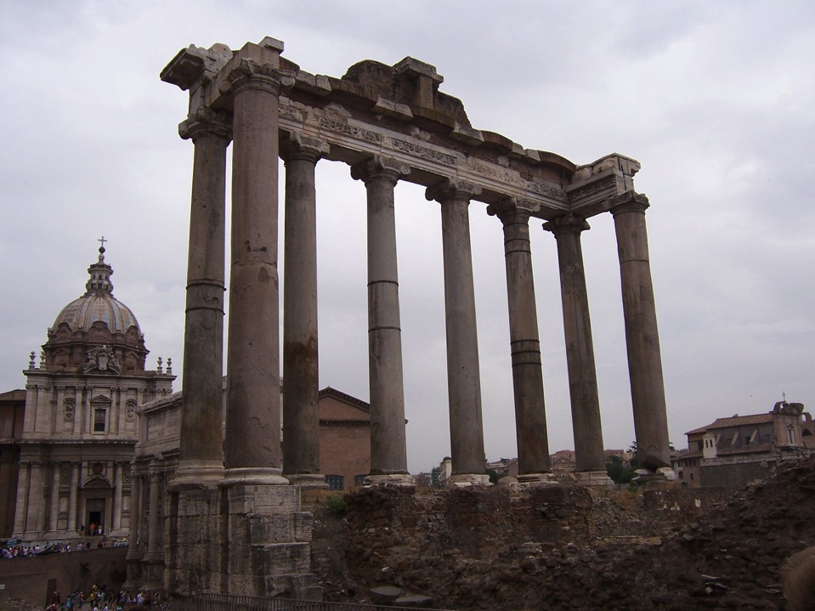

Slide 19
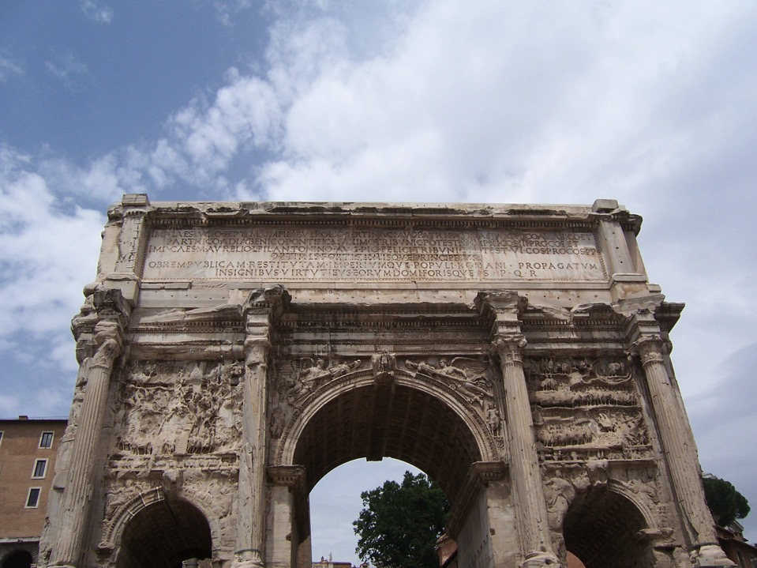

Slide 20
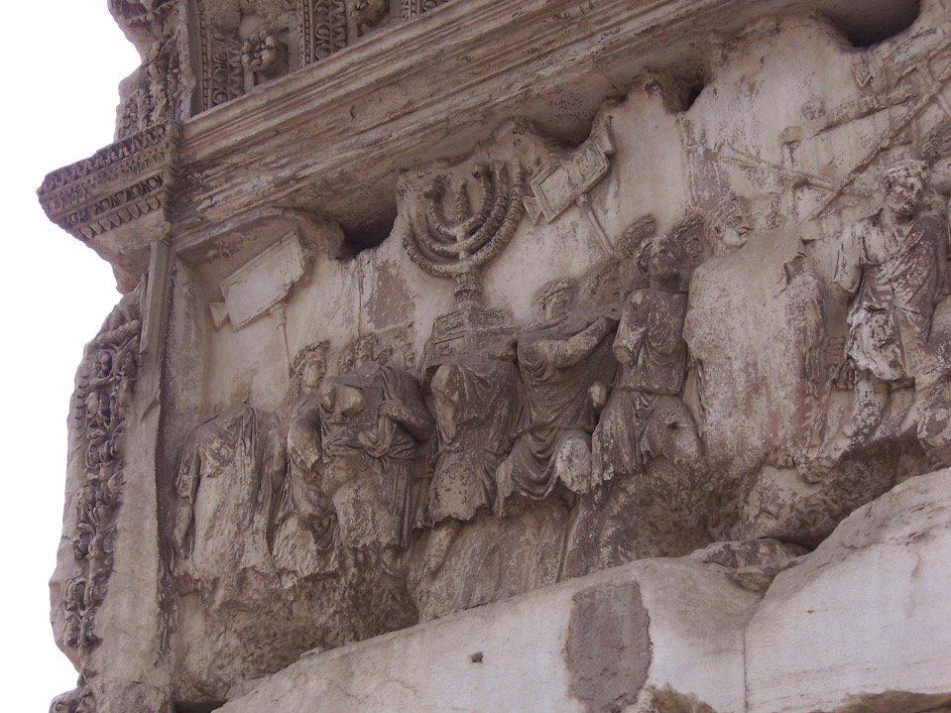

Slide 21
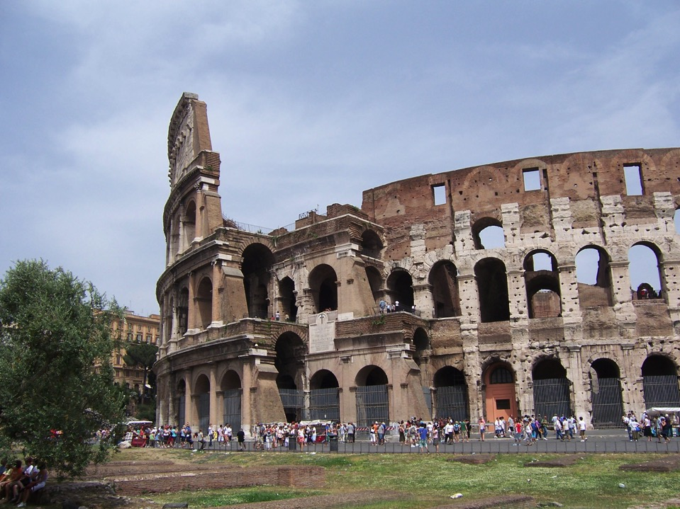

Slide 22
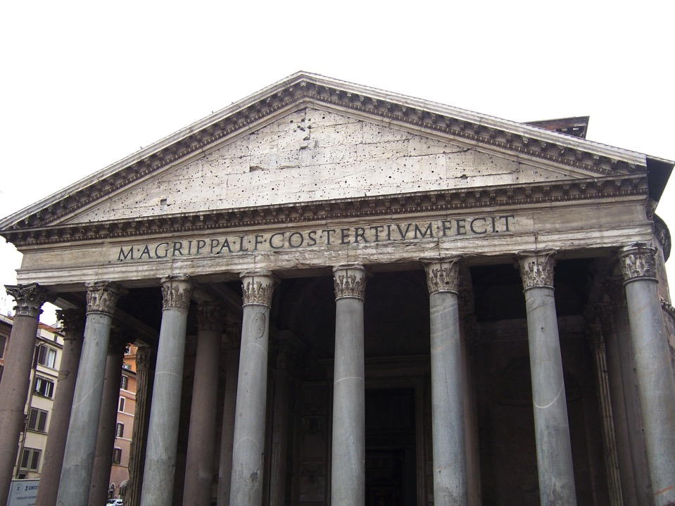

Slide 23
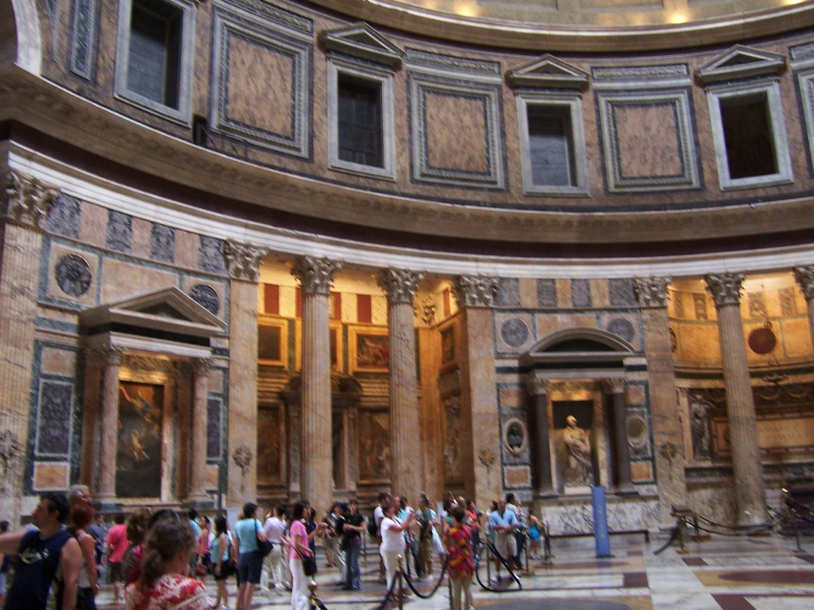

Slide 24
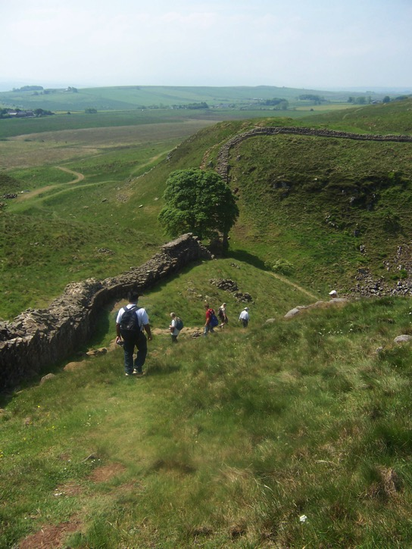

Slide 25
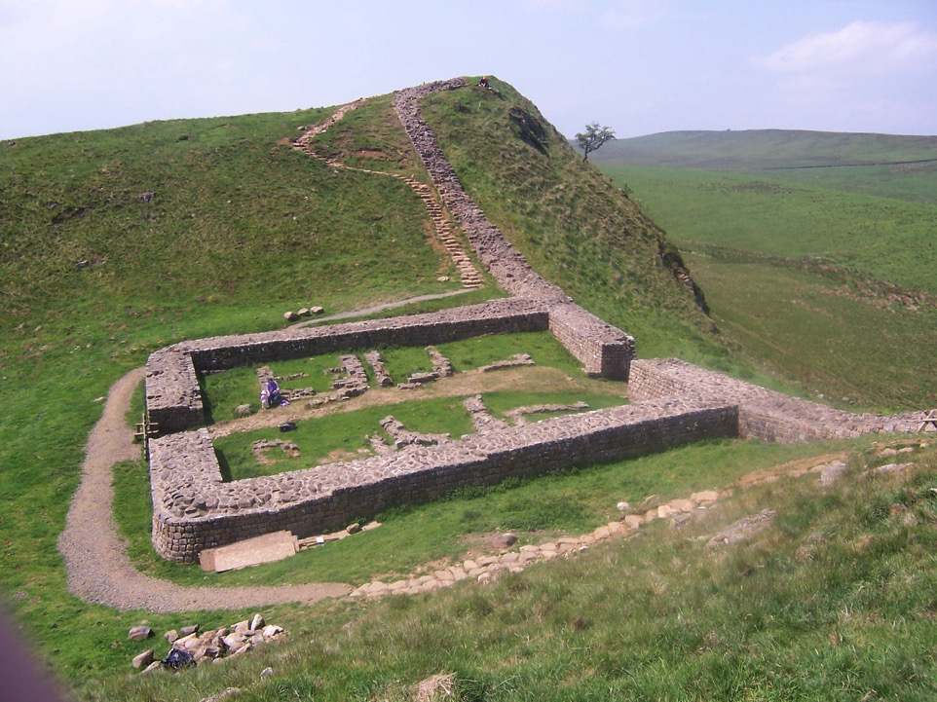

Slide 26
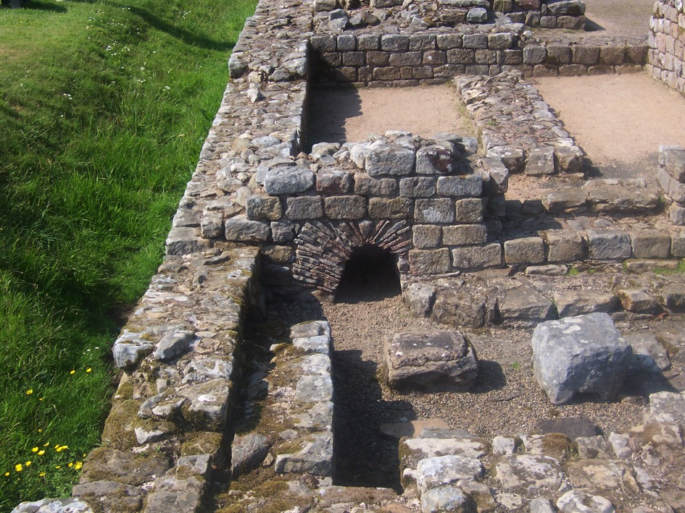

Slide 27
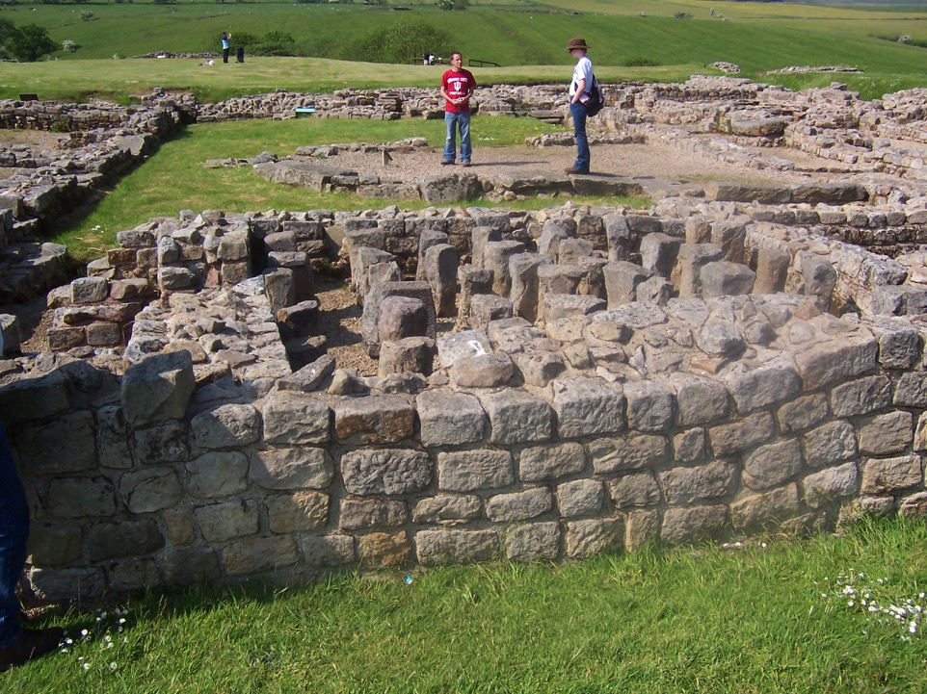

Slide 28
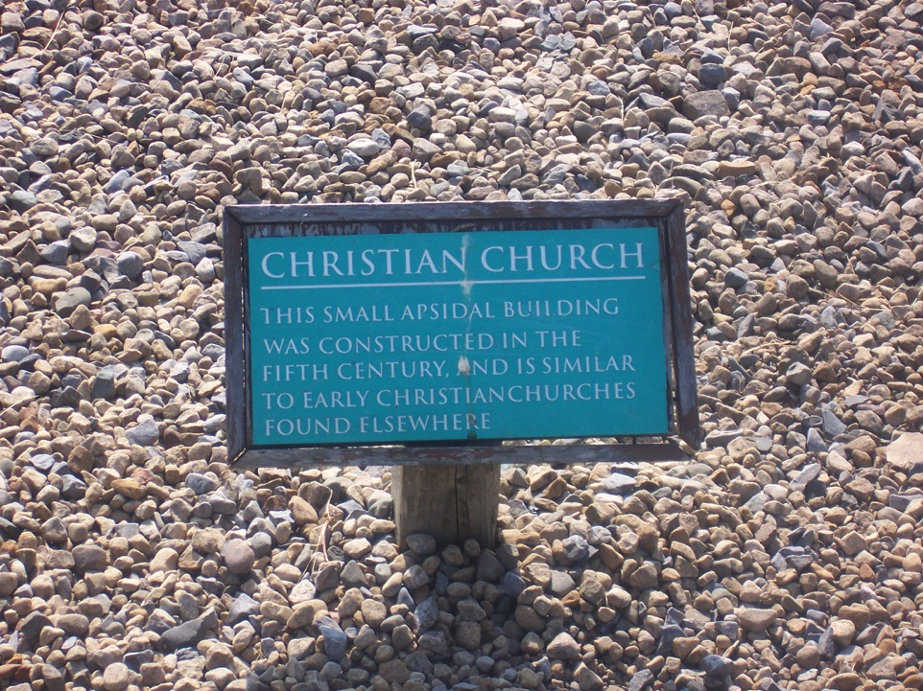

Slide 29
Divided Roman Empire
Emperors –many assassinated
3rd Century Imperial Crisis 235-284 A.D. Warring generals….Diocletian in 285 A.D. divides into Western and Eastern Empires.
Constantine the Great 312 A.D. Reunites briefly, founds Constantinople, capital of East: Byzantium. Makes Christianity preferred religion of Empire-317

Slide 30
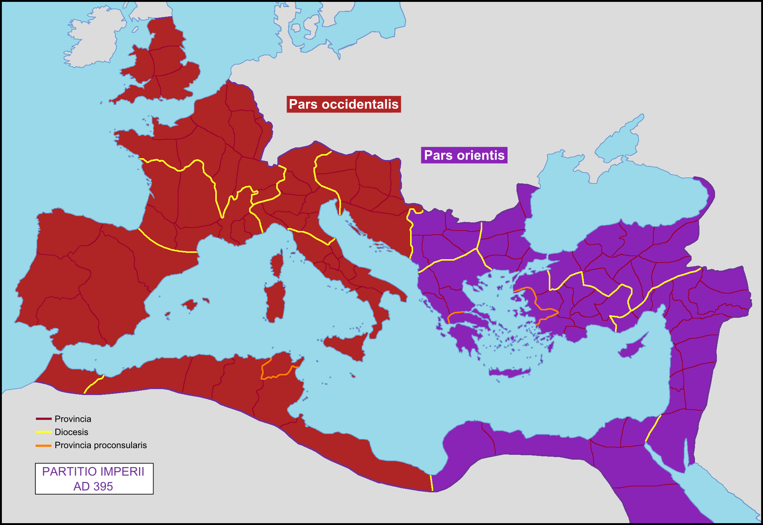
https://upload.wikimedia.org/wikipedia/commons/4/46/Partition_of_the_Roman_Empire_in_395_AD.png

Slide 31
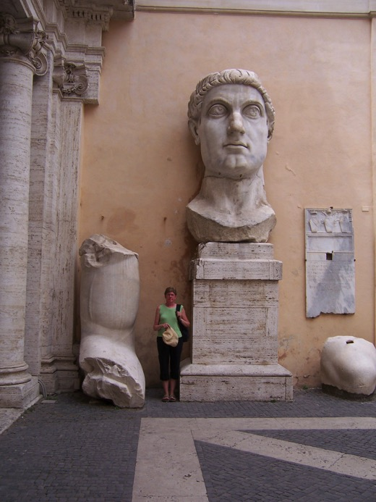

Slide 32
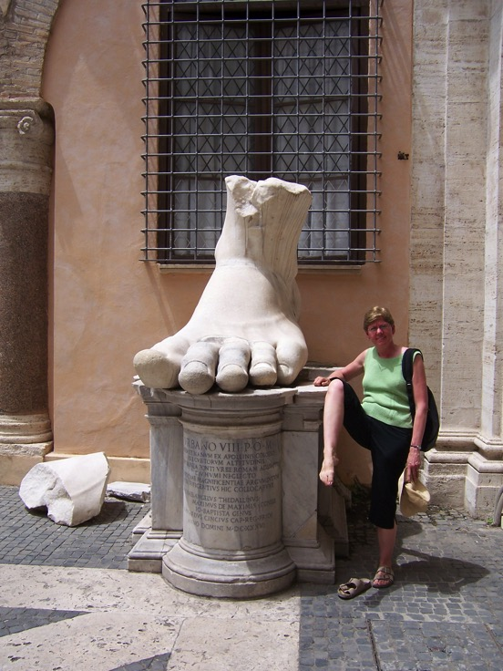

Slide 33
Early Christianity
1. First generations: Jewish sect---Paul, gentile world.
2. Popular among lower classes, and a few wealthier women
3. Under suspicion as a “mystery cult”---not patriotic: Pliny Book 10, letters 96-97
4. More common in East than West

