Slide 1
Section Three:
1. International Trade
2. Clash of Religions
3. Hostile Take-Overs (Conquests)
4.Political/Social Organization
5. Cultural/Social Developments

Slide 2
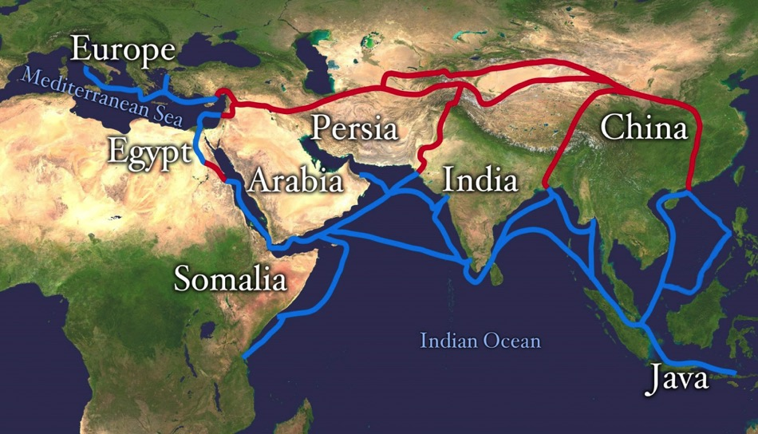
“Silk” Routes 200-1500 A.D.

Slide 3
Reading Assignment
Article on the Silk Road by Joshua Mark
www.ancient.eu/Silk_Road/

Slide 4
International Trade 1000-1500 A.D.
“Silk Road”---overland and sea routes that connect China, Asia, India, Africa, Europe by means of trade and cultural exchange.
Began in 2nd Century B.C., and continued until 16th Century A.D..
Means of wealth for Rome/Europe, China, India, Middle East, Central Asia, East Africa
Trade as a means for peace

Slide 5
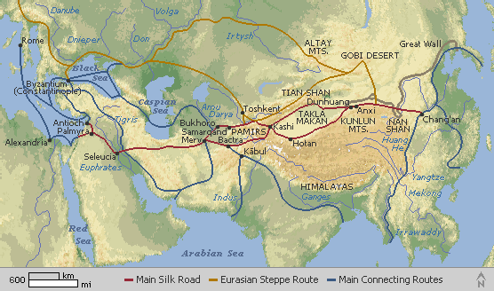
Silk Road Trade Cities

Slide 6
Cultural Exchanges
1. Luxury goods
2. Technologies: gunpowder, paper, silk production, different notions of government
3. Religions: Islam, Buddhism, Christianity
4. Languages
5. Diseases: Black Plague

Slide 7
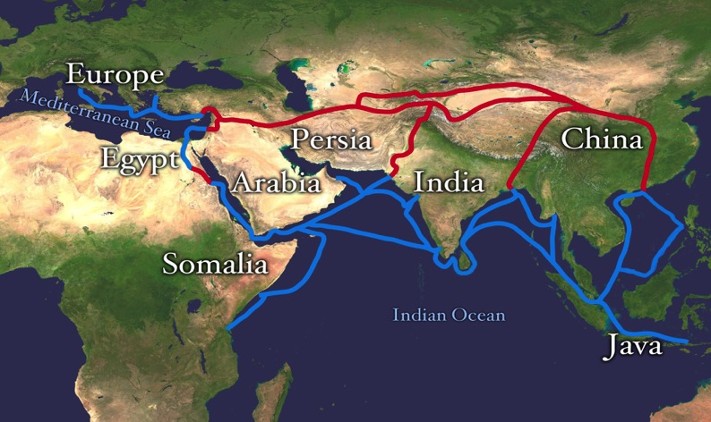
Sea Routes
https://upload.wikimedia.org/wikipedia/commons/9/9e/Silk_route_copy.jpg
https://upload.wikimedia.org/wikipedia/commons/9/9e/Silk_route_copy.jpg

Slide 8
Spice Routes
“The history of these maritime routes can be traced back thousands of years, to links between the Arabian Peninsula, Mesopotamia and the Indus Valley Civilization. The early Middle Ages saw an expansion of this network, as sailors from the Arabian Peninsula forged new trading routes across the Arabian Sea and into the Indian Ocean. Indeed, maritime trading links were established between Arabia and China from as early as the 8th century AD. Technological advances in the science of navigation, in astronomy, and also in the techniques of ship building combined to make long-distance sea travel increasingly practical. Lively coastal cities grew up around the most frequently visited ports along these routes, such as Zanzibar, Alexandria, Muscat, and Goa, and these cities became wealthy centres for the exchange of goods, ideas, languages and beliefs, with large markets and continually changing populations of merchants and sailors.”
https://en.unesco.org/silkroad/about-silk-road

Slide 9
Viking Trade Routes
Linked northern Europe with Middle East
Furs and slaves primary “goods”
Bullion economy, esp. silver

Slide 10
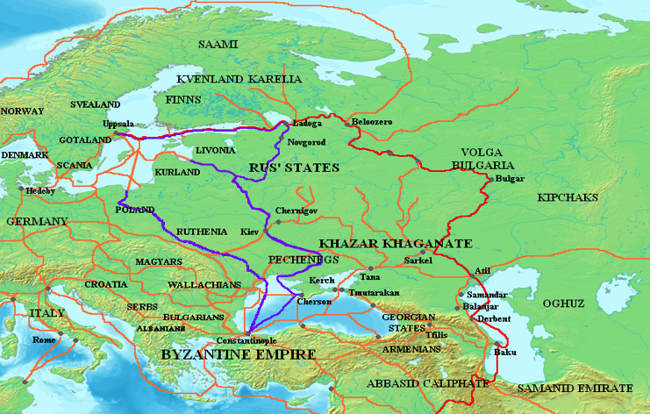
Viking trade routes

Slide 11
Disruptions of Trade Routes between 1000 and 1500 A.D.
Environmental Changes—drying of Steppes
Viking Decline/ Rise of Kiev (after 1100)
Turkish/Crusader Invasions and conquests: Byzantium, India, Egypt, East Africa (ca. 1050-1500)
Mongolian Invasions: (1200-1400)

Slide 12
Inca Roads READING ASSINGMENT Article by Mark Cartwright: The Inca Road System https://www.ancient.eu/article/757/the-inca-road-system/

Slide 13
Inca Roads
Two main routes: Royal Road and Costal Road ran north and south…linked west coast of South America
Used for military, messengers (runners), and official traders….lamas and alpaca caravans
Symbolized Inca dominance over region
Also linked over the Andes to Argentina
Some evidence of linkage with Amazon basin

Slide 14
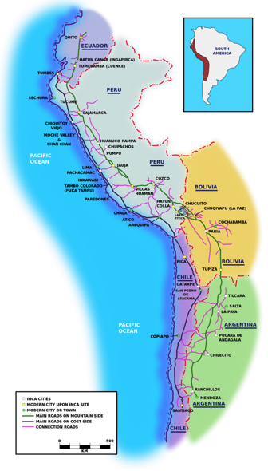
https://upload.wikimedia.org/wikipedia/commons/thumb/5/53/Inca_roads-en.svg/2000px-Inca_roads-en.svg.png

Slide 15
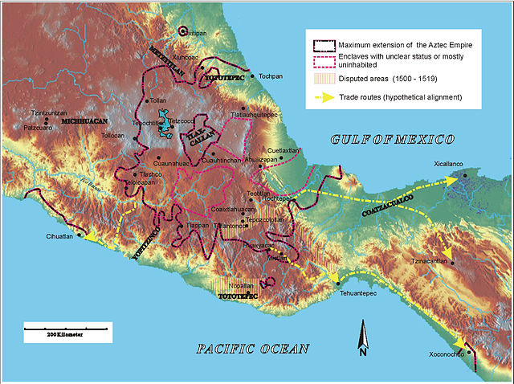
Aztec Trade Routes
https://upload.wikimedia.org/wikipedia/commons/thumb/6/62/AztecEmpire.jpg/640px-AztecEmpire.jpg

