Slide 1
Leadership 23
Creating a Strategic Plan

Slide 2
Vision
Culture
Prayer and Planning
Leader

Slide 3
Prayer and Planning

Slide 4
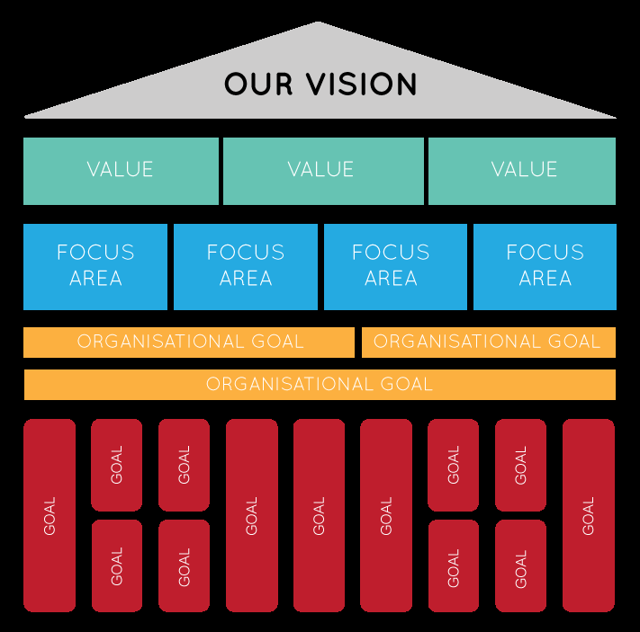

Slide 6
What has God called us to be and become through the mission and vision?
Values that reflect
The completion of the mission

Slide 7
Tradition
Relevance
Christian School
Community
Ethnic
Multi-ethnic
Old music
Contemporary

Slide 9
Focus Areas
Worship
Children’s
Youth
Outreach
Preaching
????

Slide 10
Vision: To see 100 people come to faith in the next year through our ministry.

Slide 11
Vision: To see 100 people come to faith in the next year through our ministry.
Core Value: We will be an outreaching ministry.

Slide 12
Vision: To see 100 people come to faith in the next year through our ministry.
Core Value: We will be an outreaching ministry.
Focus Areas:
Worship Children Men’s

Slide 13
Worship
Give an invitation regularly
Make music relevant and inviting
Hold up the value of being outreaching in worship
Preach on relevant topics with the
light of Scripture

Slide 14
Outreach
Training in evangelism
Events that touch the community
Welcome training
Children’s
Offer parenting training?
Events outside the church?
e.g. of Central Weslyan
Training volunteers in welcome

Slide 15
Vision
Renewed Values
Focus Areas

Slide 16
Vision
Renewed Values
Focus Areas
Goals

Slide 18
Goals must be SMART
- Specific
Who
What
Where
When
Which
Why

Slide 19
Goals must be SMART
- Specific
- Measurable
You know when it is reached

Slide 20
Goals must be SMART
- Specific
- Measurable
- Achievable
Within the realm of the possible
“Undersell, Over-deliver”

Slide 21
Goals must be SMART
- Specific
- Measurable
- Achievable
- Realistic
It’s been done before

Slide 22
S | Specific | What will be accomplished? What actions will you take?
M | Measurable | What data will measure the goal? (How much? How many? How well?)
A | Achievable | Is the goal doable? Do you have the necessary skills and resources?
R | Relevant | How does the goal align with broader goals? Why is the result important?
T | Time-Based | What is the time frame for accomplishing the goal?

Slide 23
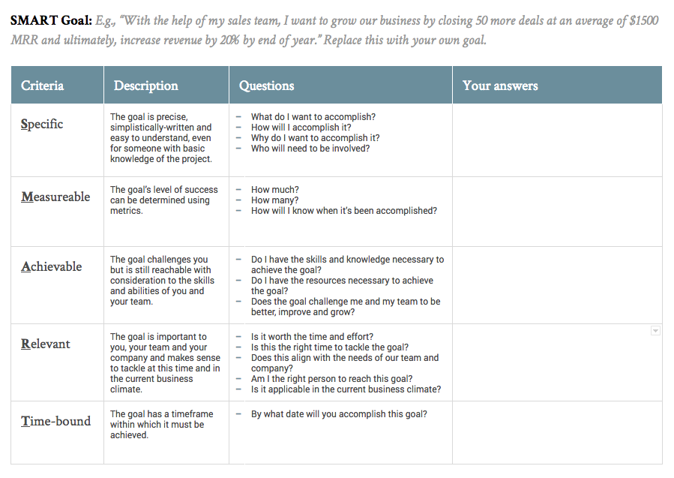

Slide 24
Goal Action Who? When?

