Slide 1
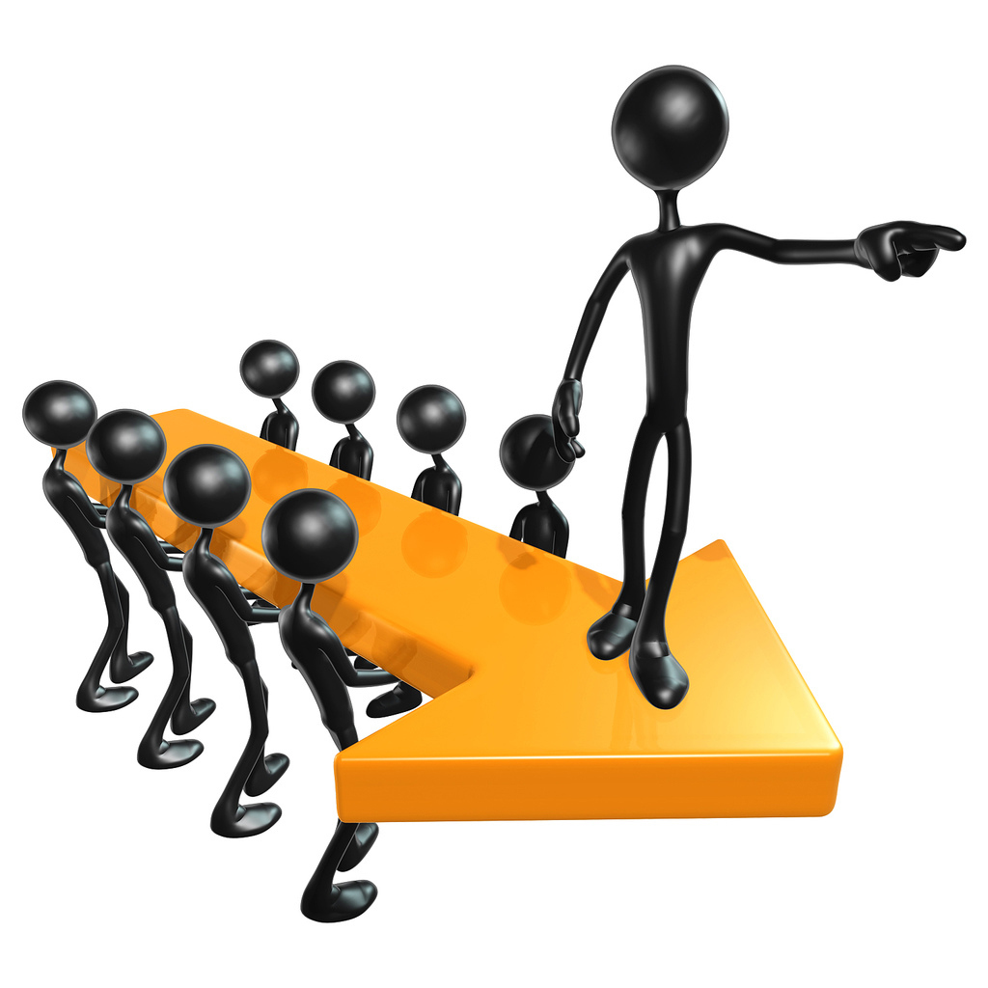
Leadership Session 6
Culture Introduction
and Definitions

Slide 2
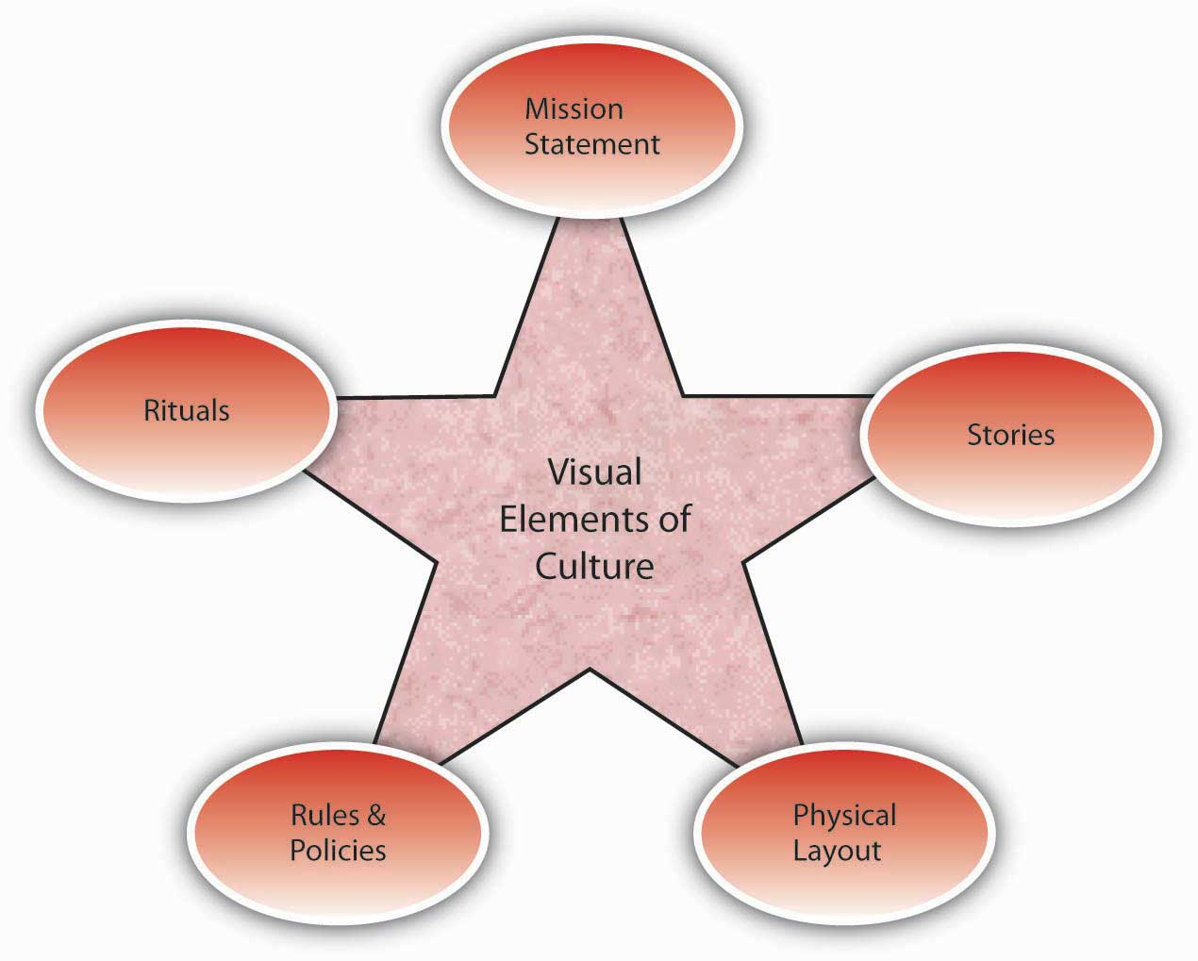
Vision
Culture
Prayer and Planning
Leader

Slide 4
Definitions:
Webster’s Dictionary: The integrated pattern of human behavior that includes thought, speech, action and artifacts.

Slide 5
Denham Grierson: The patterned way of life produced by a people through which its members are formed and shaped by the manner of their being.

Slide 6
Terry Deal: Culture is a concept that captures the subtle, elusive, intangible, largely unconscious forces that shape a society or work place. It is a potent shaper of human thought and behavior within organizations and even beyond its boundaries. Culture provides stability, fosters certainty, solidifies order and predictability and creates meaning.

Slide 7
A pattern
Thoughts
Words
Actions
Artifacts -- anything made by a
human

Slide 8
The way we do things here.

Slide 9
“Culture” from 1430
To cultivate the soil

Slide 10
Macro Culture

Slide 11
1900
Economy
Church life
Children’s Ministry
Youth Ministry
Agriculture
Family

Slide 12
1920
Major events
War
Automobile
1940
Depression
War
Move to the cities

Slide 13
1960’s
Societal Upheaval
Vietnam
1980’s
Globalization
Electronics
2000’s

Slide 14
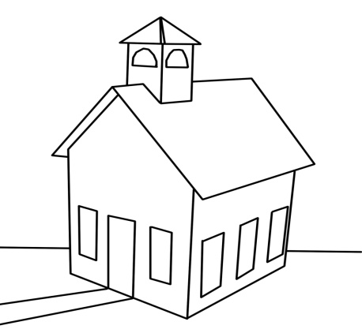
ttttttttrr
1900

Slide 15
1920’s

Slide 16
1940’s

Slide 17
1960’s

Slide 18
1980’s

Slide 19
2000’s

