Slide 1
FINANCIAL SECURITY SEMINAR “Become Your Own Bank”
&
Present
Alex Barrón
www.wealthheritage.com

Slide 2
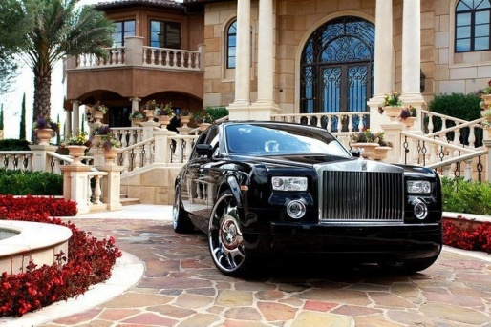
FINANCIAL SECURITY SEMINAR How to Become Your Own Bank
How to Finance Major Purchases
Take Control of Your Money - Become Your Own Bank
How to Protect Your Love Ones
How to Pay your Kids Education
How to Enjoy a Predictable Income and Better Retirement
By Alex Barrón
www. wealthheritage.com

Slide 3
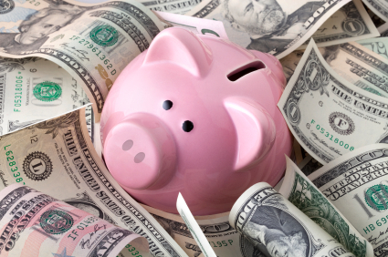
LESSON 2: HOW TO ACHIEVE FINANCIAL SECURITY? PAY YOURSELF FIRST!

Slide 4
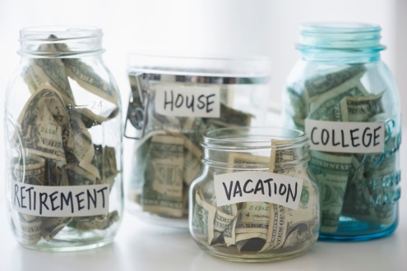
WHAT IS MONEY FOR?
SHORT TERM
For Living - Spending on Food, Clothes, Gasoline
To Pay Debts - What We Already Consumed
To Enjoy - Spending on Fun, Entertainment, Vacations
For Protection - In case something bad happens
LONG TERM
For Large Purchases - Cars and House
To Save - Children's Education
For a Business - Save Capital and Grow
To Invest - Our Retirement

Slide 5
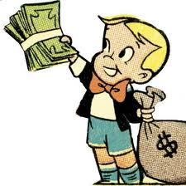
Rich vs. Middle Class vs. Poor
Poor
Win $100
- Spend $101
₌₌₌₌₌₌₌₌₌₌₌₌₌₌₌₌₌₌₌₌₌₌
Borrow =
($1)
Middle Class
Win $100
- Spend $100
₌₌₌₌₌₌₌₌₌₌₌₌₌₌₌₌₌₌₌₌₌₌
Net Income= $0
Rich
Win $100
- Spend $99
₌₌₌₌₌₌₌₌₌₌₌₌₌₌₌₌₌₌₌₌₌₌
Save = $1

Slide 6
How to Pay Yourself First
Rich DO NOT Spend First
Earn $100
- Spend $90
₌₌₌₌₌₌₌₌₌₌₌₌₌₌₌₌₌₌₌₌₌₌
Save = $10
Rich Save First
(Pay Themselves)
Earn $100
- Pay Yourself First $10
₌₌₌₌₌₌₌₌₌₌₌₌₌₌₌₌₌₌₌₌₌₌
Spend = $90

Slide 7
Rule #1: Pay Yourself First
Income
- Expenses
Net Income (At least 10%)
How?
1.) Earn More Or
2.) Spend Less
The Key to Financial Freedom
1.) Invest in Assets
2.) Eliminate Liabilities
Pay Yourself First!

Slide 8
Pay Yourself
Start a Tree of Wealth
Save 10% Every Month
Do it first
Increase your income or cut your expenses
Do it Consistently
Financial Freedom is a Daily Decision
Dare to Prosper!

Slide 9
Instead of Using 1 Account and Spending All Your Money
EXPENSES
INCOME
Credit Cards
BANK
Car Loan
Salary $$
Student Loan
Mortgage
Daily Expenses

Slide 10
Use 2 Accounts and Save Before Spending!
SAVINGS
INCOME
SAVINGS
Pay Yourself FIRST!
Salary $$
EXPENSES
Credit Cards
EXPENSES
Car Loan
Student Loan
Mortgage
Daily Expenses

Slide 11
The Majority tries to Save & Invest While they Pay down Debt
SAVE & INVEST
PAY
DEBTS
KIDS UNIVERSITY(529)
CREDIT CARD
INCOME
HELOC
MUTUAL FUND (401k)
LINE OF CREDIT
MUTUAL FUND (IRA)
STUDENT LOAN
PERMANENT LIFE INSURANCE
CAR LOAN 1
INVESTMENT STOCK
MARKET
CAR LOAN 2
MORTGAGE
BUSINESS
TEMPORARY LIFE INSURANCE

Slide 12
Use 2 Accounts, Consolidate Your Assets into “Your Own Bank”
YOUR OWN BANK
SAVINGS
Savings, CD’s
401(k)
IRA
529
Temporary Insurance
INCOME
X
X
Loans
X
X
X
Salary $$
Loan Payment
EXPENSES
X
EXPENSES
Credit Cards
Car Loans
X
Student Loans
Ask for a loan on “Your Own Bank” so that you eliminate debts faster.
Pay your loans to “Your Own Bank” later.
X
Mortgage
X

Slide 13
The Idea is to Save and Pay Debt at the Same Time
Monthly Premiums
Borrow Policy Loan
Savings
SAVINGS ACCOUNT
“YOUR OWN BANK” POLICY
Extra Payments
INCOME
Pay Back Policy Loan
CHECKING ACCOUNT
DEBT
Minimum Payments

Slide 15
Money Goes to Many Hands
DEBTS
Income $$
ASSETTS
Credit Cards
Medical Savings (HSA)
Car Loans
BANK
Life Insurance
University Savings
Plan 519
Student Loans
Retirement Account (401k)
Mortgage
Retirement Account (IRA)
Investment Savings
Business Savings

Slide 16
Money Goes to Many Hands
DEBTS
Income $$
ASSETTS
Bank 1
Bank 3
Bank 2
BANK
Insurance Company
Mutual Fund 1
University / Government
Mutual Fund 2
Constructor / Government
Investment Company 1
Investment Company 2
Bank 4

Slide 17
The 2 Most Important Questions of Your Life
WHAT DO YOU WANT?
WHY DO YOU WANT IT?

