Slide 1
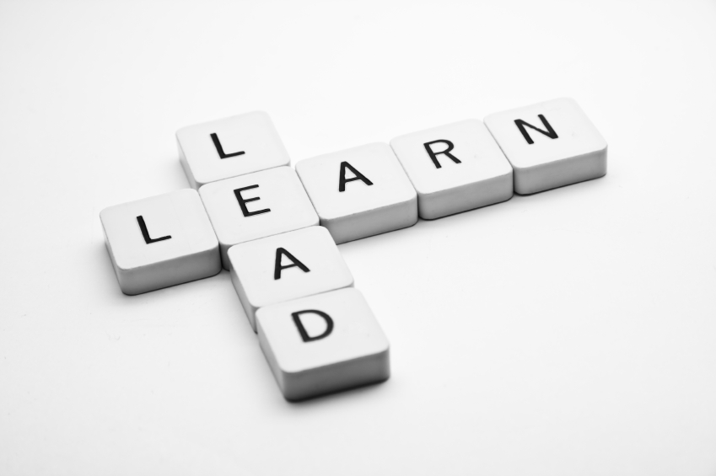
Learning To Lead
Session 4)
What Makes the
Leader?

Slide 2
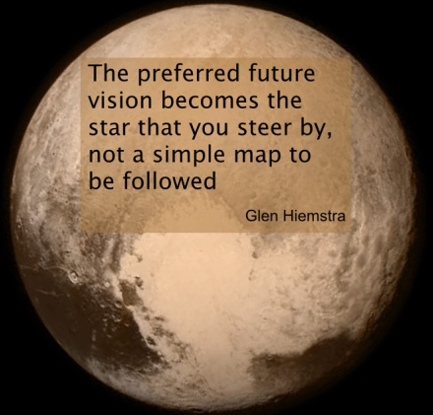
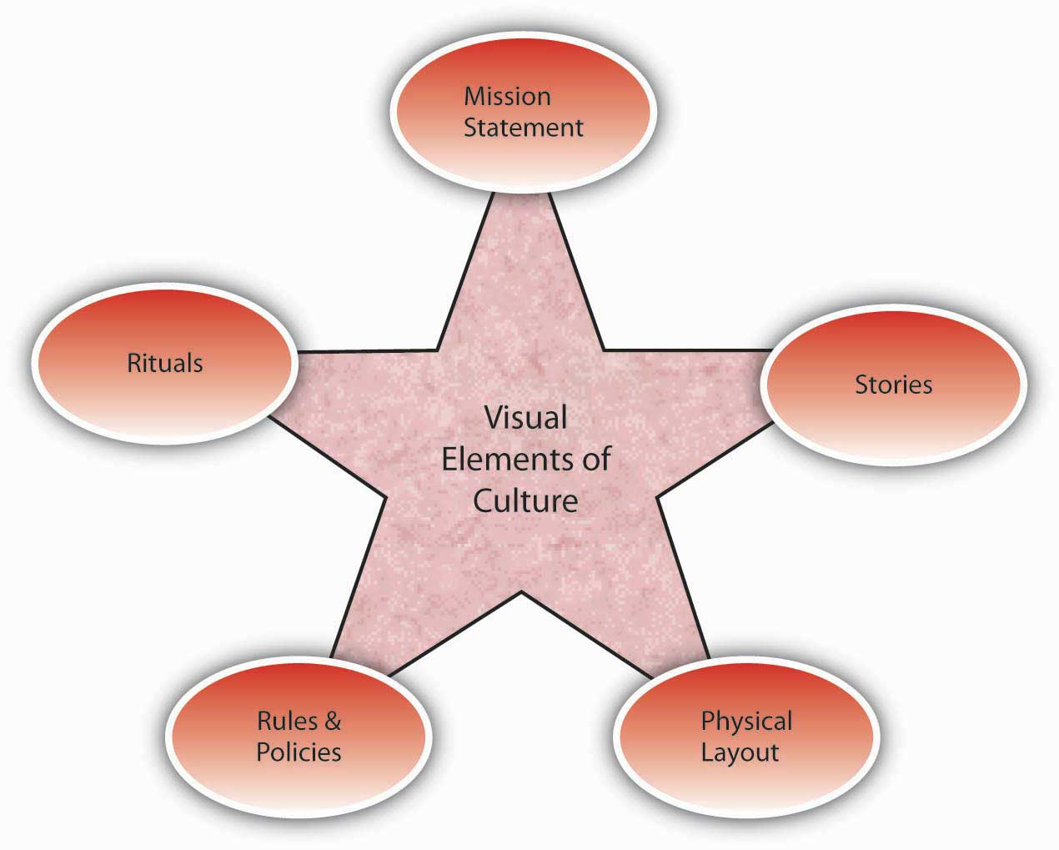
Vision
Culture
Prayer and Planning
Leader

Slide 3
A leader, with all his plusses and minuses, strengths and weaknesses, interacts with a group of people to define the culture (the way things are done here) in order to develop a vision for a preferable future, and then provides the impetus for doing the actions necessary to bring about that future with plans and prayer.

Slide 4
The Leader
What goes into making you the leader you are today?
Baggage
Birth Order
Education
Family of Origin

Slide 5
The Leader
What goes into making you the leader you are today?
Baggage
Personality
Meyers-Briggs
Introvert-Extrovert
Sensing-iNtuition
Thinking-Feeling
Judging-Perceiving

Slide 6
The Myer-Briggs Type Indicator (MBTI) is a personality assessment that scores individuals, assigning them four letters. The Myers-Briggs Foundation explains the 4 functions as:
Favorite world: Do you prefer to focus on the outer world or on your own inner world? This is called Extraversion (E) or Introversion (I).
Information: Do you prefer to focus on the basic information you take in or do you prefer to interpret and add meaning? This is called Sensing (S) or Intuition (N).
Decisions: When making decisions, do you prefer to first look at logic and consistency or first look at the people and special circumstances? This is called Thinking (T) or Feeling (F)
Structure: In dealing with the outside world, do you prefer to get things decided or do you prefer to stay open to new information and options? This is called Judging (J) or Perceiving (P).

Slide 7
www.humanmetrics.com

Slide 8
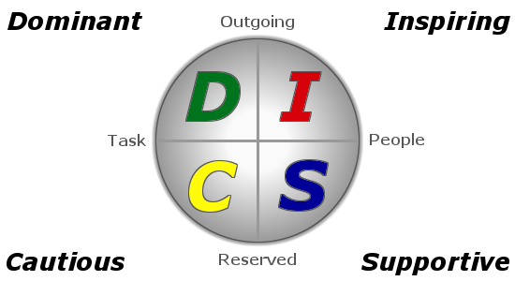
The Leader
What goes into making you the leader you are today?
Baggage
Personality
Meyers-Briggs
DISC
Dominance
Influence
Steadiness
Conscientious

Slide 9
Onlinepersonalitytests.org

Slide 10
The Leader
What goes into making you the leader you are today?
Baggage
Personality
Meyers-Briggs
DISC
Kolbe
The Kolbe index measures how you get things done. There are four action modes that you will be measured on:
Fact Finder Follow Thru
Quickstart Implementor

Slide 11
The Leader
What goes into making you the leader you are today?
Baggage
Personality
Life-Experience
Write your life-story
Focus on events that have had an impact
People who have had an impact
Significant circumstances that affected your life- direction
Ask God to guide your thoughts.
Look for the way that God has guided.

Slide 12
The Leader
What goes into making you the leader you are today?
Baggage
Personality
Life-Experience
Spiritual Giftedness
I Corinthians 12
Romans 12
I Peter 4:10

Slide 13
Vision
Culture
Prayer and Planning
Leader

