Slide 1
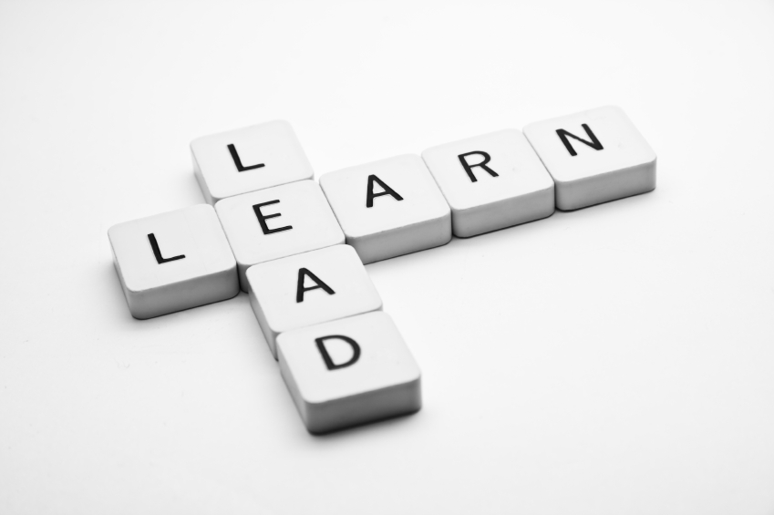
Learning To Lead
Session 6)
Your Leadership
Style

Slide 2
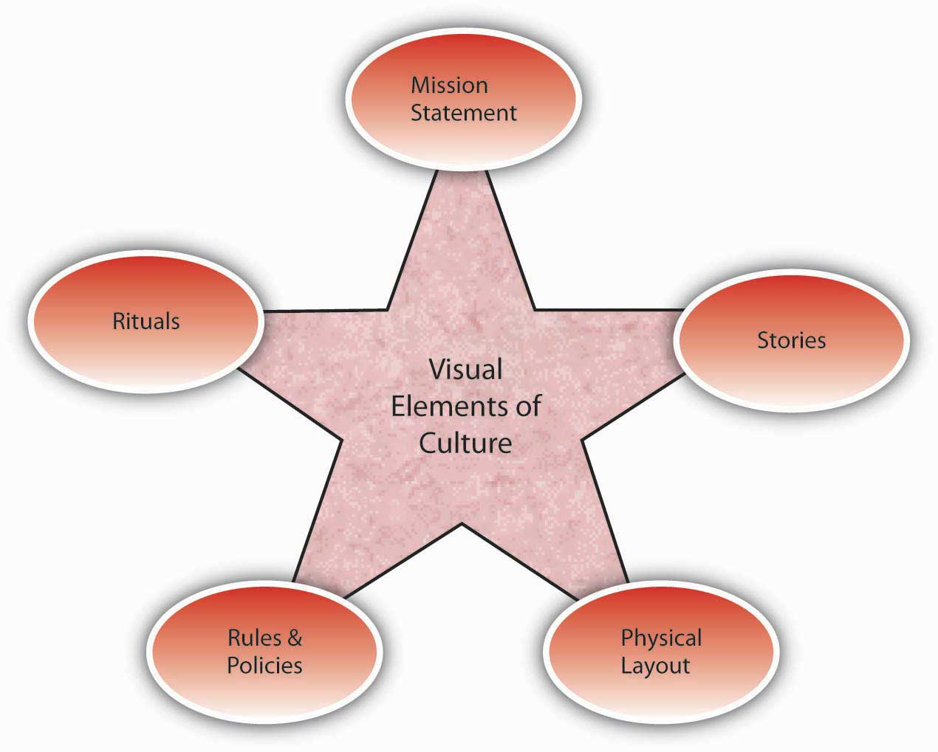
Vision
Culture
Prayer and Planning
Leader

Slide 3
A leader, with all his plusses and minuses, strengths and weaknesses, interacts with a group of people to define the culture (the way things are done here) in order to develop a vision for a preferable future, and then provides the impetus for doing the actions necessary to bring about that future with plans and prayer.

Slide 4
Leadership Styles
Laissez-Faire
Democratic-Participative
Benevolent-Autocratic
Autocratic-Bureaucratic

Slide 5
Leadership Styles continued
Daniel Goleman, Leadership That Gets Things Done
1. The pacesetting leader – “Do as I do”
2. The authoritative leader – “Come with me”
3. The affiliative leader – “People come first”
4. The coaching leader– “Try this”
5. The coercive leader— “Do what I tell you”
6. The democratic leader – “What do you think?”

Slide 6
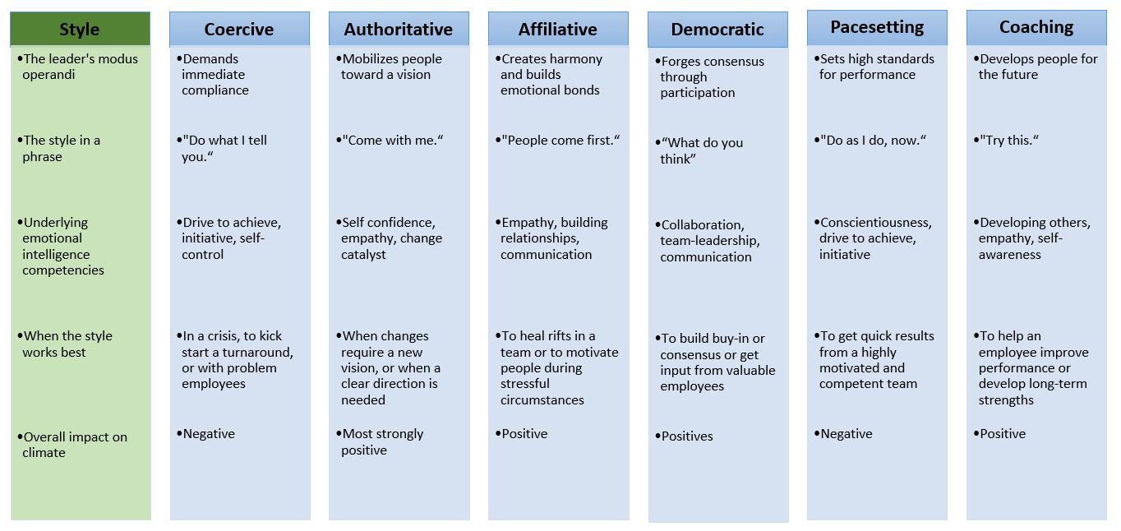

Slide 7
Effective Leadership
Use of time

Slide 8
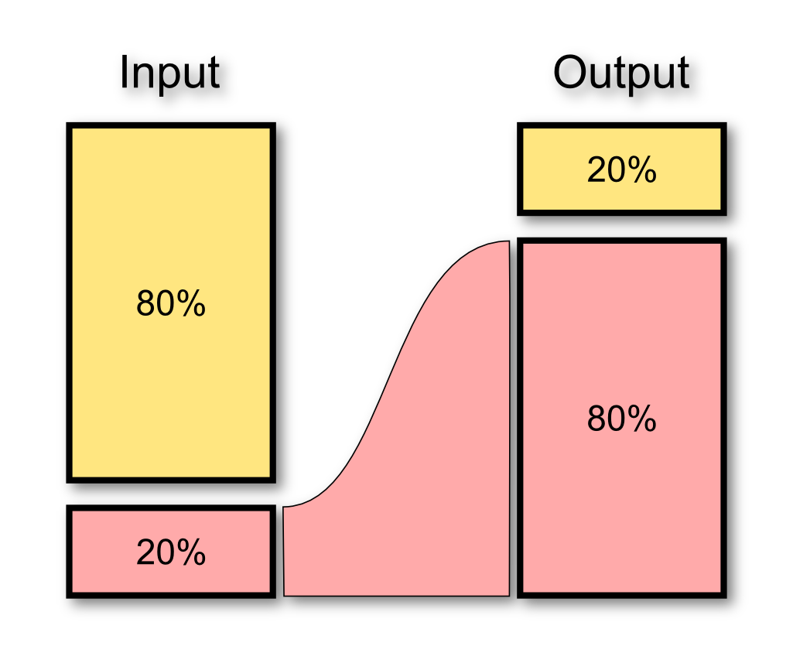
Effort Results

Slide 9
