Slide 1
Learning To Lead
Session 9)
Leadership Applied

Slide 2
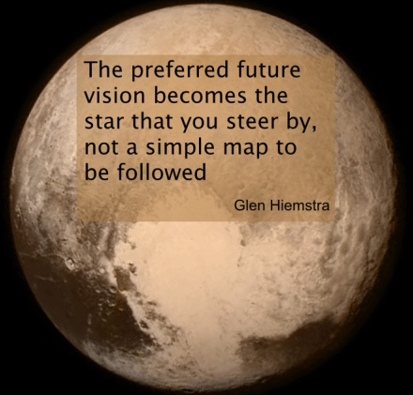
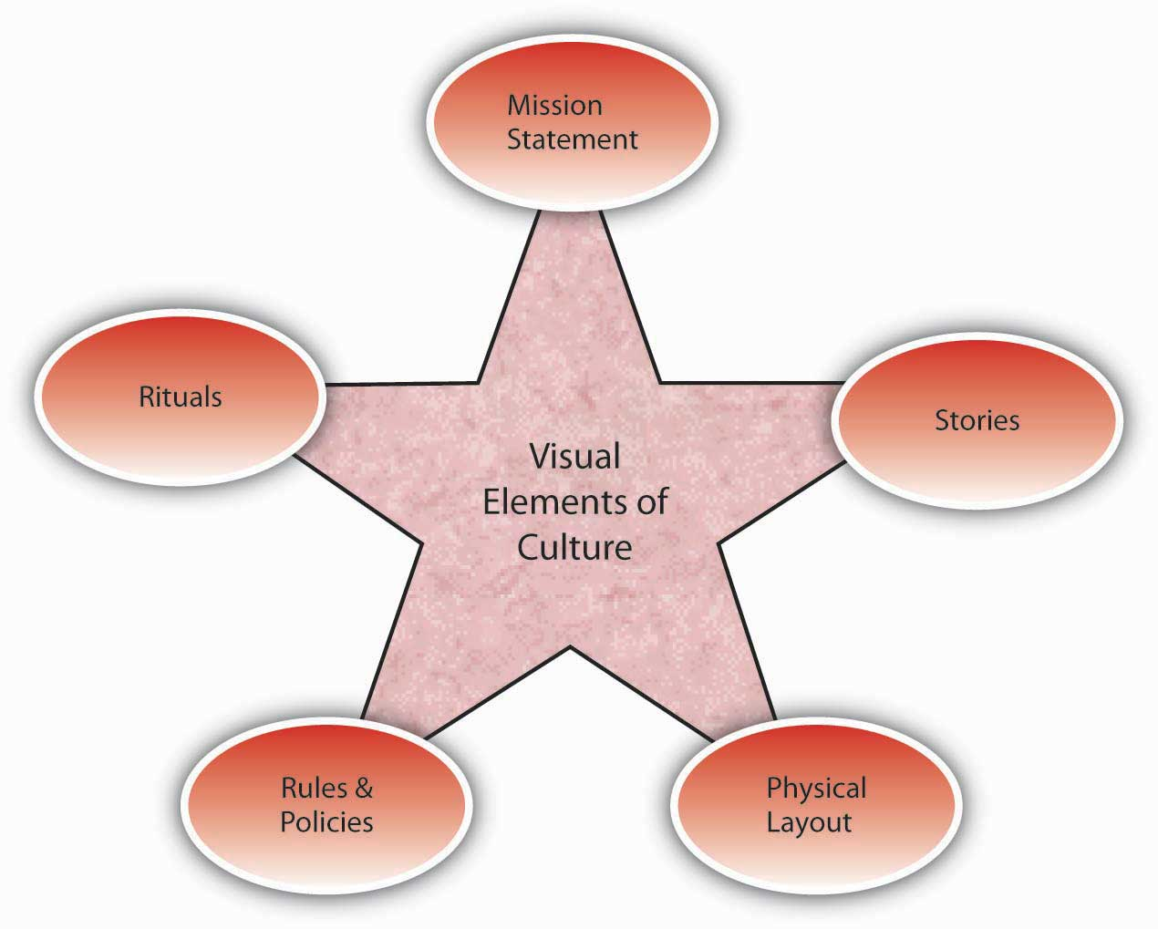
Vision
Culture
Prayer and Planning
Leader

Slide 4
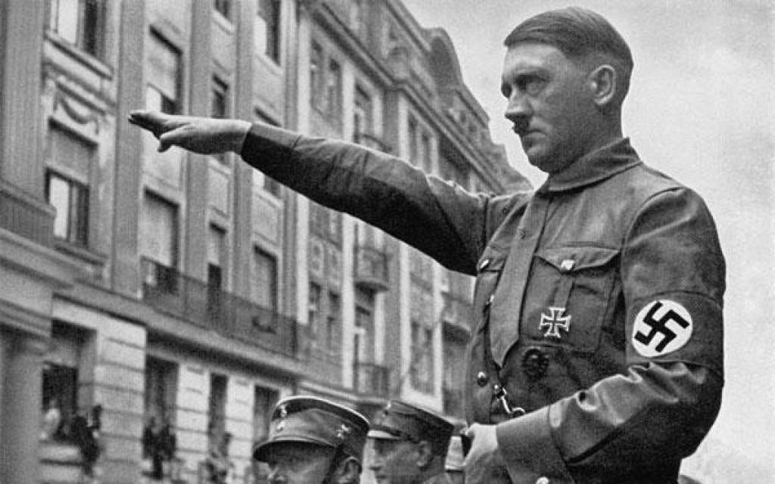

Slide 5
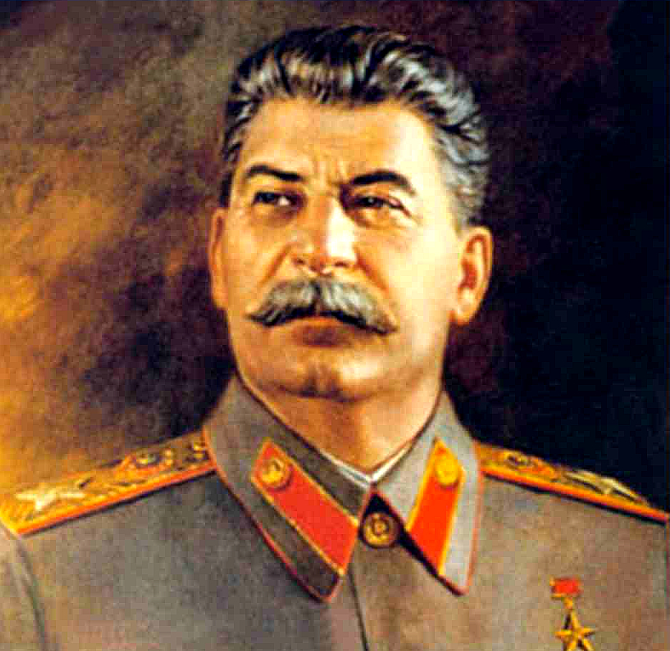

Slide 6
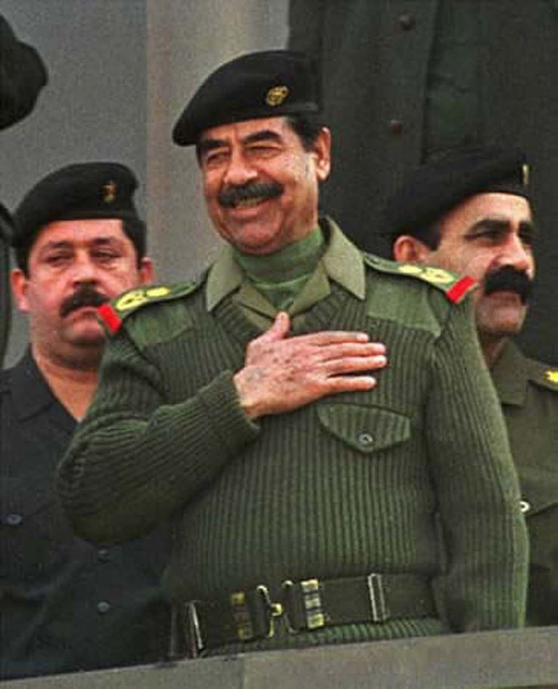

Slide 8
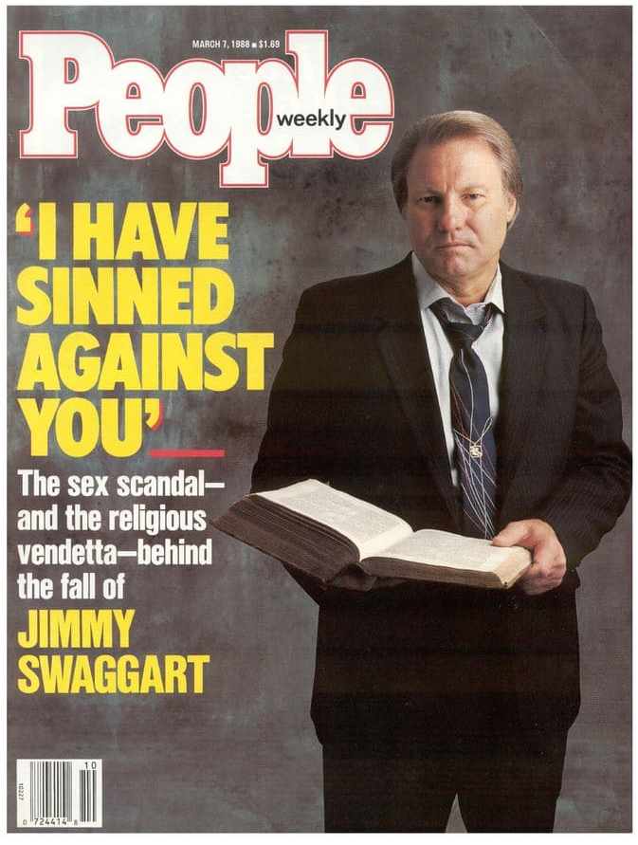

Slide 9
“Gradually it was disclosed to me that the line separating good and evil passes not through states, nor between classes, nor between political parties either—but right through human hearts—every human heart.”
- Alexander Solzhenitsyn

Slide 10
How did it get there?

Slide 11
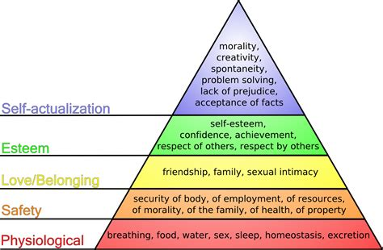

Slide 12
What does it look like?

Slide 13
Insecurity Manipulation
Perfectionism Driven to prove
Loneliness Lack of Trust
People pleasing Arrogance
Victimization Lack of authenticity
Disempowerment Self-denial

Slide 14
What do you do about it?

