Slide 1
Preacher, Preparation,
Presentation
A class on making and preaching sermons
Session 33
Practical
Considerations
Building
Bridges

Slide 2
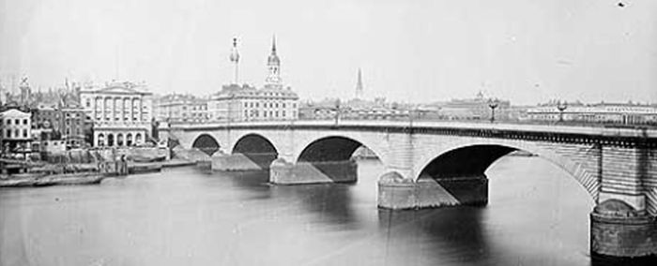

Slide 3
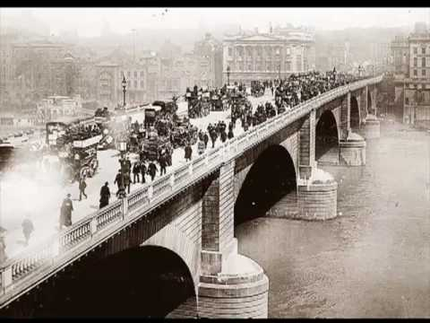

Slide 8
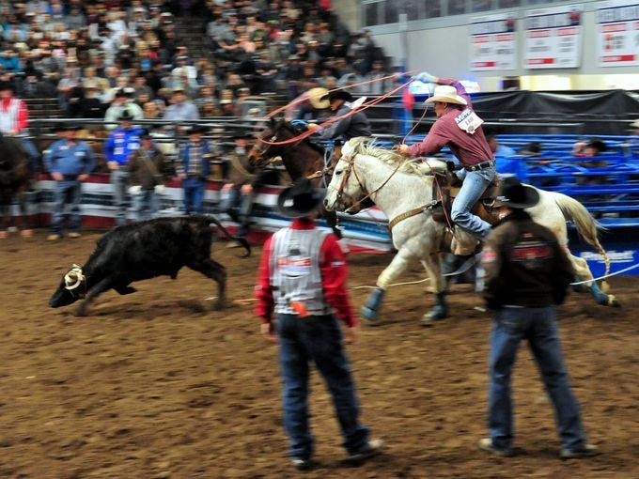

Slide 9
Top Complaints
Content irrelevant
Too much analysis, too little answer.
Too impersonal and too propositional—doesn’t relate to life

Slide 10
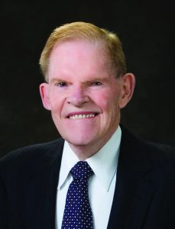
“Most sermons resemble hovercrafts skimming over the water on blasts of hot air, never landing anywhere.”

Slide 11
Who are they?
Young? Old?
Educated?
Ethnic experience?
Rural? Urban?

Slide 12
Who are they?
What do they believe?
Doctrinally?
Convictions?
Bible knowledge?

Slide 13
Who are they?
What do they believe?
What do they know
about God?
- almost nothing
- preaching can be too
“preachy”

Slide 14
Who are they?
What do they believe?
What do they know
about God?
How can I help them come to
terms with who they are?

Slide 15
Steps to determine culture
Advance research
-food choices, websites,
city hall, demographics

Slide 16
Steps to determine culture
Advance research
2. Understand what are their felt needs
3. Meet them at the door

Slide 17
Steps to determine culture
Advance research
2. Understand what are their felt needs
Meet them at the door
Get to know them

Slide 18
Steps to determine culture
Advance research
2. Understand what are their felt needs
Meet them at the door
Get to know them
Listen to the Listeners

Slide 19
Listen before the message
- group sermon prep
- practice preach to
someone
- Bible study

Slide 20
Listen after the message
- random evaluation
- sermon reflection group
Reuel Howell, Partners in Preaching

Slide 21
What did the sermon say to you?
What difference, do you think the sermon will make in your life?
How did the preacher’s method, language, illustrations and delivery help or hinder your hearing of the message?
Do you agree with any of it? What would you have said about the subject.

