Slide 1
Taking control of your parenting Part 6 Steve Elzinga
Teaching your kids Discipline

Slide 2
Self-discipline
1. There is an upfront cost
2. There is the hope of a good payoff
3. The whole thing is self-imposed

Slide 3
What are your greatest fears if your child grows up lacking self-discipline?

Slide 4
1. That your child will waste his/her life.
Proverbs 10:5 A wise youth makes hay while the sun shines, but what a shame to see a lad waste his opportunity.

Slide 5
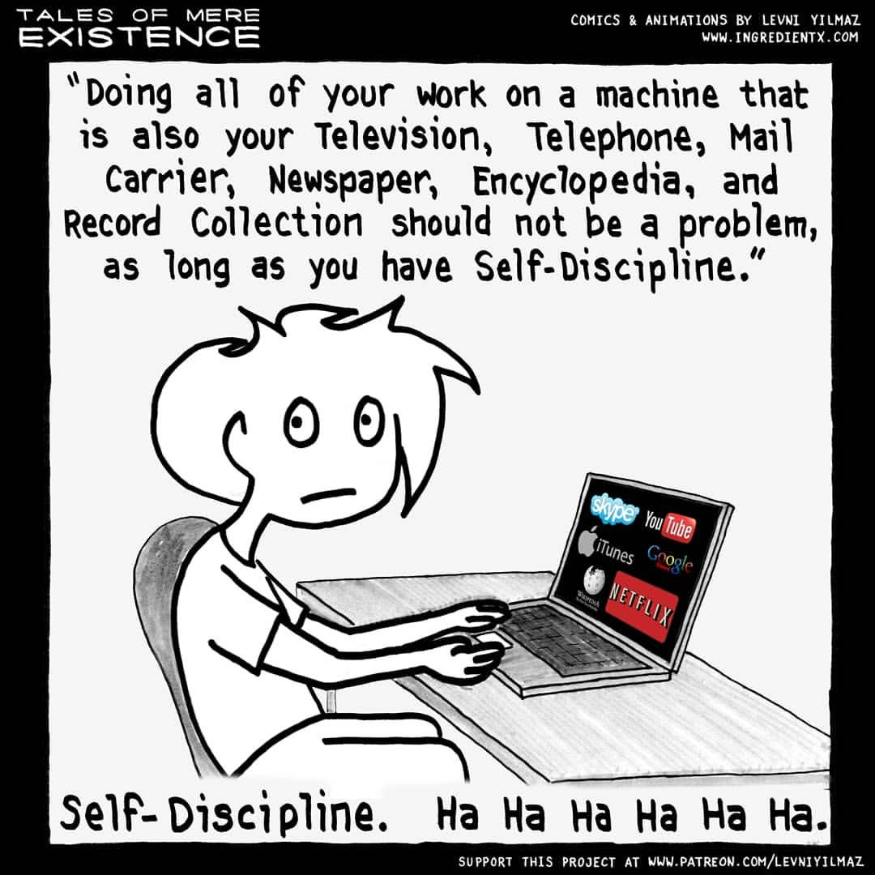

Slide 6
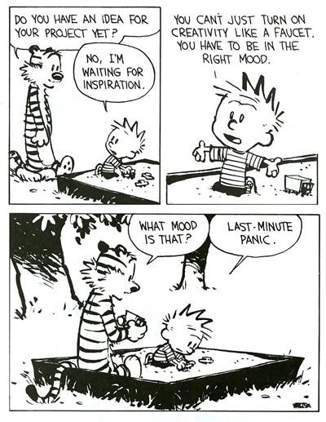

Slide 7
2. That your child will lose his/her life.
Proverbs 5:23 He will die for lack of discipline, led astray by his own great folly.

Slide 8
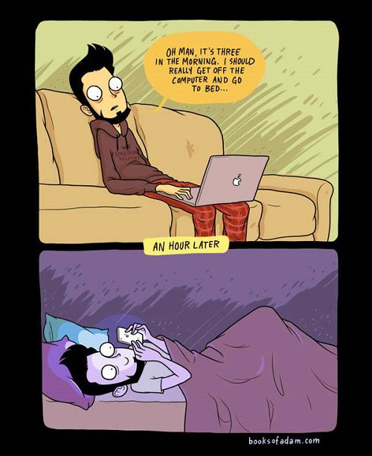

Slide 9
The two most common mistakes:

Slide 10
1. Too strict
Colossians 3:21 Fathers, do not embitter your children, or they will become discouraged.

Slide 11
2. Too permissive
Proverbs 29:19 Sometimes mere words are not enough discipline is needed. For the words may not be heeded.

Slide 12
What kids need to acquire self-discipline:
2 Thessalonians 3:10 For even when we were with you, we gave you this rule: “If a man will not work, he shall not eat.”

Slide 13
What kids need to
Acquire self-discipline:
1. Kids need to know the cost.
2. Kids need to know the payoff.
3. Kids need to know the connection between the two.

Slide 14
1. Character
Hebrews 12:11 Being punished isn’t enjoyable while it is happening it hurts! But afterwards we can see the result, a quiet growth in grace and character.

Slide 15
James 1:2-4 (TLB) Whenever trouble comes your way, make it an opportunity for JOY. For when your faith is tested, your endurance has a chance to grow...so let it grow. For when your endurance is fully developed, you will be strong in character and ready for anything.

Slide 16
2 Peter 1:4 And by that same mighty power he has given us all the other rich and wonderful blessings he promised; for instance, the promise to save us from the lust and rottenness all around us, and to give us his own character.

Slide 17
2. Glorious living
Ephesians 1:11 It’s in Christ that we find out who we are and what we are living for. Long before we first heard of Christ and got our hopes up, he had his eye on us, had designs on us for glorious living, part of the overall purpose he is working out in everything and everyone.

Slide 18
Final Note: There is really no such thing as self-discipline.

Slide 19
Three things needed:
Accountability
Encouragement
Power
2 Timothy 1:7 For God did not give us a spirit of timidity, but a spirit of power, of love and of self discipline.

